Slide 1
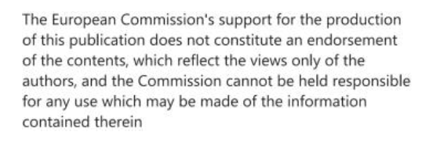
Sustainable urban mobility plans (SUMP) and related policies
S@mpler
Integrated Education Based On Sustainable Urban Mobility Projects

Slide 2
Topic in the sump cycle
S@mpler
SUMP and related policies
02 – planning framework, supporting policies and context for implementation of SUMPs

Slide 3
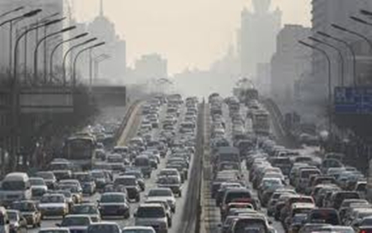
Urban transport – sustainable?
S@mpler
SUMP and related policies
„ The majority of European citizens lives in urban areas, their daily lives take place in the same space and they share the same infrastructure for their journeys. Urban transport produces 40% of all CO₂ emissions from road transport and up to 70% of other pollutants from transport.“
„All external costs from transport amount to 1 bil. Euro yearly in the whole EU (7% GDP)“ (2019)
(European Commission, Clean Urban Transport)

Slide 4
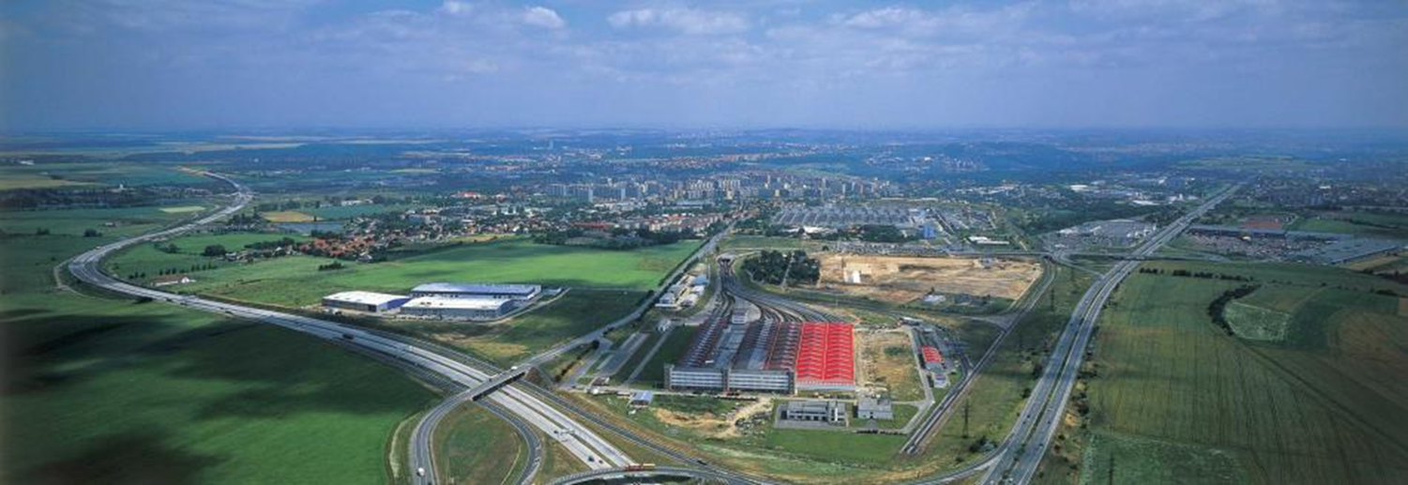
Urban mobility – sustainable?
S@mpler
SUMP and related policies
„Approximately 74% of population of the whole Europe (350 mil. inhabitants) live and work in cities with more than 50,000 inhabitants. Europe thus represents the densest urbanised area in the world and the share of urban population is even expected to grow up to 82% till 2050.“ (UN)

Slide 5
Urban mobility – sustainable?
S@mpler
SUMP and related policies
Urban mobility problems are the most alarming problems in the field of transport.
Coordinated reduction of unsustainable means of transport is necessary.
Municipalities play the key role and occupy the most important position in decision-making on the future form of mobility but they should be supported from the national and EU levels.
integrated planning and mobility plans
Transport and Mobility
Land Use
Environmental quality
Doprava a mobilita
Využití území
Životní prostředí

Slide 6
Urban transport – sustainable?
S@mpler
SUMP and related policies
UN Brundtland Commission (WCED, 1987)
„…planning that satisfies the needs of present
generations without compromising future generations’ ability to satisfy their own needs
Marsden and McDonald (2017):
„…planning which accepts that supply cannot expand to meet demand and endeavours to limit congestion, improve air quality, and socially optimise safety, climate and social external costs“.

Slide 7
Urban transport - sustainable?
S@mpler
SUMP and related policies
Sustainability in transport is not luxury but a necessity for maintaining the quality of life
Sustainable mobility is based on multimodality (use of all modes of transport) and the best combination of transport system, on the principle of integration
Sustainability in transport includes regulation of polluting modes of transport
Modal split – clear mobility indicator, its target could be:
Individual car transport < 30%
Public transport > 40%
Non-motorised transport > 30%

Slide 8
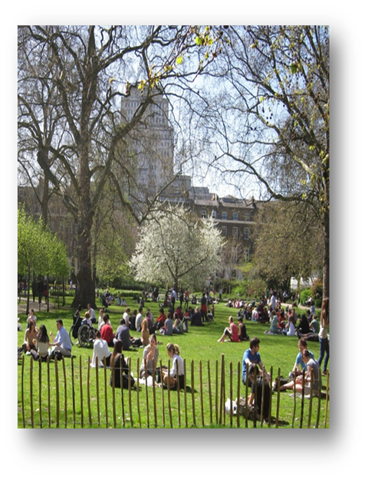
Urban transport – sustainable?
S@mpler
SUMP and related policies
Sustainable Urban Mobility Plan – SUMP
Definition:
„SUMP is a strategic plan that is created to satisfy
mobility needs of people and companies in cities and their
surroundings to improving the quality of life. It is based on
existing activities and integration, participation and evaluation
principles.“ EU SUMP Guidelines
Mobility solutions + better quality of life

Slide 9
Doprava ve městech – udržitelná?
S@mpler
SUMP and related policies
EU: SUMPs (Sustainable Urban Mobility Plans)
France: PDUs (Plans de Déplacements Urbains)
UK: LTPs (Local Transport Plans)
Czechia: PUMM (Plány udržitelné městské mobility)
In EU countries – different level of obligation (legislation) and financial support
In Czechia, since 2020 the cities over 50 thousand inh. have to prove they have adopted a SUMP f they apply for subsidies for transport projects from the Operational programme for Transport
In the present – over 40 Czech cities have their SUMPs

Slide 10
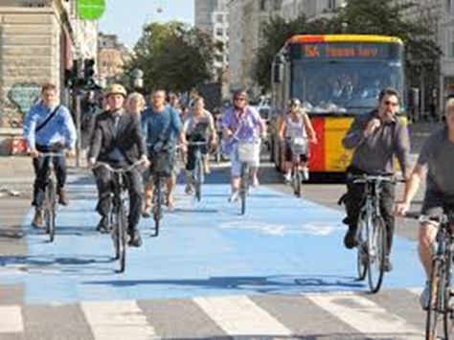
Main SUMP objective: create a sustainable transport system and mobility
S@mpler
SUMP and related policies
Ensure transport accessibility for all;
Improve transport safety and security;
Reduce air pollution, noise levels, GHG emissions and energy consumption;
Improve effectivity of personal and freight transports;
Ensure a good-quality urban environment as a pleasant place for life.

Slide 11
Thematic Strategy on the Urban Environment (COM(2005)718)
S@mpler
SUMP and related policies
Proposes elaboration of the EU guidelines for sustainable Urban
transport plans
Experiences of cities
Expert views
Support of research

Slide 12
Action Plan on Urban Mobility (COM2009(490)
S@mpler
SUMP and related policies
– 20 activities
recommends to prepare and implement SUMPs in agglomerations with more than 100.000 inhabitants.
The Council of EU „supports development of SUMPs in cities and metropolitan areas (…) and supports initiatives for preparation of SUMPs”

Slide 13
White Paper on Transport – Roadmap to a Single European Transport Area – Towards a competitive and resource efficient transport system (2011)
S@mpler
SUMP and related policies
- 40 initiatives
Initiative 31. Sustainable Urban Mobility Plans
„Introduce procedures and mechanisms of financial support non the EU level for preparation of urban mobility audits, and elaborate the European urban mobility observatory based on common objectives. Investigate possibilities for mandatory approach in case of cities of a certain size, on the basis of national norms coming out from EU guidelines.“
„Support large employers to introduce company travel plans“

Slide 14
Urban Mobility Package (2013)
S@mpler
SUMP and related policies
EC endeavours to strengthen sustainable urban mobility:
Share experiences, distribute good practice and cooperate at the EU level,
Provide targeted financial support,
Focus on research and innovation – new solutions of transport problems in cities, H2020, Civitas, Smart cities
Involve national levels of EU Member States – to ensure framework conditions for municipalities (+ operational programs in transport), in Czechia SUMPs/SUMFs are mandatory when applied for OP subsidies

Slide 15
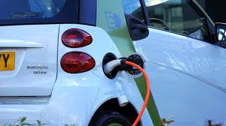
European Strategy for low-emission mobility COM 2016(501)final
S@mpler
SUMP and related policies
Principles such as multimodality, support of public transport; just pricing, smart technologies
Zero emission vehicles – integration of electromobility into the energetic system etc.
Integration of land use and transport planning (demand for transport)
Changes in modal split – supply of alternatives (sharing of mobility, public transport)

Slide 16
Green Deal for Europe (2019)
S@mpler
SUMP and related policies
Climate neutrality till 2050
Transport – almost 25% GHG emissions in EU cities
Objective: reduce GHG emissions from transport till 2030 by 55 % in comparison to 1990
Objective: reduce GHG emissions from transport till 2050 by 90 % in comparison to 1990
Task: to implement cleaner, cheaper and healthier forms of private and public transport, electromobility, alternative fuels and propulsions
Strategy for sustainable and smart mobility – brings solutions to the Green Deal objectives

Slide 17
Sustainable and Smart Mobility Strategy – putting European transport on track for the future (2020)
S@mpler
SUMP and related policies
As set out in the 2030 climate target plan, increasing the modal shares of collective transport, walking and cycling, as well as automated, connected and multimodal mobility will significantly lower pollution and congestion from transport, especially in cities and improve the health and well-being of people. Cities are and should therefore remain at the forefront of the transition towards greater sustainability. The Commission will further engage with cities and Member States to ensure that all large and medium-sized cities that are urban nodes on the TEN-T network put in place their own sustainable urban mobility plans by 2030. The plans should include new goals, for example on having zero emissions and zero road fatalities. Active transport modes, such as cycling, have seen growth with cities announcing over 2300 km of extra cycling infrastructure. This should be doubled in the next decade towards 5000 km in safe bike lanes. The Commission is also considering developing a mission in the area of Climate-neutral and Smart Cities as a strategic priority for joint action to accomplish decarbonisation within a large number of European cities by 2030.
European research and innovation missions will aim to deliver solutions to some of the greatest challenges facing our world. They are an integral part of the Horizon Europe framework programme beginning in 2021.
https://ec.europa.eu/info/horizon-europe/missions-horizon-europe/climate-neutral-and-smart-cities_en

Slide 18
National strategic documents related to sustainable urban mobility planning – example of Czechia
S@mpler
SUMP and related policies
National Transport Policy of the Czech Republic – 2021-2027 with prospect of 2050
Conception of urban and active mobility (2020) – recommended measures for cities of different sizes
Conception of public transport
National SUMP guidelines 2015, update 2021
Sectorial policies – Policy of territorial development of the Czech Republic, Strategy of regional development 2021+ (Ministry for Regional Development), Strategic Framework of sustainable development of the Czech Republic (Ministry of the Environment)
National program for reduction of emissions of the Czech Republic
National Energy and Climate Plan of the Czech Republic
National Clean Mobility Plan
Specific directives (emission limits, on pricing freight transport, toll interoperability, on support of clean and energy efficient vehicles…)

Slide 19
National Transport Policy of the Czech Republic – 2021-2027 with prospect of 2050
S@mpler
SUMP and related policies
Specific objective 1.3: Transport in metropolitan areas and agglomerations, SUMP
Articulated into mobility plans and regional public transport strategies
Prevention of mobility needs,
Supporting the use of alternative means of transport (public transport, active mobility),
Reduction of negative impacts of particular modes of transport in cities (environmental and health impacts and global changes),
Humanisation of street spaces so as streets become a multifunctional space and not only a one-purpose capacity for transport and parking functions.

Slide 20
National Transport Policy of the Czech Republic – 2021-2027 with prospect of 2050
S@mpler
SUMP and related policies
Specific objective 1.3: Transport in metropolitan areas and agglomerations, SUMP
Measures:
On the basis of Sustainable Urban Mobility Plans to adapt public space in cities as multifunctional areas with suitable criteria for public life.
Reduce automobilisation rates in large cities and their suburban areas and increase the share of trips by public and active transports.
Develop services related to mobility of people and goods with focus on various options to satisfy mobility needs through trips by the means of transport alternative to car transport (incl. Needs of specific target groups such as e.g. Children, elderly, caregivers, people with disabilities in movement, orientation and communication).

Slide 21
Odkazy, zdroje, literatura
SUMP and related policies
European Commission. (2011). White Paper: Roadmap to a Single European Transport Area - Towards a competitive and resource efficient transport system. COM(2011) 144 final. https://eur-lex.europa.eu/LexUriServ/LexUriServ.do?uri=COM:2011:0144:FIN:EN:PDF
European Commission. (2013). Urban Mobility Package - Together towards competitive and resource-efficient urban mobility (COM(2013)0913 final. https://eur-lex.europa.eu/legal-content/EN/TXT/HTML/?uri=CELEX:52013DC0913&from=EN
European strategy for low-emission mobility, COM(2016) 501 final https://www.eea.europa.eu/policy-documents/a-european-strategy-for-low
Sustainable and Smart Mobility Strategy – putting European transport on track for the future (SWD 2020(331)final) https://eur-lex.europa.eu/legal-content/EN/TXT/?uri=CELEX%3A52020DC0789
European Commission. (2019). The European Green Deal. (COM (2019) 640 final. https://ec.europa.eu/info/strategy/priorities-2019-2024/european-green-deal_en
EU SUMP Guidelines - Rupprecht Consult (editor), Guidelines for Developing and Implementing a Sustainable Urban Mobility Plan (SUMP), Second Edition, 2019.

Slide 22
Thank you for attention !
S@mpler
Integrated Education Based On Sustainable Urban Mobility Projects
.
Project information:
The main project aim is to enhance the quality of teaching at the involved universities in the field of sustainable urban mobility management. Our efforts consist in distributing practical skills of students through implementation of the practical project methodology of teaching. The emphasis is put on the reflection of challenges which cities have to tackle in the real world, especially in the area of Sustainable Urban Mobility Plans (SUMP). The project is intended to contribute to improving the knowledge and skills of students, particularly for the position and job placement of mobility managers.
Topic elaborated by : Radomíra Jordová
mobilita-ieep.cz
Link to the web database

Slide 23
CORRESPONDING PART FOR TEACHERS AND THEIR COMMUNICATION WITH STUDENTS

Slide 24
Tasks for students
S@mpler
SUMP and related policies
What encompasses „sustainability in transport“? What are its main aspects are considered at the world-wide, European and national levels?
What are the main EU policies supporting sustainable urban mobility?
How is the topic of SUMP reflected in these policies?
What impact is expected to be achieved thanks to SUMPs? What is their aim?

Slide 25
Děkuji za pozornost!
S@mpler
Integrated Education Based On Sustainable Urban Mobility Projects
Informace o projektu:
Hlavním cílem projektu je zvýšit kvalitu výuky na zapojených univerzitách v oblasti managementu udržitelné městské mobility. Naší snahou je rozšířit praktické dovednosti studentů díky implementaci praktické projektové metody výuky. Důraz je kladen na reflexi výzev, s kterými se města potýkají v reálném světě, především pak na problematiku Plánu udržitelné městské mobility (SUMP). Projekt by měl přispět ke zlepšení znalostí a dovedností studentů souvisejících s pozicí manažerů mobility.
Zpracovatel tématu: Radomíra Jordová
mobilita-ieep.cz
Link na web databáze

