Slide 1
Smart city concept, modern technologies and mobility, autonomous mobility
S@mpler
Integrated Education Based On Sustainable Urban Mobility Projects

Slide 2
Topic in the sump cycle
Smart city concept, modern technologies and mobility, autonomous mobility
03 – Analyse mobility situation
05 – Develop vision and strategy with stakeholders
06 – Select targets and indicators
07 – Select measure packages with stakeholders

Slide 3
Basic terms
Autonomous mobility
Automated driving vehicle = a vehicle equipped with assistance systems, some driving operations can be done without the driver’s intervention (e.g., parking assist);
Fully autonomous/robotic vehicle = a vehicle that is capable of sensing and assessing the state of its surroundings (throughout the trip) and navigate to the set destination without human intervention, while assuring all safety features;
Connected vehicle = a vehicle with real-time data connection to surrounding vehicles (Vehicle-to-Vehicle, V2V);
Connected and automated vehicle (CAV) = a vehicle that meets two basic functionalities: it has general data connection and is driven automatically;
If a vehicle has real-time data connection with equipment located in the road network or communicates with other vehicles, it is a part of a cooperative intelligent transport system (C-ITS).

Slide 4
Autonomous vehicle
Autonomous mobility
Definition of the German Federal Highway Research Institute (BASt):
“The vehicle is driven automatically without human supervision; in the case of a failure of the automated features, it switches automatically to a mode that is the least risky for the autonomous vehicle passengers and surrounding road users.”

Slide 5
Degrees of vehicle driving automation
Autonomous mobility
 | SAE level | Level description | Vehicle driving | Traffic situation monitoring | Response to dynamic traffic situation | Travel modes (e.g., motorway, city)
Traffic situation monitored by driver | 0 | NO AUTOMATION - the vehicle is driven exclusively by the driver - the driver also monitors the traffic situation and responds to it |  |  |  | none
 | 1 | DRIVER ASSISTANCE - the machine performs operations connected either with transverse movement or longitudinal movement of the vehicle (but not both at the same time) - the driver continuously monitors the traffic situation and has to be ready to take over the driving if needed |  |  |  | limited
 | 2 | PARTIAL AUTOMATION - the machine performs operations connected with both transverse and longitudinal movement of the vehicle at the same time - the driver continuously monitors the traffic situation and has to be ready to take over the driving if needed |  |  |  | limited
Traffic situation monitored by vehicle | 3 | CONDITIONAL AUTOMATION - all tasks are performed by the machine - the driver has to be able to take over the driving if needed |  |  |  | limited
 | 4 | HIGH AUTOMATION - all tasks are performed by the machine without the need for driver intervention - the machine works in limited travel modes |  |  |  | limited
 | 5 | FULL AUTOMATION - all tasks are performed by the machine without the need for driver intervention (there is no driver) - the machine works in all travel modes |  |  |  | all
Source: MD, 2019
Degrees of automation according to SAE J3016 standard

Slide 6
Autonomous mobility
A transport transformation can be expected – gradual deployment of automated transport systems and vehicles
Radical change to not only passenger and freight transport, but in turn, also production, service provision, energy systems, education, employment, city structure and the environment —> broader social and environmental changes
ATS will lead to optimisation of road network utilization, improved control, optimisation of traffic flows, reduction to traffic problems (e.g., traffic jams), fewer accidents, lower fuel consumption and shorter travel times

Slide 7
Benefits for society
Autonomous mobility
Positive impact on the environment and lower emissions
Increased road capacity, improved intersection throughput, fewer traffic jams, lower costs of new traffic lane construction, less time spent searching for parking spaces --> better transport system efficiency
Improved safety
Improved availability of transport and mobility services (e.g., for people who cannot drive a car for medical reasons)

Slide 8
Opportunities and threats
Autonomous mobility
Transport sector – an important area of national economy
Autonomous mobility = new way of traffic organisation and functioning
Research, development and manufacturing activities associated with autonomous mobility bring:
Development of cutting-edge technologies
Increasing technology and knowledge capacity of firms
Stimulate creation of high-skill jobs Stimulate new foreign investment
Indirectly, support professional secondary and higher education

Slide 9
Opportunities and threats
Autonomous mobility
Development of autonomous vehicles:
Innovation of existing vehicle system (preferred by current car makers)
Development of brand new autonomous vehicle (preferred by technology companies not previously directly involved in car making but intending to enter the market)
Necessary setting of safety standards that will not hamper development
Motivation for CR: maximum use of traditional automotive industry and innovation potential of Czech industry and academia + strategic location in Europe near countries more technologically advanced in automation
failing that, demand for traditional vehicles would decrease = negative impact on CR’s national economy

Slide 10
Smart city and smart traffic control
Smart city concept, modern technologies
Smart City = worldwide concept aimed at implementation of information and communications technology and tools for more efficient city administration and involvement of citizens in its creation
Smart City Index - monitors implementation of smart technologies and solutions —> smartness
How to find out a city is smart?
ecological
innovative
friendly and motivating
digitized
safe and resilient

Slide 11
Areas of interest in the smart city concept
Smart city concept, modern technologies
Source: Brussels Smart City, 2021

Slide 12
Smart mobility
Smart city concept, modern technologies
= Innovative road and transport infrastructure that conserves resources and builds on new technologies for maximum possible transport efficiency
Main factors: availability, reliability, safety
Goal of smart mobility = assure trouble-free travel using transport
Clean mobility = mobility aimed primarily at reducing transport emissions

Slide 13
Smart mobility
Smart city concept, modern technologies
In the smart city concept, mobility is one of the basic factors of improving quality of life in cities
Key topics of smart mobility:
Reducing pollution
Reducing congestion
Increasing safety of persons
Reducing noise burden
Increasing travel speed
Reducing costs of transport

Slide 14
Smart mobility
Smart city concept, modern technologies
Transport areas of focus in smart city concept that can be affected the most and have a great impact on environmental improvement:
Electromobility
Intelligent transport systems
Smart parking
Smart public transport
Bikesharing
Park and ride

Slide 15
Intelligent transport systems (ITS), telematics
Smart city concept, modern technologies
Telematics = connection of information and telecommunications technology with transport engineering in order to increase traffic performance, safety and psychic wellbeing of passengers
ITS - transport and telematic systems, combination of smart vehicles, smart infrastructure and transport services
Collects data on vehicle or equipment status and sends them to a control unit or an operator
Objective: reduce congestion, improve traffic control, minimise environmental impact —> ITS help reduce travel times and increase comfort and safety

Slide 16
Intelligent transport systems - examples
Smart city concept, modern technologies
Traffic detectors (sensors) - traffic intensity, occupancy rate, speed, vehicle classification
Video detection systems - detect obstacles in traffic
Road meteostations - warning against rime, fog, snow, ice
Smart traffic lights - respond to speed of oncoming vehicles
Variable traffic signage, information signs
Penalty systems - red light violation, speed measurement

Slide 17
Smart parking
Smart city concept, modern technologies
Tool for optimum use of parking capacity
Reduces pointless searching for parking space —> protects the environment
Smart cobblestone - useful for various types of pavement, shows a vacant parking place
Advantages:
increases parking space use efficiency,
supervises parking discipline,
facilitates supervision over parking system,
enables flexible pricing,
reduces negative impacts of searching vehicles,
data for transport planning and zoning processes,
supervision over vehicles
Investment returns within months
Smart cobblestone
Smart cobblestone
Free space indicator
Smart cobblestone installation Source: CDV

Slide 18
Smart public transport
Smart city concept, modern technologies
Autonomous vehicle potential for urban transport
Autonomous driving not only for road transport, but also for rail (e.g., metro) —> requires legislative changes
Autonomously driven metro trains in London, Paris, Dubai, Barcelona, Copenhagen as a separate infrastructure
Besides, contactless fare system and cashless fare payment in PT vehicles

Slide 19
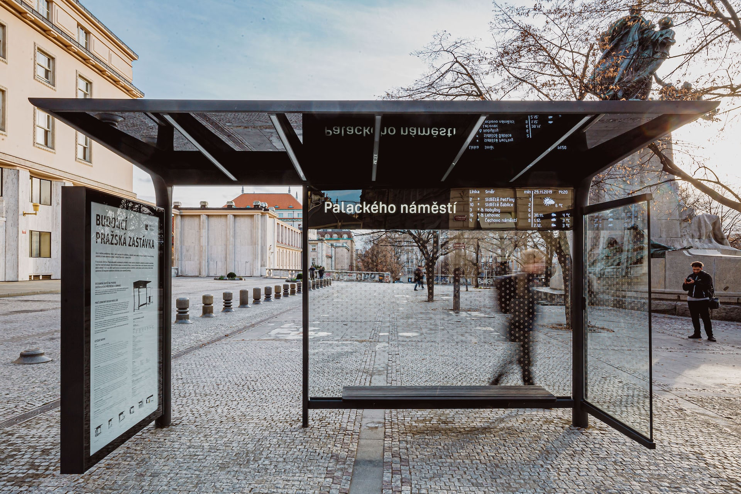
Smart stops
Smart city concept, modern technologies
Promote travel by PT
A way to make waiting for a service pleasant
Stops equipped with detection, imaging, information and communications technology
e.g., internet provision, traffic sensors and passenger counters, real-time vehicle arrival information, emergencies, buttons to call for help, information about cultural and other events, video messaging, competitions, video spots
Source: IPR, 2019

Slide 20
Park and ride
Smart city concept, modern technologies
A system of parking areas (at city outskirts) used for car parking followed by travel by PT
Promotes PT and integrated transport systems
Effort to regulate cars entering city centres

Slide 21
Smart city examples from abroad - Barcelona
Smart city concept, modern technologies
Sensors along main avenues - monitor noise and air quality and send information straight to officials
Parking - drivers can find a vacant parking space using a mobile application, book it and pay for it if the wish
QR codes in various places - show where the nearest PT stop is

Slide 22
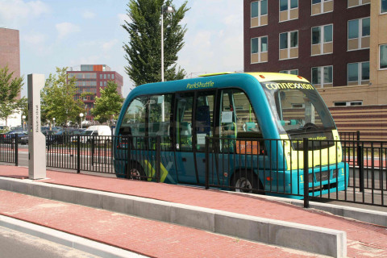
Smart city examples from abroad - Amsterdam
Smart city concept, modern technologies
Uses Open Data at a high level
Automated control of Amsterdam city - implementation of smart traffic control (e.g., traffic light automation)
Parkshuttle - autonomous vehicle connecting a metro station with a department store
Amsterdam Smart City, 2017

Slide 23
Smart city examples from abroad - Malmö
Smart city concept, modern technologies
Development of “smart” neighbourhoods
Use of smart technologies in combination with energy from renewables
Minimum of cars - five-year membership in a carsharing system free of charge, people pay only for kilometres travelled
Promotion of cycling - built 490 km of cycling trails, traffic lights with special sensors

Slide 24
Smart city examples from abroad - Singapore
Smart city concept, modern technologies
Effort to reduce car ownership in order to reduce numbers of cars on the roads → experimenting with alternatives to the car and service sharing
Own bikesharing systems
Implementation of ridesharing using electric cars
Sensors in buses - enable monitoring and help solve traffic complications
Contactless public transport fare payments

Slide 25
Smart city examples from abroad - Prague
Smart city concept, modern technologies
The term Smart City is heard increasingly often
Smart Prague initiative established - goal to make Prague a smart metropolis
Smart Prague 2030 concept - six key area (including Future Mobility)
Example projects:
Electric car charging infrastructure
Travel time information system
Intermodal route planner
Digital payment system in taxis

Slide 27
References, Sources, Bibliography
Smart city concept, modern technologies and mobility, autonomous mobility
Brůhová Foltýnová, H. (2009). Doprava a společnost : ekonomické aspekty udržitelné dopravy (1st ed. ). Karolinum.
Becker, U. J. (2008). Základy dopravní ekologie. Ústav pro ekopolitiku. http://www.digitalniknihovna.cz/mzk/ uuid/uuid:1e5520d0-d739-11e3-b110-005056827e51
CDV. (2020). Chytré uliční parkování je základem chytrého města. In Centrum dopravního výzkumu. CDV. https://www.cdv.cz/file/vice-o-nabidce-chytreho-parkovani/
CityOne. (2020). Retrieved 7 December 2020 from https://www.cityone.cz
Kostopoulos, E., Spyropoulos, G., Christopoulos, K., & Kaldellis, J. K. (2018). Solar energy contribution to an electric vehicle needs on the basis of long-term measurements. Procedia Structural Integrity, 10, 203-210.
Ministerstvo dopravy. (2019). Akční plán autonomního řízení. Ministerstvo dopravy. https://amsp.cz/wp- content/uploads/2019/02/Akčn%C3%AD-plán-autonomn%C3%ADho-ř%C3%ADzen%C3%AD- ma_KORNB8UGXNR8.pdf
Přibyl, P., & Svítek, M. (2001). Inteligentní dopravní systémy. BEN-technická literatura.
Smart Prague Index. Je Praha chytrým městem?. (2020). Akademie Městské Mobility. Retrieved 7 December 2020 from https://www.akademiemobility.cz/aktuality/813/smart-prague-index.-je-praha-chytrym-mestem
Smart Prague. (2020). Retrieved 7 December 2020 from https://smartprague.eu
Šlemr, J., Seigertschmidová, I., Zadina, V., Ćirlićová, A., Jiranová, E., Rohelna, M., Kotmel, B., Tesař, P., & Lonská, T. (2018). Smart Prague Index: Ročenka 2017 (1st ed.). Operátor ICT. https://www.smartprague.eu/files/ 2018-08_Brozura_SP_A4_po_kor_web-str.pdf
Xu, G., Li, M., Zhao, Y., & Chen, Q. (2017). Study on emission characteristics of hybrid buses under driving cycles in a typical Chinese city. Advances in Mechanical Engineering, 9(10), 1687814017728238.

Slide 28
Thank you for your attention!
S@mpler
Integrated Education Based On Sustainable Urban Mobility Projects
Project information:
The main project objective is to enhance the quality of teaching at the involved universities in the field of sustainable urban mobility management. Our efforts consist in expanding students‘ practical skills through implementation of a practical project teaching method. An emphasis is put on the reflection of challenges which cities have to tackle in the real world, especially in the area of Sustainable Urban Mobility Plans (SUMP). The project is intended to contribute to improving students‘ knowledge and skills, particularly for the position and job placement of mobility managers.
Topic elaborated by: Lucie Vávrová
mobilita-ieep.cz
Link to the web database

Slide 29
CORRESPONDING PART FOR TEACHERS AND THEIR COMMUNICATION WITH STUDENTS

Slide 30
Questions for students
Smart city concept, modern technologies and mobility, autonomous mobility
Define advantages and drawbacks of autonomous mobility. Does autonomous mobility pose any threats too? What type?
What does the term smart city mean? Can “smartness” be measured? How to find out a city or mobility is smart?
What elements of smart mobility are in use in this country? Which are used in your city? What benefits and costs do these elements have for the city and its inhabitants?

Slide 31
Thank you for your attention!
S@mpler
Integrated Education Based On Sustainable Urban Mobility Projects
Project information:
The main project objective is to enhance the quality of teaching at the involved universities in the field of sustainable urban mobility management. Our efforts consist in expanding students‘ practical skills through implementation of a practical project teaching method. An emphasis is put on the reflection of challenges which cities have to tackle in the real world, especially in the area of Sustainable Urban Mobility Plans (SUMP). The project is intended to contribute to improving students‘ knowledge and skills, particularly for the position and job placement of mobility managers.
Topic elaborated by: Lucie Vávrová
mobilita-ieep.cz
Link to the web database

