Slide 1
Transport Policy 1 Forecasts and scenarios
Faculty of Transport and Traffic Sciences – Chair of Transport Ecology
Prof. Dr.-Ing. Udo Becker
Prof. Dr.-Ing. Udo Becker
2021

Slide 2
Content and learning objectives
Content:
Actors involved in traditional transportation policies
Forecasts and scenarios: Are not "true facts"!
What is the goal of all actions in transportation?
“Sustainable development“: What does this mean?
Actions are already taking places: Examples for encouragement
Learning objectives:
Know and understand the background (actors, interests, instruments)
Be able to classify scenarios and forecasts
Understand goals in transportation and “sustainable development”
Do not despair: Everyone can improve something!

Slide 3
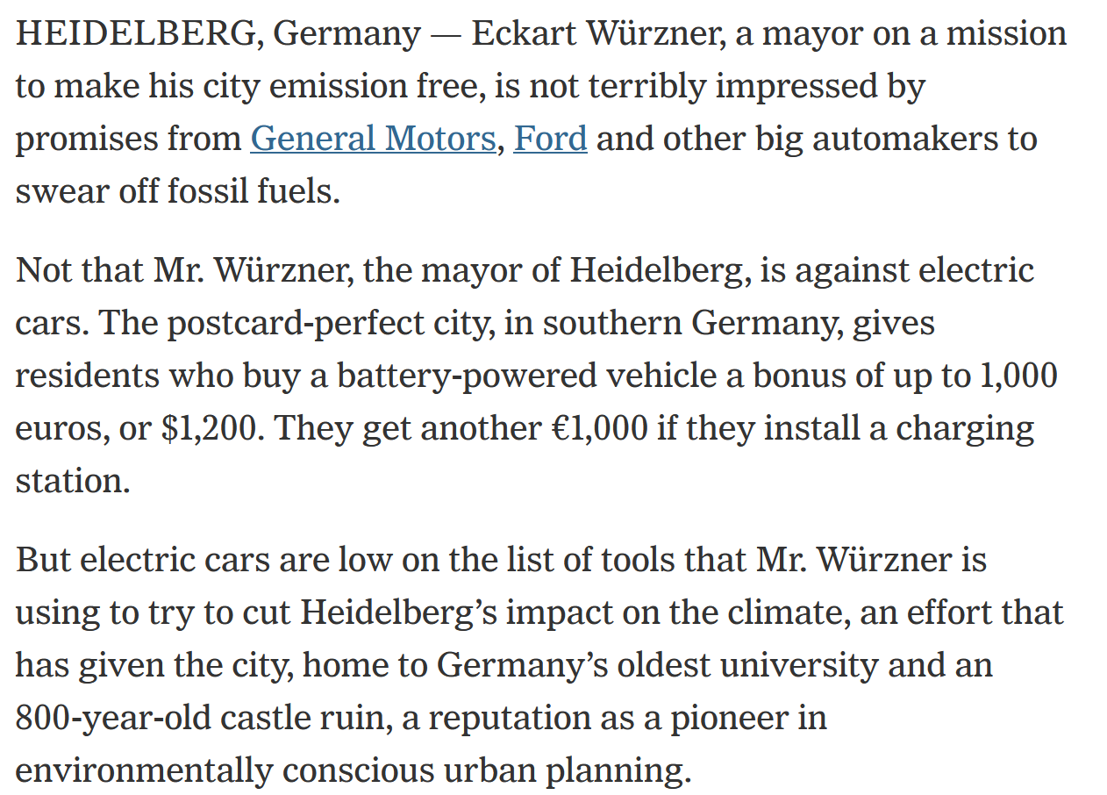
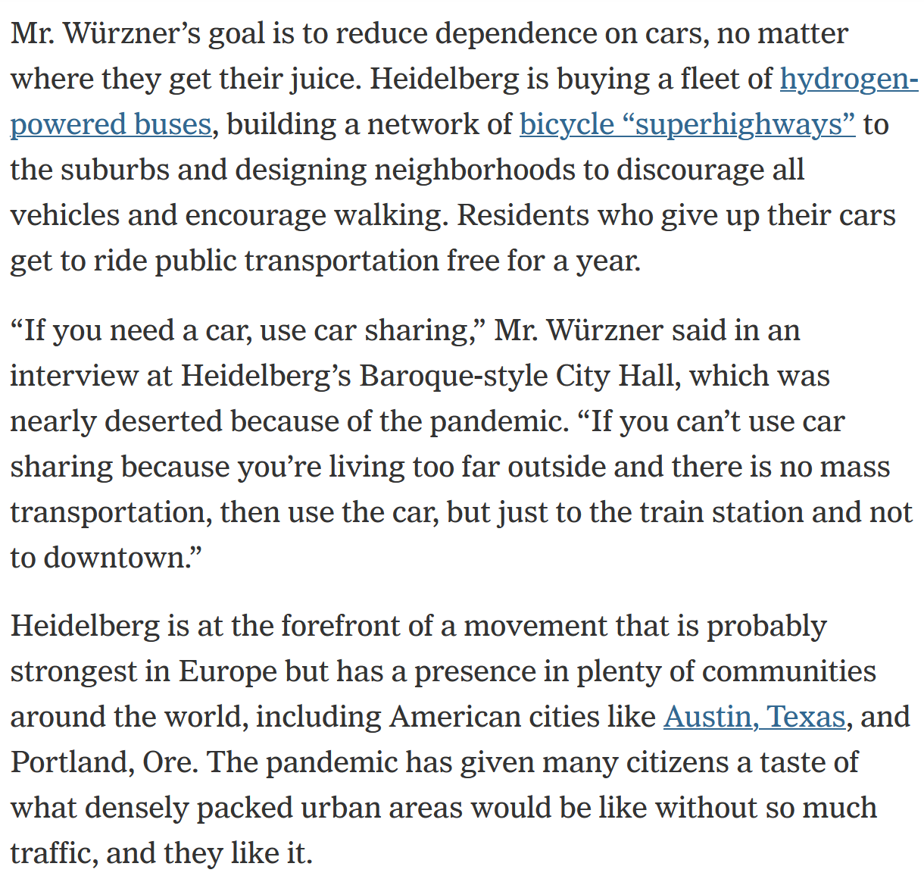
Current example (1)
New York Times: The City Where Cars Are Not Welcome - As automakers promise to get rid of internal combustion engines, Heidelberg is trying to get rid of autos. (28.02.2021)
Source: New York Times; https://www.nytimes.com/2021/02/28/business/heidelberg-cars-environment.html

Slide 4
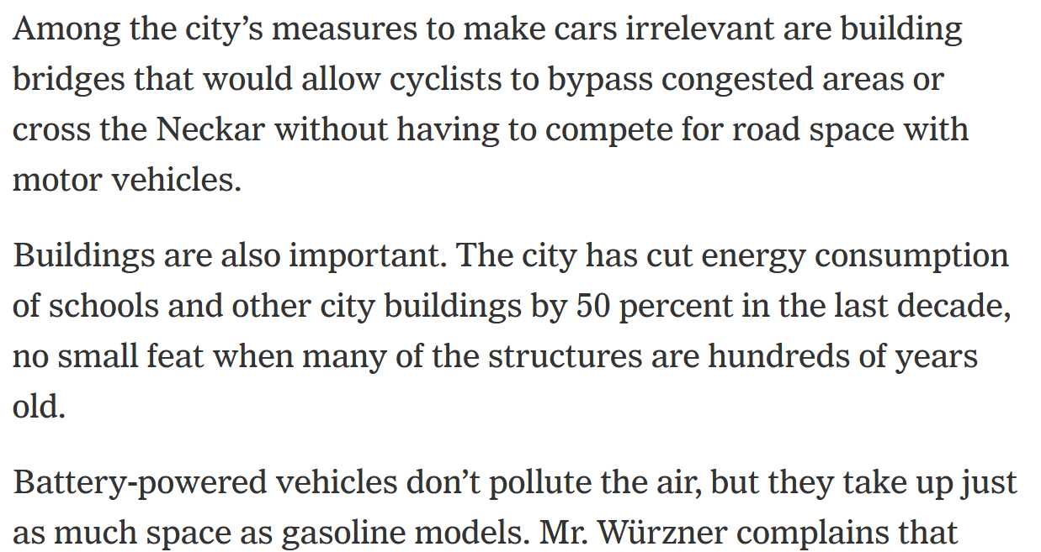
Current example (1)
New York Times: The City Where Cars Are Not Welcome - As automakers promise to get rid of internal combustion engines, Heidelberg is trying to get rid of autos. (28.02.2021)
Source: New York Times; https://www.nytimes.com/2021/02/28/business/heidelberg-cars-environment.html

Slide 5
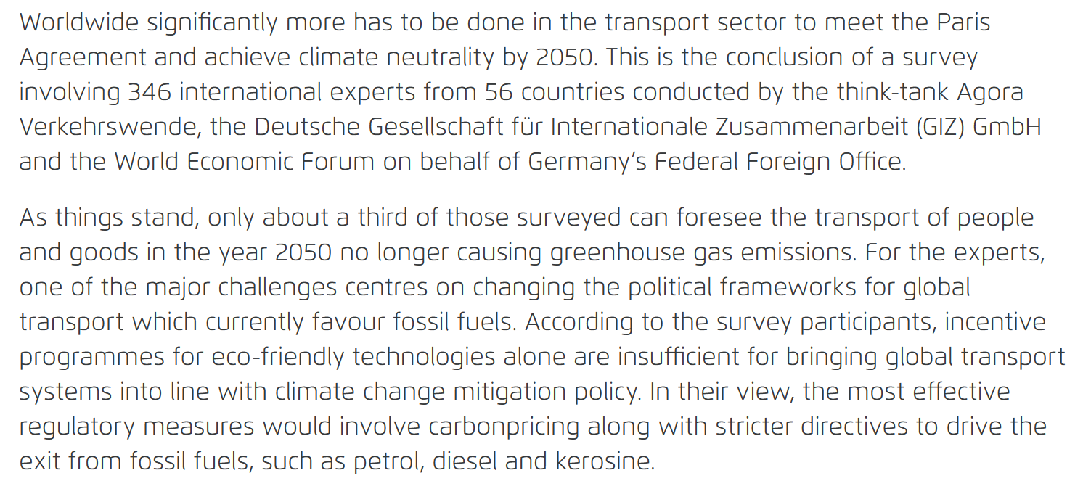
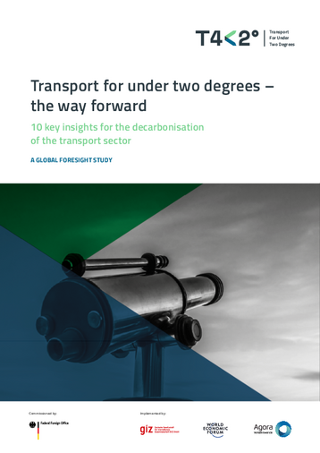
Current example
Study ‘Transport for under two degrees – the way forward’ (08.10.2020)
Source: https://www.t4under2.org/pdf/T4under2_Global-foresight-study_FINAL.pdf

Slide 6
1. Actors involved in transportation policies
National level
BMVI:
Responsible for the billions in road construction/maintenance
Fixated on growth: traffic forecast 2030
Worried about: Car toll, DB, financing, environment, diesel scandal ...
BaSt: Responsible for issues concerning road traffic (on the highway)
UBA: Responsible for issues concerning the environment (located at the train station in Dessau)
EU: Council, Commission, Parliament: sometimes bold, sometimes dominated by lobbies
Lobbies:
VDA, BDI, DIHT, ACEA, (trade unions): major impact
NGOs, DUH, VCD, WWF, BUND, etc.: constant disruption; shaping the debate
Science: Arguments; often long-term; interference ("alternative facts")

Slide 7
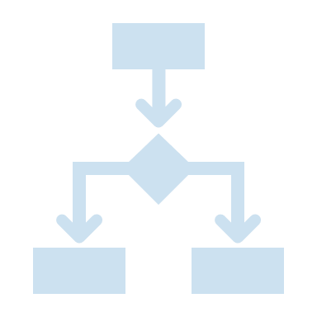
Politics: Actors, interests, instruments
Actors have experience, knowledge and expectations:
"When I implement action A, the effects B, C, D occur ...
... then the actors F, G, H, ... will be for or against ...
... so from now on they will act for/against me ...
... enemies act stronger than friends ....
... Hmmm, maybe I should do nothing at all?
... or I just say, that was "factual constraint" or "without alternative" or
"according to a scientific forecast“
Forecasts are not final truths, but instruments in the political business: because they depend on assumptions. For each question there is in general ONE reasonable delimitation - and only for this question!

Slide 8
2. Forecasts: Consistent hypotheses
In order to assess the effects of action, one must have a picture of the current state and the future:
„Zero-Case“: The world as it is today (In German often: “IST-Fall” (actual case))
„Without-Case“: The world in the future without realization of the measure (Attention: confusingly often also called “Zero-case”)
„With-Case“: The world in the future with realization of the measure
What is the appropriate forecasting model?
The future always remains uncertain: There are always different schools of thought and many conceivable futures.
Caution: Reality is c. p. no forecast test! Never!

Slide 9
Forecasting models
Every forecast needs a (thought) model?
Can the model explain/predict reality?
Are all assumptions disclosed, all mechanisms described?
Above all: Do the assumptions fit together (consistency)?
Truth of representation: is reality correctly represented?
Attention: Self fulfilling prophecy and self refuting prediction!
Serves to identify system effects, reality is not a forecast test.

Slide 10
Forecasting models
Forecast model for determining two future images
The result of forecasts…
… is determined by:
Without- Case
Zero-Case
Forecast model
Future
Today
With- Case
the assumptions, delimitations and framework conditions!

Slide 11
Future development, forecasts, scenarios
Playing out a consistent world systematically/scientifically: Consistent thought structures (not: oil is getting scarcer and gasoline cheaper!)
Analysis today - Development 1 - Measures 1, 2, 3 - Reactions 5, 6, 7 - World 1
Analysis today - Development 2 - Measures 1, 4, 5 - Reactions 6, 8, 9 - World 2
Status-quo, trend, measure, target: self-fulfilling, self-disproving.
Always consider field of application and definition range (“serves for ... in order to ...”)
Indispensable: Problem, delimitations, general conditions.
First: Analyze the basic situation Then: Draw conclusions
First: Describe assumptions Then: Developments & results
The benefit of forecasts is not in the result itself, but in recognizing the interaction. (from "A" follows "B, C, D", which leads to "Z")
KISS: Keep it simple, stupid. A. Einstein: „Keep it as simple as possible but not simpler.“

Slide 12
Example: Driving performance (VKT) in Saxony, Germany
1. Driving performance = f (Vehicles/Inhabitant)
km
km
$$VKT$$
$$\frac{Vehicle}{Inhabitant}$$
𝑉𝑒ℎ𝑖𝑐𝑙𝑒/𝐼𝑛ℎ𝑎𝑏𝑖𝑡𝑎𝑛𝑡
1,1 1,1 1,1 1,1
$$Inhabitant$$
𝐼𝑛ℎ𝑎𝑏𝑖𝑡𝑎𝑛𝑡
n.c. 0,9 0,8 0,8
$$\frac{VKT}{Vehicle}$$
𝑉𝐾𝑇/𝑉𝑒ℎ𝑖𝑐𝑙𝑒
n.c. n.c. 0,8 0,7
$$VKT \\ (rounded)$$
𝑉𝐾𝑇 (𝑟𝑜𝑢𝑛𝑑𝑒𝑑)
1,1 1,0 0,7 0,6
VKT= Vehicle kilometer travelled, n.c. = not considered

Slide 13
Example: Driving performance (VKT) in Saxony, Germany
1. Driving performance = f (Vehicles/Inhabitant)
2. Driving performance = f (Vehicles/Inhab., Inhab.)
km
km
$$VKT$$
$$\frac{Vehicle}{Inhabitant}$$
𝑉𝑒ℎ𝑖𝑐𝑙𝑒/𝐼𝑛ℎ𝑎𝑏𝑖𝑡𝑎𝑛𝑡
1,1 1,1 1,1 1,1
$$Inhabitant$$
𝐼𝑛ℎ𝑎𝑏𝑖𝑡𝑎𝑛𝑡
n.c. 0,9 0,8 0,8
$$\frac{VKT}{Vehicle}$$
𝑉𝐾𝑇/𝑉𝑒ℎ𝑖𝑐𝑙𝑒
n.c. n.c. 0,8 0,7
$$VKT \\ (rounded)$$
𝑉𝐾𝑇 (𝑟𝑜𝑢𝑛𝑑𝑒𝑑)
1,1 1,0 0,7 0,6
VKT= Vehicle kilometer travelled, n.c. = not considered

Slide 14
Example: Driving performance (VKT) in Saxony, Germany
1. Driving performance = f (Vehicles/Inhabitant)
2. Driving performance = f (Vehicles/Inhab., Inhab.)
3. Driving performance = f (Vehicles/Inhab., Inhab. < 80, specific VKT/Year)
km
km
$$VKT$$
$$\frac{Vehicle}{Inhabitant}$$
𝑉𝑒ℎ𝑖𝑐𝑙𝑒/𝐼𝑛ℎ𝑎𝑏𝑖𝑡𝑎𝑛𝑡
1,1 1,1 1,1 1,1
$$Inhabitant$$
𝐼𝑛ℎ𝑎𝑏𝑖𝑡𝑎𝑛𝑡
n.c. 0,9 0,8 0,8
$$\frac{VKT}{Vehicle}$$
𝑉𝐾𝑇/𝑉𝑒ℎ𝑖𝑐𝑙𝑒
n.c. n.c. 0,8 0,7
$$VKT \\ (rounded)$$
𝑉𝐾𝑇 (𝑟𝑜𝑢𝑛𝑑𝑒𝑑)
1,1 1,0 0,7 0,6
VKT= Vehicle kilometer travelled, n.c. = not considered

Slide 15
Example: Driving performance (VKT) in Saxony, Germany
1. Driving performance = f (Vehicles/Inhabitant)
2. Driving performance = f (Vehicles/Inhab., Inhab.)
3. Driving performance = f (Vehicles/Inhab., Inhab. < 80, specific VKT/Year)
4. Driving performance = f (Vehicles/Inhab., Inhab. < 80, specific VKT/Year, Oil price)
km
km
$$VKT$$
$$\frac{Vehicle}{Inhabitant}$$
𝑉𝑒ℎ𝑖𝑐𝑙𝑒/𝐼𝑛ℎ𝑎𝑏𝑖𝑡𝑎𝑛𝑡
1,1 1,1 1,1 1,1
$$Inhabitant$$
𝐼𝑛ℎ𝑎𝑏𝑖𝑡𝑎𝑛𝑡
n.c. 0,9 0,8 0,8
$$\frac{VKT}{Vehicle}$$
𝑉𝐾𝑇/𝑉𝑒ℎ𝑖𝑐𝑙𝑒
n.c. n.c. 0,8 0,7
$$VKT \\ (rounded)$$
𝑉𝐾𝑇 (𝑟𝑜𝑢𝑛𝑑𝑒𝑑)
1,1 1,0 0,7 0,6
VKT= Vehicle kilometer travelled, n.c. = not considered

Slide 16
Scenarios: Consistent projections and images
„Scenarios are
neither forecasts that ...quantitatively ... extrapolate...
nor unrealistic utopias and fantasies...“
„The scenario technique [creates] ... detailed future situations .... holistically."
Procedure:
Phase I - Task and problem analysis
Phase II - Influence analysis and descriptor determination
Phase III - Trend projections and factor bundling
Phase IV - Scenario development and interpretation
Phase V - Measures and possible actions
Different internally consistent, value-free development paths!
Scenarios reflect: Intelligence. Linkage. Feedback: Ecology.

Slide 17
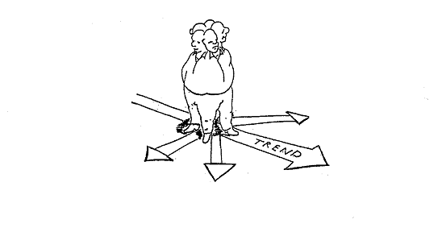
Which scenario do we want?
What is the “proper" development for our region or our city?
Past Development
Possible future: Scenario „Car-friendly city”
Possible future: Scenario „Environmentally friendly transportation system“
Possible future: Scenario „Trend”
Possible future: Scenario „Sustainable transport“ (In German „Sanfte Mobilität”)
Source: Illustration Dietiker, Looser 1985

Slide 18
German example: Forecast in the Federal Transport Infrastructure Plan (“Bundesverkehrswegeplan BVWP”)
After the war, everything was broken Building and maintaining infrastructure.
The federal transport routes can only be taken over by society.
Calls for help ("needs") come from all the states, as always!
Federal government pays (2015-2030: approx. 270 billion €): what will be built now?
From the states' point of view, it makes sense to bring more money into their own country.
So, the states want "everything": Pick up as many “gifts” as possible!
The BVWP methodology is only to put the wishes in an order.
And then each country builds until its country quota is exhausted.
THIS is all simple politics, "science" is not needed.
It all depends on the goal: What do you want? More and faster traffic?

Slide 19
German example: Goals of the BVWP?
"The basis for each planning instrument is the establishment of a target system and a deficiency analysis with regard to the current achievement of objectives: What are the objectives of transport infrastructure planning? What are the deficiencies in the network? Where do we stand, where do we want to go? In the following, the objectives of the BVWP 2015 are first presented (see Section 4.1) and the federal transport networks are analyzed with regard to these objectives in terms of their condition and possible deficiencies (see Section 4.2). Based on the condition analyses, indications of the nationwide and regional extent of infrastructure deficiencies can be derived in order to systematically identify the network areas and objectives with the greatest need for action (see Section 4.3). The findings serve as a basis for generating project ideas and prioritizing projects.“ *
The BVWP does not have the goal of examining which people (or companies) cannot meet certain mobility needs or can only do so with difficulty. The BVWP has the specification deriving from the structural data forecast to expand the networks. It only answers the question of where which expansion would be better. Options for action other than infrastructure expansion (such as traffic avoidance, climate protection) are not considered as primary goals. These options are only used as criteria for the selection of the infrastructure options !!!
* translated; Source: https://www.bmvi.de/SharedDocs/DE/Anlage/G/BVWP/bvwp-2015-grundkonzeption-langfassung.pdf?__blob=publicationFile

Slide 20
Please note!
The structural data forecast specifies by how much the pkm / tkm should increase.
It will then be checked whether the network can still cope with these traffic increases.
Of course, it can't - so it has to be expanded. If it were not expanded, the traffic increases desired in step 1 would also be illusory.
Only infrastructure upgrades are now considered as measures.
With 270.000 million €, all traffic routes become more attractive then leading to an overall increased attraction of traffic. Heavy traffic will be induced/forced.

Slide 21
Please note!
Ergo, after 20 years you can say: See, the forecast was right after all!
But one could just as well have said: The traffic increases called for in Step 1 contradict every health, spatial and climate policy.
Measures would then have to be developed to ensure mobility without these threatening increases occurring.
But then other measures would result: Spatial planning, organizational, pricing, public transport promotion, etc.
OR

Slide 22
Again: The difference between need / instrument
Needs
Not possible at home: the demand
Infrastructure: the offer
Environment / World
Personal decision
FOR WHAT? Mobility satisfaction WITH WHAT? With traffic!
Needs Instruments

Slide 23
The difference: need / instrument
Mobility = For What
Measure reflecting the total number of different needs covered
Indicator for
number of needs met
number of activities
number of trips per person and day
Mobility is usually unchanged even across societies: Law of constant travel time budget
Vehicles, structures, routes and instruments are necessary
Traffic = With what
Instrument with which these needs can satisfied
Total number of all instruments for the realization of needs
Necessary to cover mobility
Measurable in different sizes regarding the effort
Goal: Ensure the possibility of meeting needs for all: Mobility
Instrument: As little traffic as possible (little effort=money, noise, ${CO}_{2}$...)
Need-based (for all) mobility with less transport

Slide 24
What would be a proper benefit-cost ratio?
Let's assume you are the boss of a company:
Of course, you evaluate your investments according to benefit/cost difference (!), alternatively also according to benefit/cost ratio
Example: Production machines
Hence: At the top is your objective function ("Output/Revenue")
Below are the costs ("input/expenses"): all costs!
Ratio greater than 1?
η :=
Revenue (profit) from products sold [€]
€ _{Acquisition costs} + € _{Operating costs} + € _{Labor costs} € _{Electricity costs} + …

Slide 25
So, for society that would make sense
In the numerator of the term: Mobility - all covered needs - must be listed That's the goal, that's what it's all about in the first place!
In the denominator: All expenses must be listed A procedure with lying prices, without external costs, is not purposeful.
For a certain degree of mobility, all actions taken must then in in a second step try to lower the traffic (the efforts)! To generate more and more traffic and always higher efforts are no useful goals from a social perspective!
(A federal supplemental transportation generation program is not appropriate)
τη :=
Mobility (arbitrarily delimited: Germany, city, group...)
€_{private} + €_{public} + €_{time} + €_{energy} + €_{space} + €_{pollution} + €_{noise} + €_{trash} + €${CO}_{2}$…

Slide 26
German example: What does the old “BVWP” say?
Federal Government Decision 2003, page 13, quote*:
3.4.2 Further development of the benefit-cost analysis
Benefit-cost analysis (BCA) remains at the core of macroeconomic evaluations ... benefit components ...
These benefit components are compared with the investment costs. The result is presented as a benefit-cost ratio (BCR). If this ratio of benefits to costs is greater than 1, this indicates that the project under consideration is economically viable.
Reduction of transportation costs
Maintenance of traffic routes
Increase of traffic safety
Improvement of accessibility
Positive spatial effects
Relief of the environment
Consideration of induced traffic
Improvement of the connection of seaports and airports
*translated

Slide 27
German example: What does the old “BVWP” say?
Reduction in the cost of transport operations (NB) NB1 Reduction of vehicle stocking costs NB2 Reduction of vehicle operation costs NB3 Changes in transport costs due to shifts in volume Preservation of traffic routes (NW) NW1 Renewal of the traffic routes NW2 Maintenance of traffic routes Increase of traffic safety (NS) Improvement of the destinations’ accessibility (NE) Spatial advantages (NR) NR1 Employment effects from the construction of transport routes NR2 Employment effects from the operation of traffic route NR3 Contributions to the promotion of international relations | Relief for the environment (NU) NU1 Reduction of noise pollution NU2 Reduction of exhaust gas pollution NU3 Reduction of inner-city separation effects Effects of induced traffic (NI) Improved connection of seaports and airports (NH) Fulfillment of non-transport functions (NF) Investment costs (K)
Federal Government Decision 2003, page 13, quote*:
3.4.2 Further development of the benefit-cost analysis
Benefit-cost analysis (BCA) remains at the core of macroeconomic evaluations ... benefit components ...
These benefit components are compared with the investment costs. The result is presented as a benefit-cost ratio (BCR). If this ratio of benefits to costs is greater than 1, this indicates that the project under consideration is economically viable.
Reduction of transportation costs
Maintenance of traffic routes
Increase of traffic safety
Improvement of accessibility
Positive spatial effects
Relief of the environment
Consideration of induced traffic
Improvement of the connection of seaports and airports
*translated

Slide 28
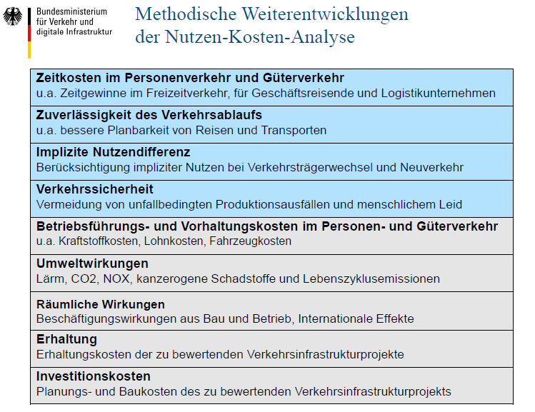
German example: And the new BVWP?
Further developments of the benefit-cost analysis regarding the methodology *
Time costs in passenger and freight transport inter alia time gains in leisure traffic, for business travelers and logistics companies
Reliability of traffic flow inter alia better planning of trips and transports
Implicit difference in utility Consideration of implicit benefits in modal shift and new traffic
Traffic safety Avoidance of accident-related production losses and human suffering
Operating and maintenance costs in passenger and freight transport inter alia fuel costs, labor costs, vehicle costs
Environmental impacts Noise, ${CO}_{2}$, ${NO}_{x}$, carcinogenic pollutants and life cycle emissions
Spatial effects Employment effects from construction and operation, international effects
Maintenance Maintenance costs of the transport infrastructure projects to be assessed
Investment costs Planning & construction costs of the transport infrastructure projects to be assessed
… No reorientation recognizable …
*translated

Slide 29
A cost reduction/cost increase - relationship
:=
A cost- cost – relationship is economically absurd; but offers mathematically unexpected possibilities! Example “Local bypass”:
Var0: Cost reductions 1000 million / construction costs 100 million = „BCR“ 10,00
Can we change that? We add what above and below?
We build more elaborately and save on operating costs: + 20 millions
Var1: Cost reductions 1020 million / construction costs 120 million = „BCR“ 8,50
Wrong direction! Now: We take something away from above and below:
Var2: Cost reductions 980 million / construction costs 80 million = „BCR“ 12,25
Var3: Cost reductions 960 million / construction costs 60 million = „BCR“ 16,00
Reduction _{User costs}+ Reduct. _{Accident costs}+ Reduct. _{Environmental costs} + Reduct. _{Operating costs}
(Increase in) Investment costs
Source: Becker, Udo J.: Das Nutzen-Kosten-Verhältnis in der Bundesverkehrswegeplanung: Wissenschaftlicher Anspruch und Auswirkungen in der Praxis. Zeitschrift für Verkehrswissenschaft 87 (1), p. 1-16, 2016

Slide 30
Transport Policy 1 Forecasts and scenarios
Faculty of Transport and Traffic Sciences – Chair of Transport Ecology
Prof. Dr.-Ing. Udo Becker
Prof. Dr.-Ing. Udo Becker
2021
Grant Agreement No.:
2019-1-PL01-K1203-065244

