Slide 1
New mobility services and shared mobility
S@mpler
Integrated Education Based On Sustainable Urban Mobility Projects

Slide 2
Topic in the sump cycle
New mobility services and shared mobility
03 – Analyse mobility situation
05 – Develop vision and strategy with stakeholders
06 – Select targets and indicators
07 – Select measure packages with stakeholders

Slide 3
New facts leading to development of shared economy
New mobility services and shared mobility
Arrival of modern ICT
Smartphones, internet
Emergence of internet applications → enabled communication even with strangers
Shift in lifestyle and values
“Fewer possessions, more experiences”
Shift from proprietary title to use title
Desire to discover new things, unusual experiences, defiance of traditional models

Slide 4
Shared economy
New mobility services and shared mobility
Authors do not agree on a unified definition
Online platform aimed at providing easier access to certain services and resources (Wosskow, 2014)
Concept of sharing unused things free of charge or for a charge to others (Botsman, 2015)
Sharing of common goods by various users, who contribute financial payments to their financing by the owner (Vorlíček, 2016)
preference of access to durable goods and production factors using digital platforms rather than ownership of such goods and production factors (Deloitte, 2017)

Slide 5
Basic preconditions for shared economy:
New mobility services and shared mobility
Existence of a good of a capacity greater than its owner can utilize
Willingness to provide the good or service to another user
Existence of an entity interested in using the good or service (free of charge or against payment)
For sharing to work, the transaction has to be more favourable than the traditional distribution and use method (e.g., economy, experience, new approach, etc.)

Slide 6
New mobility services and shared mobility
Source: AČC, 2020

Slide 7
Positive aspects of shared economy
New mobility services and shared mobility
Distribution system easier to understand and more open
Faster
Less restricted
Often cheaper
New model of connecting supply and demand, reduced transaction costs
Minimized information asymmetry
Increased efficiency of resource use
New service sector = new employer

Slide 8
Negative aspects of shared economy
New mobility services and shared mobility
No new market, only captures some of the existing
Concerns about safety, hygiene, agreed terms and conditions
Complaints and demands for compensation impossible
Disputes with competing entities offering goods or services in traditional ways
Insufficient regulation → tax obligations not met
Price reduction

Slide 9
Great potential of shared economy in transport:
New mobility services and shared mobility
Cars are relatively expensive and wear down fast
Cars are a little used asset (they move for only 10-20% of the time)
Vacant seats → can be occupied
Cars can be used even by lower-income groups
Unused capacities are a waste of resources

Slide 10
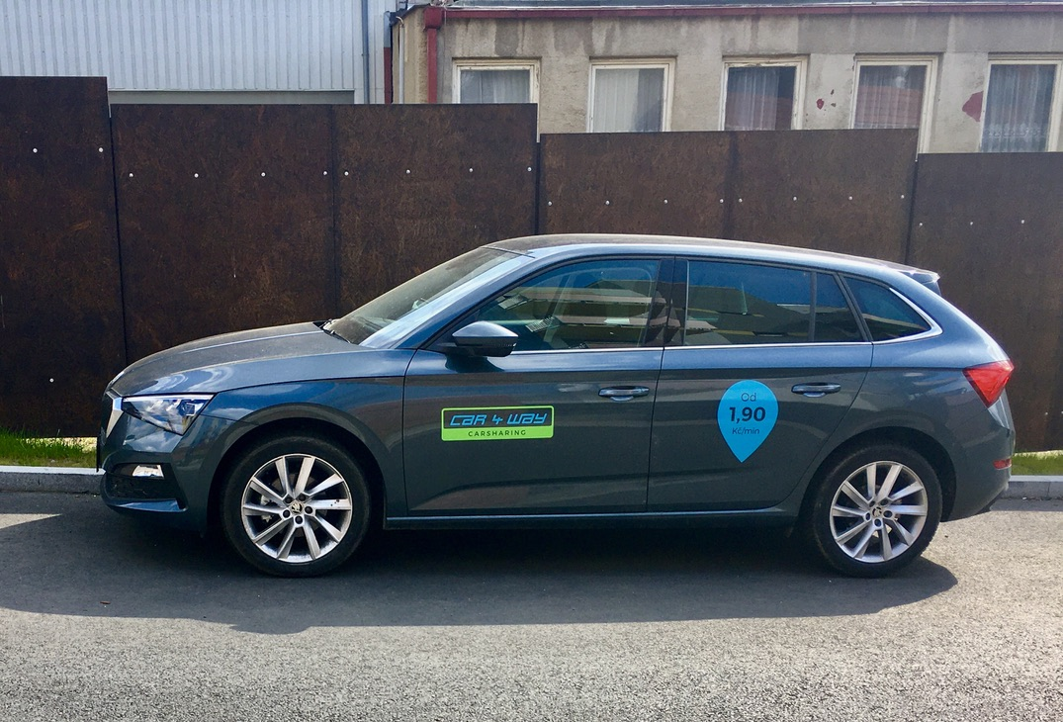
Shared economy in transport
New mobility services and shared mobility
Carsharing = cars are shared
permits use of a car without owning it
Ridesharing = seats are shared
Carpooling = trips are shared
Bikesharing = bicycles are shared

Slide 11
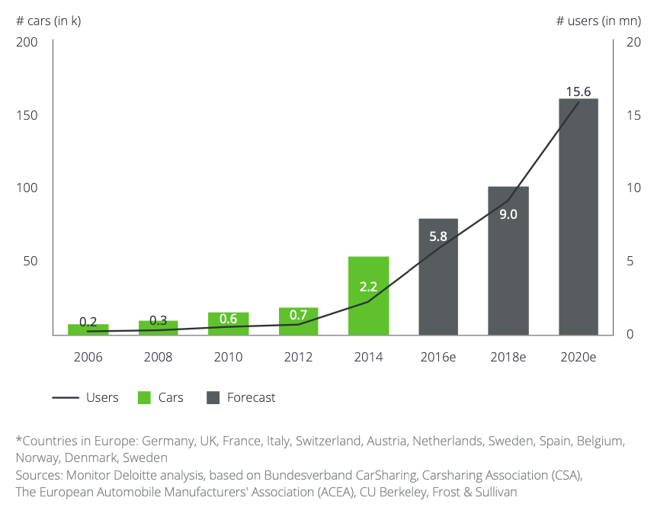
Carsharing
New mobility services and shared mobility
Carsharing market development for Europe* (2006-2020)
Carsharing
Charged per hours in use or km travelled
One-way – trip starts and ends at different points
Two-way – has to be returned to the place of origin
Free-floating – can be returned anywhere within a set area
Peer-to-peer (P2P) carsharing – people sharing cars among themselves
Source: Deloitte, 2017

Slide 12
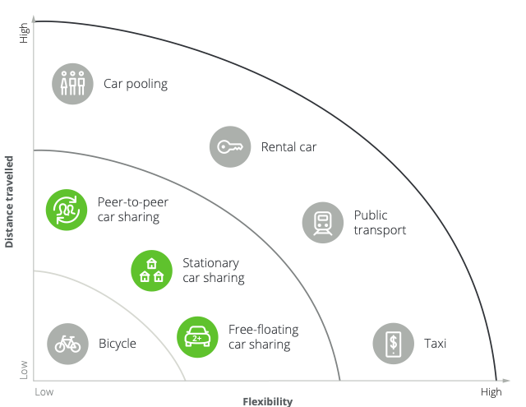
Carsharing
New mobility services and shared mobility
Classification of car sharing among existing mobility concepts
Source: Deloitte, 2017

Slide 13
Advantages of carsharing
New mobility services and shared mobility
For society
Fewer traffic jams
Less pollution
Fewer places required for parking
Transport infrastructure development
Rolling stock modernisation
Less road wear
For individuals
Cost reduction
Less stress of car driving and maintenance – more comfort
Health benefits
Access for all income categories
Lower parking fees in some cities

Slide 14
Drawbacks of carsharing
New mobility services and shared mobility
Need to walk/ride to the shared car
Not available everywhere
Risk of no car available for hire
Uncertainty about the current hygienic and technical condition of the car
Need to plan and limited vehicle choice
Car equipment may not match requirements and ideas (comfort, safety, etc.)

Slide 15
Examples of carsharing companies
New mobility services and shared mobility
Anytime
Car4way
GreenGo
HappyGo (peer-to-peer carsharing)
Re.volt – electric vehicles
OnlvyFY

Slide 16
Examples from abroad – Italy
New mobility services and shared mobility
Government regulation – increased attention to innovative approaches
Integrated nationwide system introduced
Iniziativa Car Sharing (IZS) association established – administration and grant allocation
Initial support to carsharing companies
Assurance of quality and operating standards
Nationwide communication and promotion
Technical and legal consultations
Technology for fleet and service management
Call centre services

Slide 17
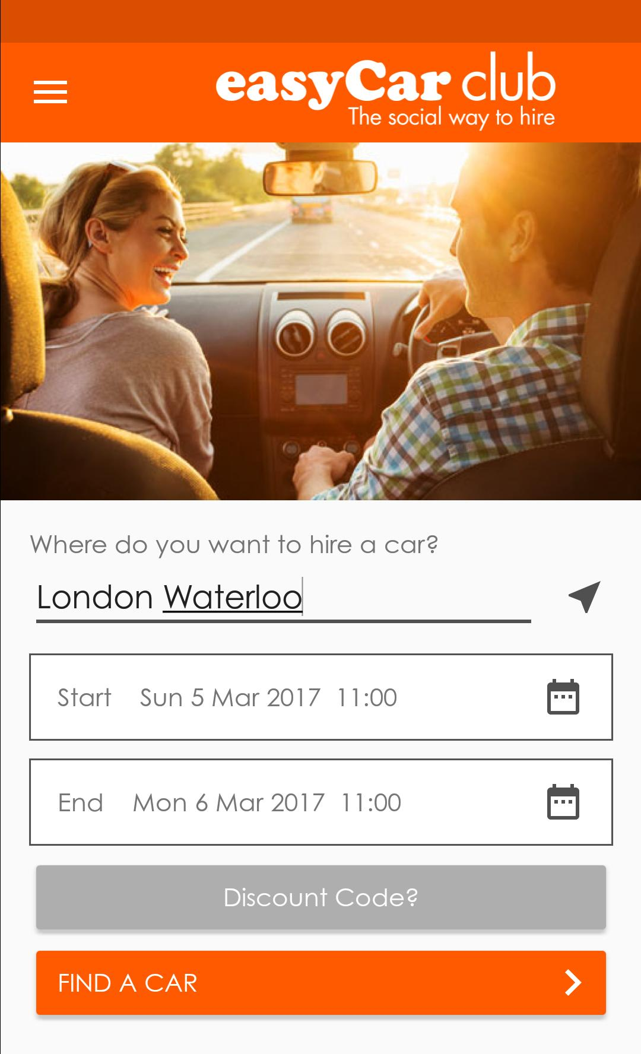
Examples from abroad – United Kingdom
New mobility services and shared mobility
Easycar Club – low-cost service company
Easyjet low-cost flights and Easycar automobile rental
Cost savings (low costs of technology) → cars rented very cheaply
Booking via the internet, mobile phone, car unlocked remotely

Slide 18
Examples from abroad – Austria
New mobility services and shared mobility
Denzeldrive – company combining car rental and carsharing
Some cars located at Denzeldrive facilities, providing advice, membership, car rental and sales
The price is based on car use time, entry fee is mandatory
Company carsharing

Slide 19
Bikesharing
New mobility services and shared mobility
Sharing of bicycles
Typically renting and returning is possible at different places → free-floating
Gradually expanded with electric bicycles and electric scooters
City itself frequently the operator – included in PT system
Problem: financial sustainability (user fees pay 5-10% of the costs)
Micromobility = transport within a city over short distances using small emission-free vehicles, such as bicycles, scooters, skateboards, etc.

Slide 20
Advantages of bikesharing
New mobility services and shared mobility
Improves traffic situation, reduces traffic jams
Positive environmental impact, air quality improvement
Faster travel around city centre (compared to walking and even PT)
Bicycles can be rented and returned at different places
Automated, easy to use
Relatively cheap fees
Can be rented anytime

Slide 21
Drawbacks of bikesharing
New mobility services and shared mobility
Financing – bicycle purchase price, maintenance and repair costs, redistribution, staff, computer support
Problems securing against theft and vandalism
Poor transport infrastructure
People’s habits – few regard the bicycle as a mode of transport
Some bicycles cannot be returned anywhere – stations overflow
Winter operation

Slide 22
Examples of bikesharing companies
New mobility services and shared mobility
Rekola
Lime
Bolt
Re.volt

Slide 23
Ridesharing and carpooling
New mobility services and shared mobility
Internal vs external
Motivation
Monetary savings, time savings
Comfort, easy access thanks to social media
Environmental aspects
Socialization
Lack of parking spaces (parking preference for carpoolers)
Barriers
Time losses (particularly for drivers)
Loss of comfort and privacy
Personal safety (riding with a stranger)

Slide 24
Ride-hailing (alternative taxi services)
New mobility services and shared mobility
= driver taking a passenger for a payment based on previous online agreement
The customer pays for travel to the required place
Uses mobile applications
Alternative taxi services
For example, Uber, Bolt, Lyft, Liftago
Personal profit is the primary motivation

Slide 25
Uber Technologies Inc.
New mobility services and shared mobility
Transport and mobility company, established in 2009
First idea – Garrett Camp and Travis Kalanick in Paris
First Uber ride on 5 July 2010 in San Francisco
December 2011 – Uber expands abroad (Paris)
August 2014 – UberPool (carpool)
30 Dec 2015 – first billion Uber rides
20 May 2017 – 5 billion rides
10 6 2018 – 10 billion rides

Slide 26
Regulate or not?
New mobility services and shared mobility
One of the most debated issues – shared economy differs from the initial idea
The missing definition of shared economy is a problem
The effect of improved service quality for consumers is arguable
Self-regulation by references and evaluations
European Commission’s position statement:
“In view of the significant benefits that new collaborative economy business models can bring, Europe should be open to embracing these new opportunities. The EU should proactively support the innovation, competitiveness and growth opportunities offered by modernisation of the economy. At the same time, it is important to ensure fair working conditions and adequate and sustainable consumer and social protection.”

Slide 27
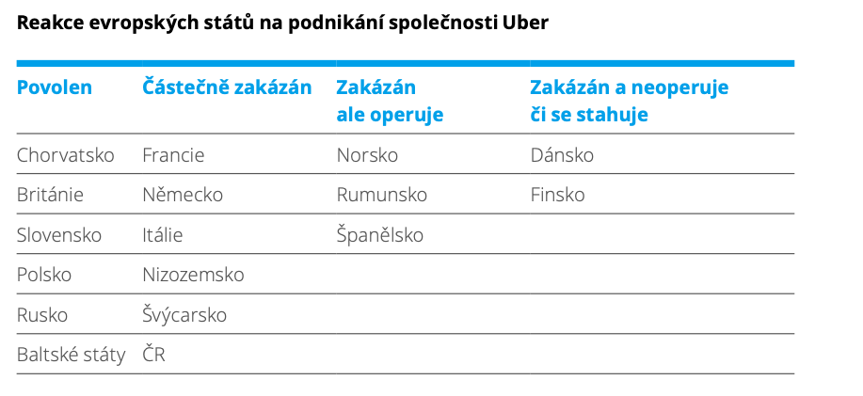
Regulation of shared economy
New mobility services and shared mobility
Source: Deloitte, 2017

Slide 28
References, Sources, Bibliography
New mobility services and shared mobility
Asociace českého carsharingu. (2020). Retrieved 7 November 2020 from http://ceskycarsharing.cz
Deloitte. (2017). Sdílená ekonomika: Bohatství bez vlastnictví. Retrieved 7 November 2020 from https://mediaguruwebapp.azurewebsites.net/media/1938/deloitte-studie-sd%C3%ADlená-ekonomika.pdf
Nourinejad, M., & Roorda, M. J. (2015). Carsharing operations policies: a comparison between one-way and two-way systems. Transportation, 42(3), 497-518.
Valentová, M. ([2007]). Car-sharing: Sdílení vozidel : inteligentní způsob využívání automobilů šetrný vůči životnímu prostředí. Ústav pro ekopolitiku.
Veber, J., Krajčík, V., Hruška, L., & Makovský, P. (2016). Sdílená ekonomika: “Vymezení metodologických postupů pro zajištění datové základny a ekonomických východisek pro regulatorní ošetření tzv. sdílené ekonomiky”. Retrieved 7 November 2020 from https://www.vspp.cz/wp-content/uploads/2017/05/zprava.pdf

Slide 29
Thank you for your attention!
S@mpler
Integrated Education Based On Sustainable Urban Mobility Projects
Project information:
The main project objective is to enhance the quality of teaching at the involved universities in the field of sustainable urban mobility management. Our efforts consist in expanding students‘ practical skills through implementation of a practical project teaching method. An emphasis is put on the reflection of challenges which cities have to tackle in the real world, especially in the area of Sustainable Urban Mobility Plans (SUMP). The project is intended to contribute to improving students‘ knowledge and skills, particularly for the position and job placement of mobility managers.
Topic elaborated by: Lucie Vávrová
mobilita-ieep.cz
Link to the web database

Slide 30
CORRESPONDING PART FOR TEACHERS AND THEIR COMMUNICATION WITH STUDENTS

Slide 31
tasks
New mobility services and shared mobility
Define advantages and drawbacks of shared economy in the city. Should it be regulated? Why, or why not?
What are the benefits of bikesharing for cities? Should bikesharing be operated or supported by the city? Why, or why not? How should it be financed?

Slide 32
Thank you for your attention!
S@mpler
Integrated Education Based On Sustainable Urban Mobility Projects
Project information:
The main project objective is to enhance the quality of teaching at the involved universities in the field of sustainable urban mobility management. Our efforts consist in expanding students‘ practical skills through implementation of a practical project teaching method. An emphasis is put on the reflection of challenges which cities have to tackle in the real world, especially in the area of Sustainable Urban Mobility Plans (SUMP). The project is intended to contribute to improving students‘ knowledge and skills, particularly for the position and job placement of mobility managers.
Topic elaborated by: Lucie Vávrová
mobilita-ieep.cz
Link to the web database

