Slide 1
More mobility and more safety with less transport for a better children's mobility
Faculty of Transport and Traffic Sciences – Chair of Transport Ecology
Prof. Dr.-Ing. Udo Becker
Dipl.-Ing. Rosemarie Baldauf
2021

Slide 2
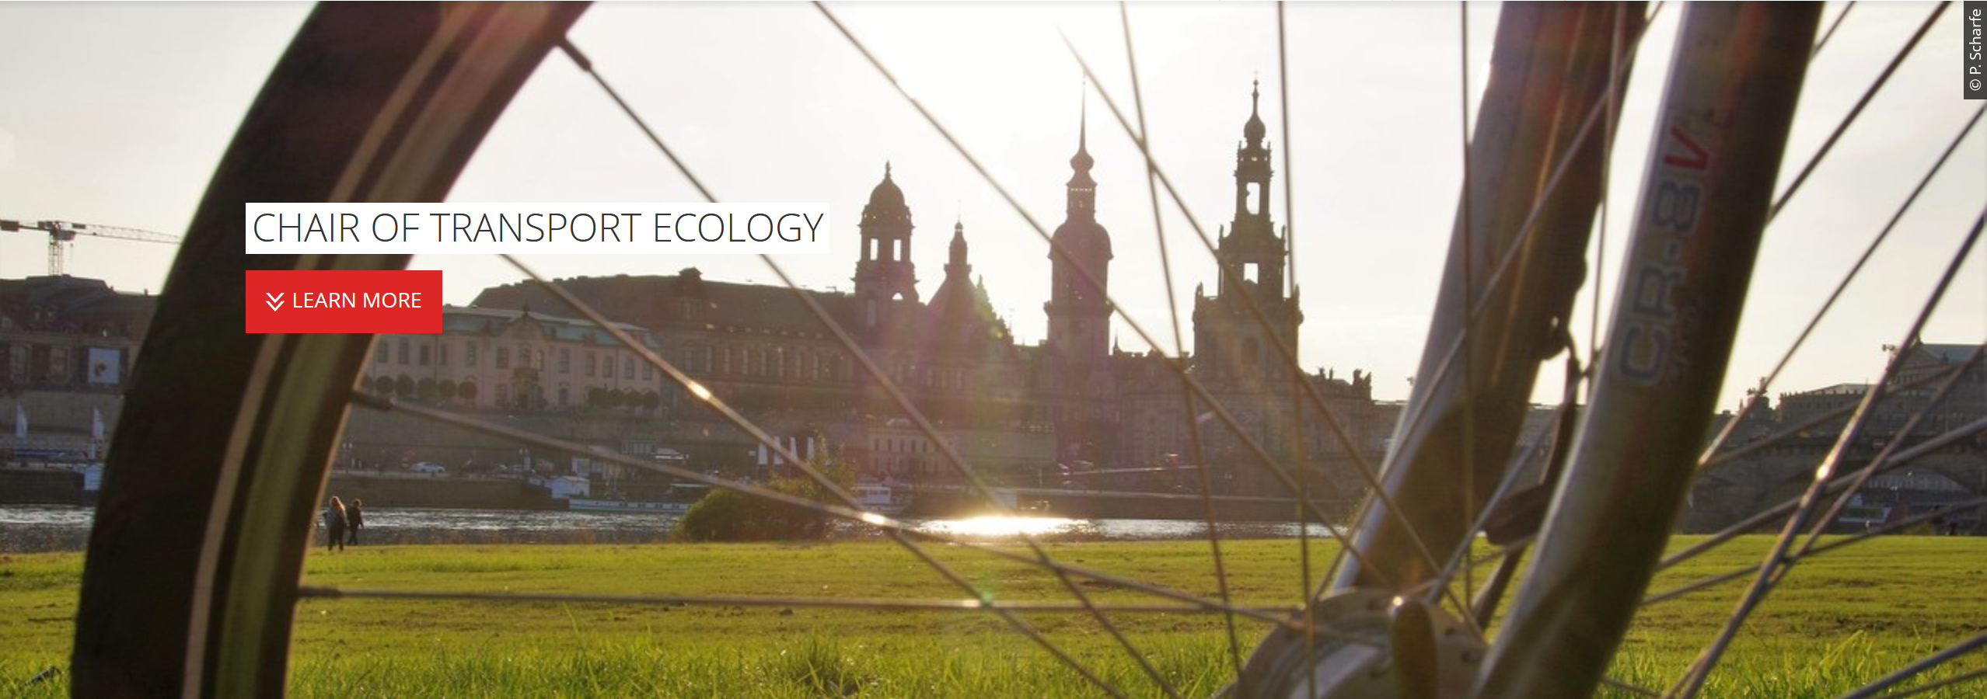
Chair of Transport Ecology
Goal: "Reduce the environmental impact of transport" and of course also the reduction of child accidents.”
How?
Best to wall everyone up at home!?
Well, get everyone to their destination, but somehow differently ... better!
It can be done! With a little effort and patience! And it's a lot of fun!
That's what I want to show you today!

Slide 3
Transport is important?
What did your city actually look like 100 years ago?
What does it look like today?
Roads are important, traffic is important, undisputed: without roads there would be no cars, no lorries, no food, no emergency doctors, no fire brigade, no social contacts ...
If you want to do something good for people, you build!
Whoever builds/opens transport routes helps the people!
The more transport routes, the more transport, the better!
Ensure the ease and fluidity of transport!
Really?

Slide 4
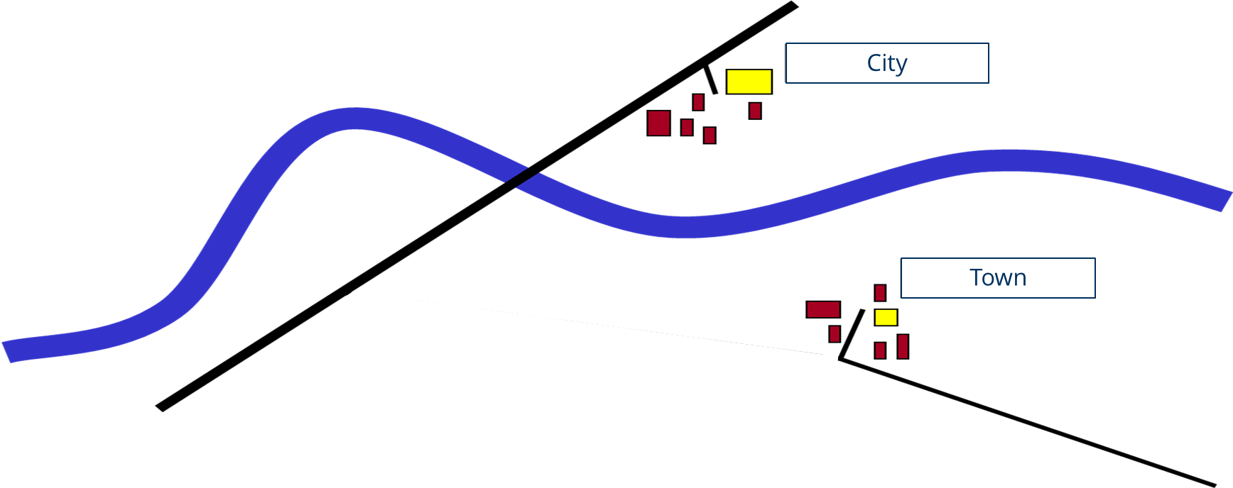
Example: Situation as follows…

Slide 5
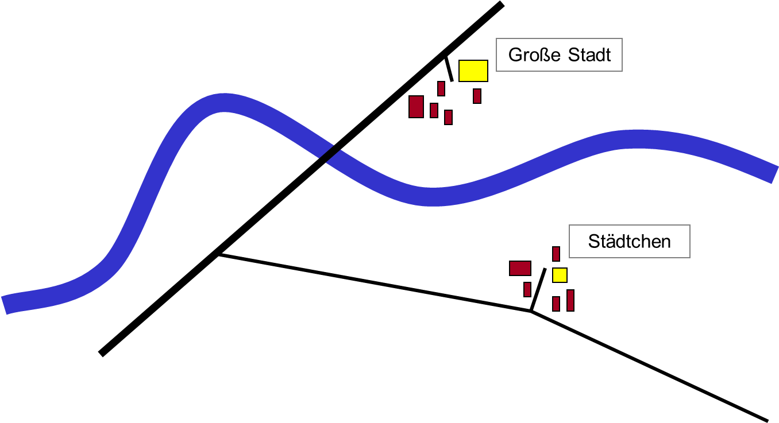
Example: Network development
City
Town

Slide 6
Example: Users react
City
Congestion
Town

Slide 7
Example: New bridge is built
City
Congestion
Town

Slide 8
Example: Forecasted traffic occupany
City
45 000 vehicles
55 000 vehicles
Town
5 000 vehicles
50 000 vehicles
20 000 vehicles

Slide 9
Example: 3 years later…
City
60 000 vehicles
congestion, noise,
air pollution
Town
10 000 vehicles
noise, air pollution

Slide 10
People react!
I'm stuck in a traffic jam.
Some people who don't really want to, now have to drive:
Urban sprawl, long trips, high costs, traffic jams...
Finally the new road is being built,
finally everything is moving again!
(very attractive!)
Spatial structures change,
shops are closing,
jobs in the surrounding area.
But: others drive too!
New car traffic,
especially wider trips.

Slide 11
People react!
I'm stuck in a traffic jam.
Always further,
more and more energy,
for the same destinations: Inefficient!
Some people who don't really want to, now have to drive:
Urban sprawl, long trips, high costs, traffic jams...
Finally the new road is being built,
finally everything is moving again!
(very attractive!)
Spatial structures change,
shops are closing,
jobs in the surrounding area.
But: others drive too!
New car traffic,
especially wider trips.

Slide 12
Is more always better?
Motorized traffic
Public transport
Train
Air traffic
Second data jump: Conversion DIW-mileage model
First data jump: German reunification
Source: Transport in Figures 1980 - 2016/17)

Slide 13
Let's think about it!
Each house has 1000 m² of land, a pool and a barbecue
2 working adults, one child, two cars
A bus stop every 500 metres: For 30 houses, 90 people

Slide 14
Let's think about it!
Each house has 1000 m² of land, a pool and a barbecue
2 working adults, one child, two cars
A bus stop every 500 metres: For 30 houses, 90 people
The nearest kindergarten is at the motorway exit/by the workplace
The most dangerous place is the exit directly in front of the kindergarten: There is always (!) absolute traffic chaos.

Slide 15
Let's think about it!
Very dangerous, you can't see children under 90 cm in the SUV.
You are only safe as long as you wear a seat belt.

Slide 16
Let's think about it!
Summary
Each house has 1000 m² of land, a pool and a barbecue
2 working adults, one child, two cars
A bus stop every 500 metres: For 30 houses, 90 people
The nearest kindergarten is at the motorway exit/by the workplace
The most dangerous place is the exit directly in front of the kindergarten: There is always (!) absolute traffic chaos.
Very dangerous, you can't see children under 90 cm in the SUV.
You are only safe as long as you wear a seat belt.

Slide 17
Let's think about it.
What do the children learn?
By car to the kindergarten, that's normal.
When/where/with whom to play? Who decides?
How many metres walk a day? How long on Nintendo?
How and where do we practise dealing with dangers?
What do the parents learn?
"It is so dangerous in front of the school in the morning and at noon, we couldn't allow them to walk. We had to buy another car so we can drop them off and pick them up."
Somehow this cannot be the solution ...
What do we want?

Slide 18
Mobility = Transport?
Mobility: Need, cause, purpose, task
Transport: Instrument for the realisation of mobility
And what do we want now? Make a wish!
1. Ensuring needs for all: Mobility as a human right!
2. With little effort, money, noise and CO2: Little transport!
Need-based mobility with less transport

Slide 19
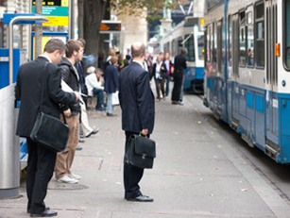
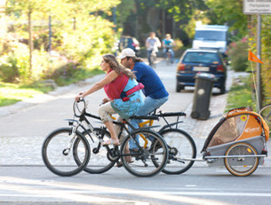
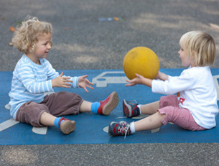
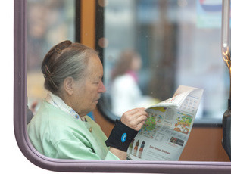
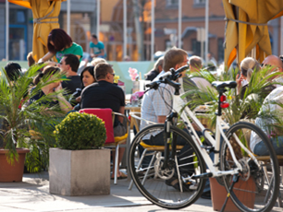
Mobility
Source: Eltis.org

Slide 20
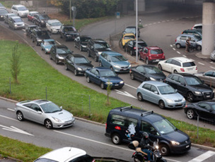
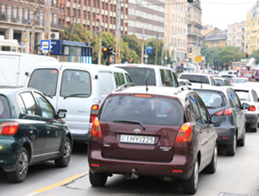
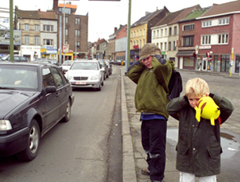
Transport
Source: Eltis.org

Slide 21
Traffic safety in Germany
Children under the age of 15 involved in road traffic accidents
Source: destatis

Slide 22
Traffic safety in Germany
Children under 15 killed in road accidents
Source: destatis

Slide 23
Traffic safety in Germany
Children under the age of 15 involved in road traffic accidents, by type of traffic involvement
Car
Bike
Pedestrian
Bus
Others
Source: destatis

Slide 24
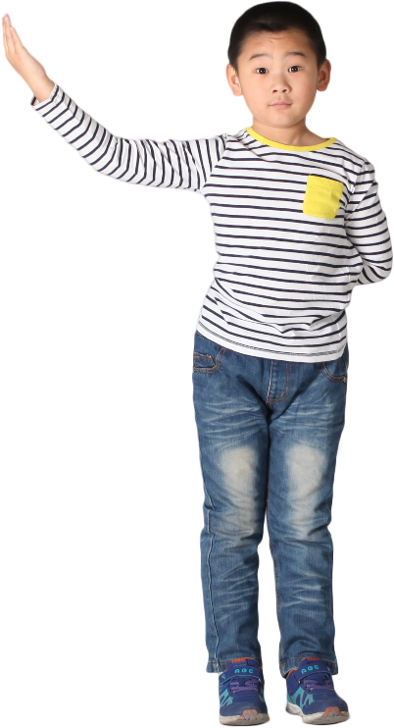
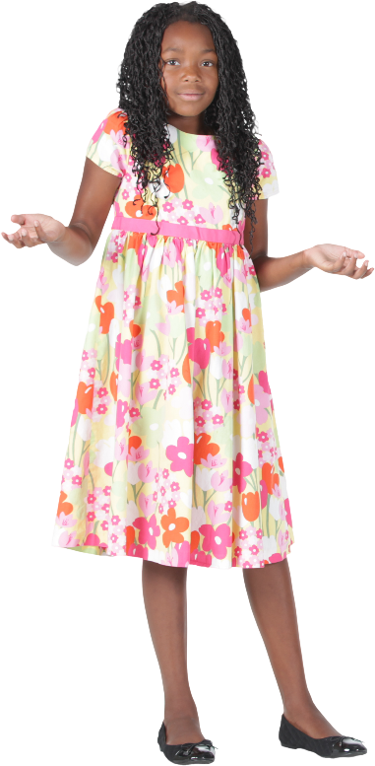
What makes children special
Are smaller and weaker.
Do not cause the exhaust fumes, but suffer from them ("victims“).
Hear differently than we do (finer, more direct).
Cannot estimate speed or can do so only with difficulty.
Higher heart rate, higher basal metabolic rate (exhaust fumes!).
Have difficulty classifying contradictory signals (important?).
Can be easily frightened or distracted.
Are in the socialisation phase (learning and practising).

Slide 25
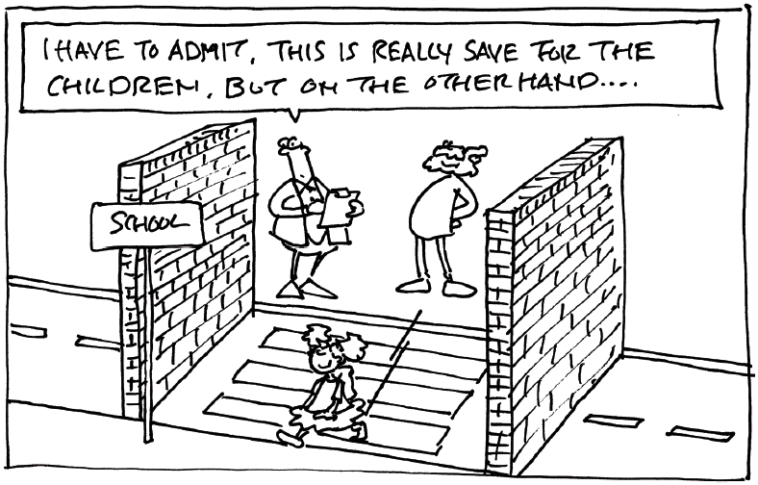
What follows?

Slide 26
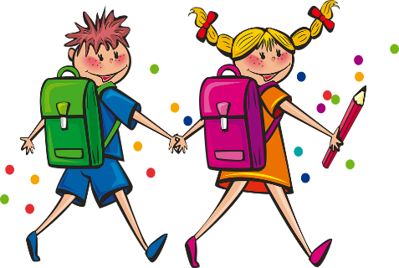
Look at what is important to children!
No stinky cars!
That you can play everywhere!
Lots of trees, lots of green!
Exciting streets and places!
Good footpaths and good cycle paths!
Crossing the road safely!
Meet friends!
Source: Juliane Krause et al. 2005

Slide 27
What follows?
First of all, children need a reliable positive role model.
Who always drives by car and has their own parking space?
Is there always scolding of "fighting cyclists" and pedestrians?
Do they often play Super Mario Kart 7 at home?
Vacationing on Mallorca - hiking or by the pool?

Slide 28
What else follows?
Clear rules and routines: For children ("At the curb you always stay ...") and for adults ("Here is play zone ...").
"Movement" must be practised every day: Muscle coordination, senses, climbing, on one leg, backwards.
The way to school and day-care is THE opportunity in the daily routine!
You have to learn and be allowed to learn: Everyone must fall off the bike at least once (soft and supervised please!)
The environment must tolerate experimentation and mistakes.
Different transport planning, tolerant of mistakes (maximum speed 30, visibility at 75 cm height,...)

Slide 29
What you can do!
You are important – at every level!
Grandparents, police, high schools, city planning office, ...
No matter what you do: As playful as possible, maybe for testing, during the European Mobility Week, at the city festival.
Share your experiences!
Talk to important partners beforehand, especially the local editor and the official gazette.

Slide 30
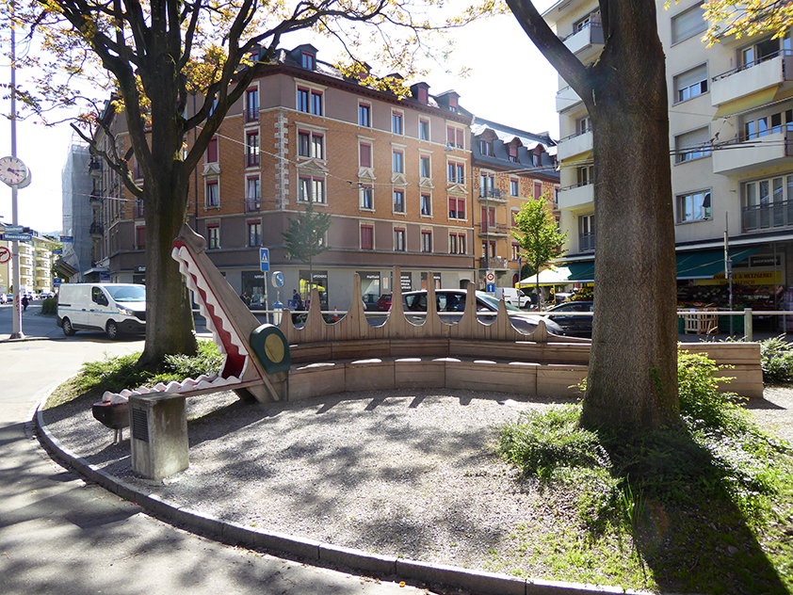
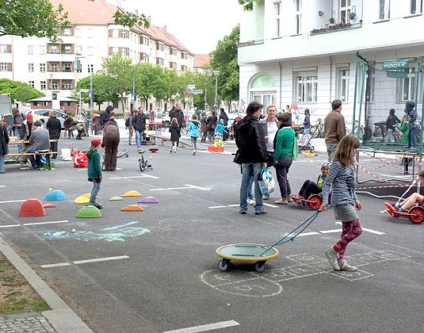
Practice: Urban space design
Zurich: Playful elements on the way to school/sidewalk (Source: Synergo)
Berlin: Temporary play streets (Source: Deutsches Kinderhilfswerk e.V. / H. Lüders

Slide 31
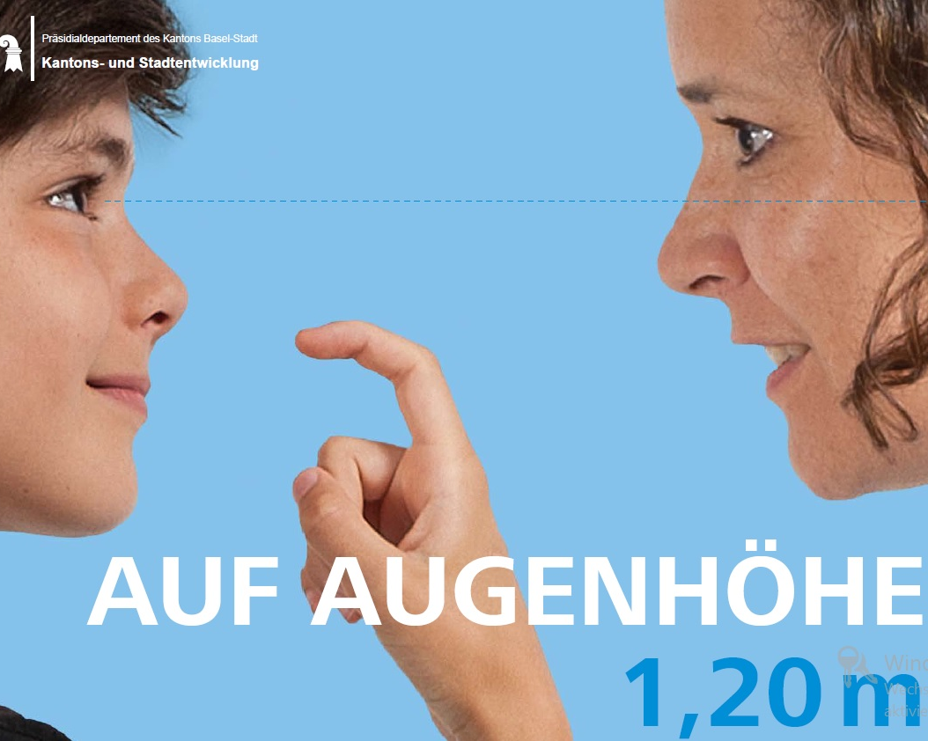
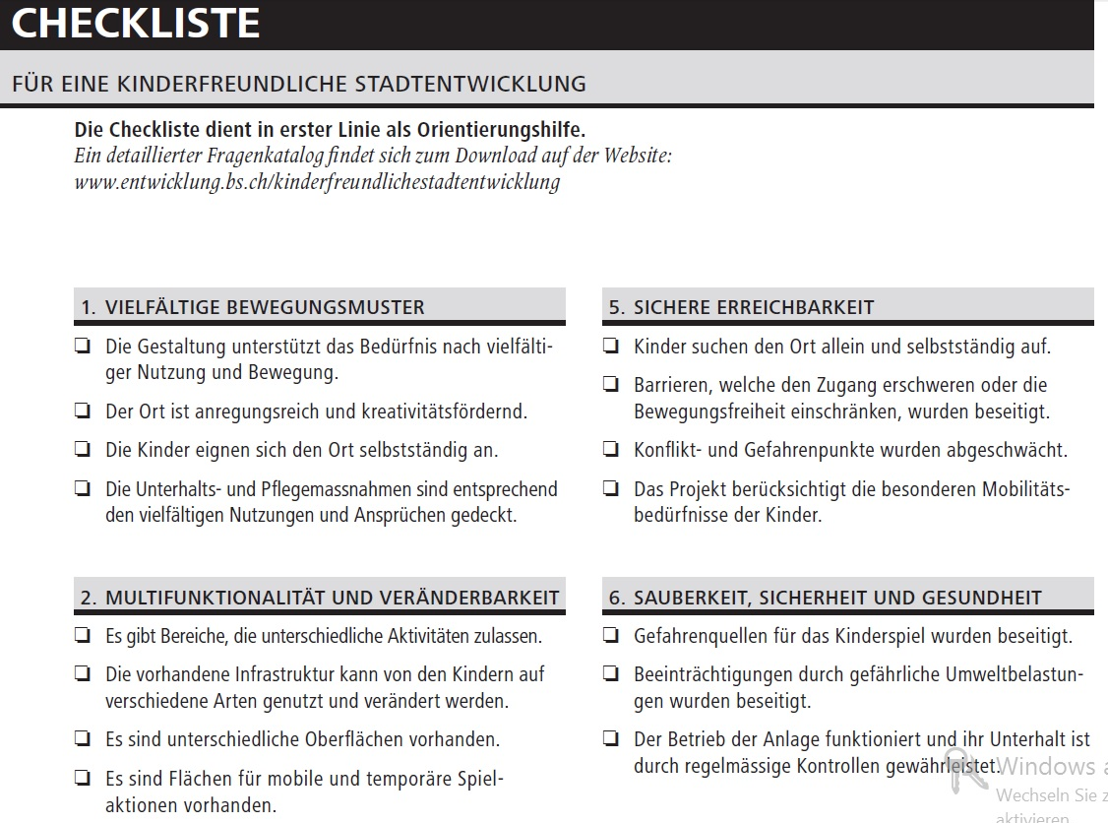
Practice: Guidelines
Basel: Guidelines for child-friendly urban development (Source: http://www.entwicklung.bs.ch)

Slide 32
Practice: Action days
VCD: Walking bus and action days (Source and tips for organisation: vcd.org)

Slide 33
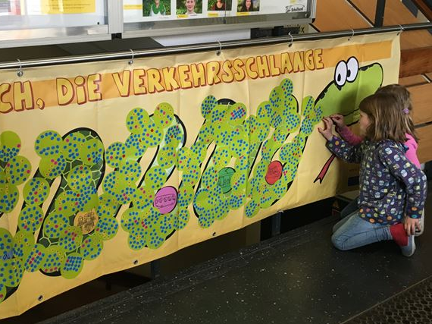
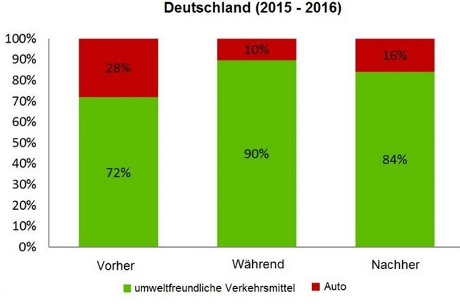
Practice: Action days
Germany (2015 – 2016)
Before
During
After
environmentally friendly means of transport
Car
Traffic snake Zora Zisch (Source: schule-brehmweg.hamburg.de)

Slide 34
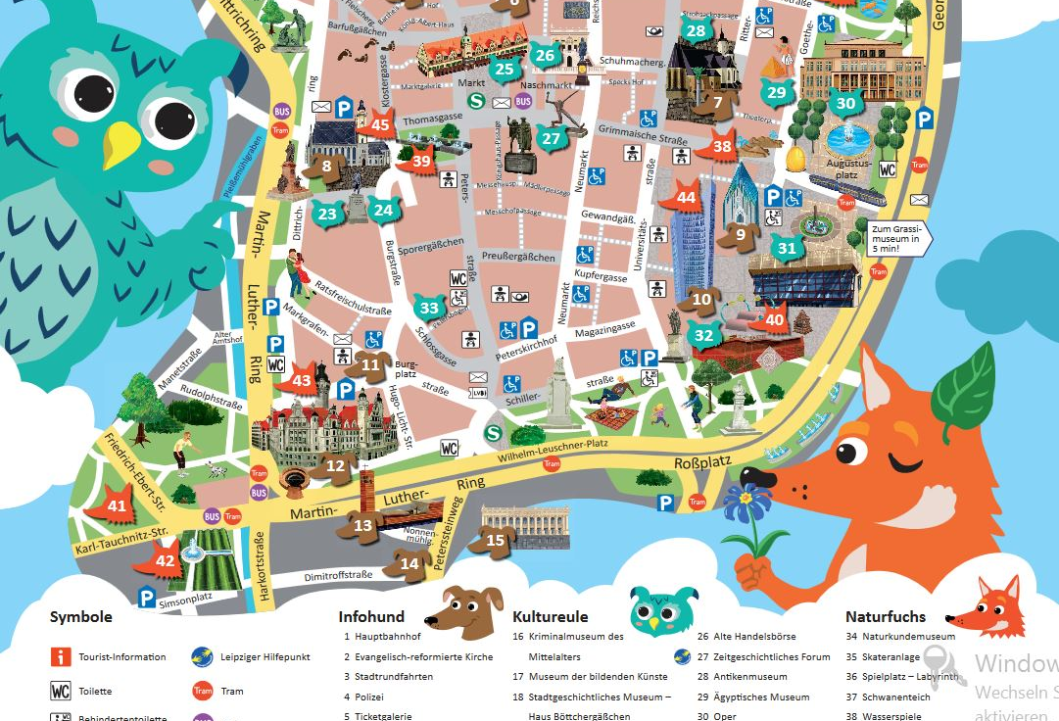
Practice: Children's city map
Leipzig city map for children (source: leipzig.de)

Slide 35
Involving children
analysis
„radical" inter-viewers
transfer
facilitators
multiplier
implementation
motivators
judges
empowerment
evaluation

Slide 36
Practice: Further links and ideas
www.eltis.org
www.civitas.org
www.epomm.eu (there: Platform EPOMM and Conference ECOMM)
www.butz-stiftung.de (safety in traffic)
Activate parents (and grandparents!)
Use good opportunities: summer festival, school refurbishment, European Mobility Week ...
Find partners/funding.
You are the experts!

Slide 37
More mobility and more safety with less transport for a better children's mobility
Faculty of Transport and Traffic Sciences – Chair of Transport Ecology
Prof. Dr.-Ing. Udo Becker
Dipl.-Ing. Rosemarie Baldauf
2021
Grant Agreement No.:
2019-1-PL01-K1203-065244

