Slide 1
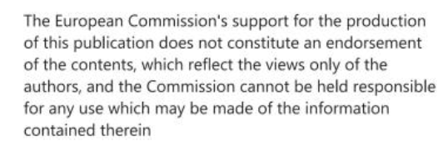
Sustainable urban mobility plans (SUMP) – Mobility vision
S@mpler
Integrated Education Based On Sustainable Urban Mobility Projects

Slide 2
Topic in the sump cycle
S@mpler
SUMP – Mobility vision
05 – Develop vision and common strategy

Slide 3
Making a vision – based on analysis of current and future situation
S@mpler
SUMP – Mobility vision
Strategic vision for the city
Problem analysis
Mobility development scenarios for the city
Winning scenario -
more sustainable modal split
Mobility vision

Slide 4
Vision as a joint decision
S@mpler
SUMP SUMP – Mobility vision
Making a common vision – what mobility in the city should look like in the long run
Active involvement of key partners and the public

Slide 5
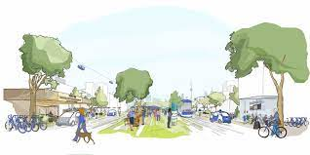
Common mobility vision
S@mpler
SUMP – Mobility vision
= foundation for all other steps – definition of goals and measures
The vision has to be common – well consulted – city, partners, representatives of target groups and the public
consensus assured
+ political commitment

Slide 6
Preparing the mobility vision
S@mpler
SUMP – Mobility vision
What transport? Priorities?
How will the city differ from other cities in terms of transport?
What city do we want to live in? What impacts will the intended transport have?
Vision puts mobility in the urban space and social development

Slide 7
Context of other policies Findings from analysis
S@mpler
SUMP – Mobility vision
strategic city development plan
spatial policy
Agenda 21, environment
economic development
social dimension
health
safety
Data
Master plans
Development scenarios
Winning scenario

Slide 8
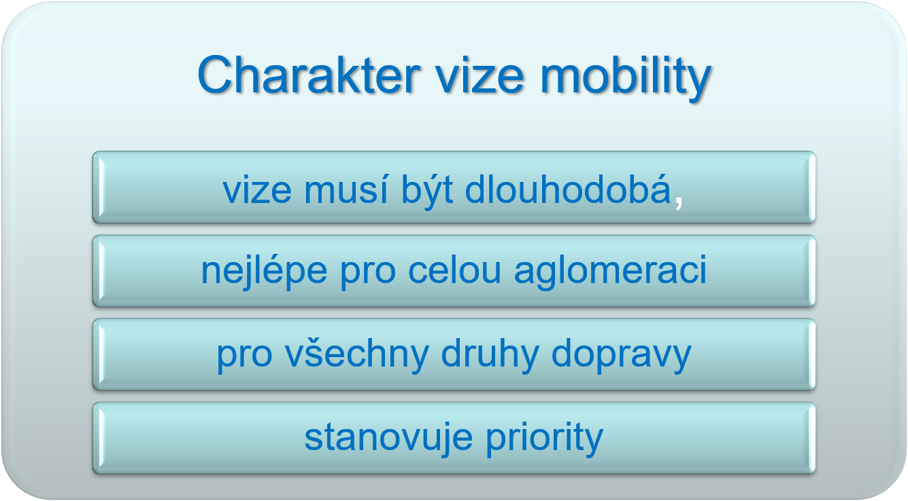
S@mpler
SUMP – Mobility vision

Slide 9
Working group for SUMP vision preparation
S@mpler
SUMP – Mobility vision
Representatives of the city, region, surrounding municipalities, state (e.g., RMD)
Representatives of transport services: providers, users
Representatives of other areas: environment, health, economic development, entrepreneurs (chamber of commerce and major employers)
Representatives of target groups – e.g., city inhabitants (different ages), employees
Other concerned partners
Representation of main groups is important for vision acceptance

Slide 10
Mobility vision on a good data foundation
S@mpler
SUMP – Mobility vision
current transport data and their interpretation, results of transport sociology surveys
information on demographics and other areas
overview of existing policies – what documents are in force and how they concern transport, mobility
Without knowing the status quo, it is not clear where the vision is to aim and what must change

Slide 11
Mobility vision consultations – information for public consultations
S@mpler
SUMP – Mobility vision
in a narrower “Mobility vision” working group – develop information for quality public presentation
Information package:
importance of SUMP, why influence mobility
conclusions of analyses – SWOT, present state and what development is probable (incl. scenarios)
what we want to achieve – design of the vision (working group outcome), or its options
Consensus will be more difficult if not impossible without good preparation for the consultations.

Slide 12
Mobility vision consultations – meeting with the public
S@mpler
SUMP – Mobility vision
Clear presentation of information – SUMP idea, reality and draft vision
Consultation – arguments for the vision, opinions from the plenary and agreement over the final vision
Publication of the final Mobility vision using popular and tried-and-tested communication channels for public consultation of projects
Consensus will be more difficult if not impossible without good preparation for the consultations.

Slide 13
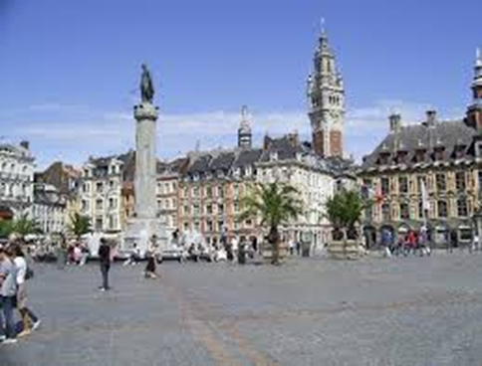
Example vision – Lille (France)
S@mpler
SUMP – Mobility vision
“A city that is economically strong, attractive, with an
international and European profile, with
renovated public spaces,
with an emphasis on traffic control and mobility
implemented by sustainable modes of transport”.

Slide 14
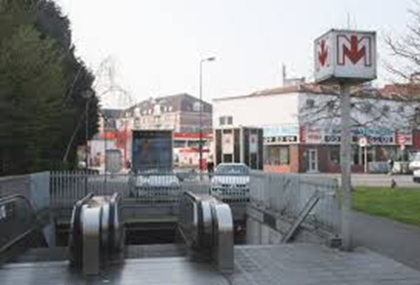
Example vision – Lille (France)
S@mpler
SUMP – Mobility vision
Important strategic question:
Continue developing the metro or surface PT (buses and trams)?
Choice:
development of surface transport – opportunity to redistribution, renovation and increased attractiveness of public spaces
Solution: “high-quality bus lines” and “train-tram”

Slide 15
Example SUMP vision – České Budějovice (Czechia)
S@mpler
SUMP – Mobility vision
BALANCE – strive for a balanced access for all modes of transport to city areas based on their specific character
EFFICIENCY – support development of different modes of transport in directions where their benefit for the city is greatest, where the efforts expended will reflect in a noticeable improvement
COOPERATION – create conditions for better interconnection among modes of transport, integration of new technologies and procedures in the existing environment

Slide 16
Next stage: setting of measurable goals – 06 in the SUMP cycle
S@mpler
SUMP – Mobility vision
Goals:
define desirable changes, in which areas improvements should occur, what is to be “reduced, increased, maintained”, e.g., reduce traffic jams, increase share of PT, etc.
should be SMART (see diagram below), measurable using concrete indicators and ideally with set quantitative targets
usually divided into main (priority) and secondary (specific)

Slide 17
References, Sources, Bibliography
SUMP – Mobility vision
EU SUMP Guidelines - Rupprecht Consult (editor), Guidelines for Developing and Implementing a Sustainable Urban Mobility Plan (SUMP), Second Edition, 2019.

Slide 18
Thank you for your attention!
S@mpler
Integrated Education Based On Sustainable Urban Mobility Projects
Project information:
The main project objective is to enhance the quality of teaching at the involved universities in the field of sustainable urban mobility management. Our efforts consist in expanding students‘ practical skills through implementation of a practical project teaching method. An emphasis is put on the reflection of challenges which cities have to tackle in the real world, especially in the area of Sustainable Urban Mobility Plans (SUMP). The project is intended to contribute to improving students‘ knowledge and skills, particularly for the position and job placement of mobility managers.
Topic elaborated by: Radomíra Jordová
mobilita-ieep.cz
Link to the web database

Slide 19
CORRESPONDING PART FOR TEACHERS AND THEIR COMMUNICATION WITH STUDENTS

Slide 20
Tasks for students
S@mpler
SUMP – Mobility vision
Why is a mobility vision made? What does it help? What does it prevent?
What are the background information for vision making?
What activities precede the mobility vision making?
How to prepare for consulting the vision, with whom to make it and consult it?

Slide 21
Thank you for your attention!
S@mpler
Integrated Education Based On Sustainable Urban Mobility Projects
Project information:
The main project objective is to enhance the quality of teaching at the involved universities in the field of sustainable urban mobility management. Our efforts consist in expanding students‘ practical skills through implementation of a practical project teaching method. An emphasis is put on the reflection of challenges which cities have to tackle in the real world, especially in the area of Sustainable Urban Mobility Plans (SUMP). The project is intended to contribute to improving students‘ knowledge and skills, particularly for the position and job placement of mobility managers.
Topic elaborated by: Radomíra Jordová
mobilita-ieep.cz
Link to the web database

