Slide 1
Transport Policy 2 Sustainable development
Faculty of Transport and Traffic Sciences – Chair of Transport Ecology
Prof. Dr.-Ing. Udo Becker
Prof. Dr.-Ing. Udo Becker
2021

Slide 2
By the way: Sustainable transport development
Brundtland definition
Sustainable development is development,
1. that meets the needs of the present and
2. without compromising the ability of future generations to meet their own needs.
In transport:
1. Meeting the mobility needs of all people today,
2. but with fewer risks, externalizations, emissions, land, noise, injustices, acidification, CO2, ...
Need-based mobility with less transport

Slide 3
Rio de Janeiro
Rio 1992: Agenda II of humanity, in transport:
Structures that reduce transportation demand
Funding of public transport systems
Supporting non-motorized transport
Integrated planning, smooth public transport, network maintenance
Information exchange (countries and municipalities)
New consumption and production patterns to reduce energy and resource consumption
Source: Agenda 21, Rio- documents (UN), Kap. 7.52: Promoting sustainable human settlement development

Slide 4
The Vancouver Principles (OECD 1996)
#1 Access: People have a right of access to people, places, goods and services
#2 Equity:
The transportation needs of all must be secured in a way that ensures equity among people, regions, and generations
#3 Individual and Community Responsibility:
People and societies are responsible for protecting the environment in their decisions
#4 Health and Safety:
Transportation systems must protect health and safety and improve quality of life
#5 Education and Public Participation:
People and societies must be integrated in this process

Slide 5
The Vancouver Principles (OECD 1996)
#6 Integrated Planning:
Transportation planning must integrate environment, health, energy, finance, and urban design quality
#7 Land and Resource Use:
Transportation systems must use land and natural resources sparingly or protect them
#8 Pollution Prevention:
Transport needs must be met without endangering health, climate, biodiversity and ecosystems
#9 Economic Well-Being:
Pricing should work for sustainable transportation; the full current and future costs should be charged to users

Slide 6
Efficiency in transport : Tau-Eta
Efficiency: Ensuring needs for all - with minimal effort (traffic)
Then we could set clear goals.
and compare measures from all fields.
Policy department would have a truly integrative effect.
We could compare districts, cities, groups with each other.
For the first time, it would be clear which investment secures which needs.
τη :=
Needs covered (per person, household, group, district)
€ _{private} + € _{public} + € _{time} + € _{energy} + € _{space} + € _{pollution} + € _{noise} + € _{trash} + €${ CO}_{2}$ …

Slide 7
Imagine the following table (as an example only):
 | People | Needs | All Costs | Efficiency | Deficits/Comment
City in NL | 2 million | 6 million | 3 million | τη = 2.0 | Good
City in DE | 3 million | 6 million | 6 million | τη = 1.0 | o.k.
City in USA | 12 million | 16 million | 32 million | τη = 0.5 | Mobile without a car?
6-10, School by foot | 10 000 | 10 000 | 2 000 | τη = 5.0 | 5 mobilities / €
Shopping (400m) | 100 000 | 25 000 | 25 000 | τη = 1.0 | o.k.
Pharmacy (all) | 100 000 | 10 000 | 20 000 | τη = 0.5 | „Suburban“
Place w/o pharmacy | 1 000 | 100 | 1000 | τη = 0.1 | Little and expensive
> 65 to the doctor | 1 000 | 100 | 500 | τη = 0,2 | Slightly better
> 65 to pharmacy | 1 000 | 100 | 500 | τη = 0.2 | Too little, expensive
0-10, playground | 1 000 | 400 | 800 | τη = 0.5 | Unsatisfactory
18-65 to work | 1 000 | 100 | 250 | τη = 0.4 | Large scatters
Local office with PT | 1 000 | 20 | 200 | τη = 0,1 | outside?

Slide 8
Key elements of planning
It comes down to needs, to mobility: That is the task!
Priority is mobility planning: Measure, plan, guarantee.
Then create minimal traffic for it,
Allowing people to choose, above all, cost-efficiently.
A lot of mobility with little traffic? Or much traffic for little mobility?
Efficiency=mobility / (money + time + energy + accidents + noise + exhaust ...)
Balancing users and stakeholders, customers and citizens ...
... endurable. Sustainable. Stabilized. Participative.
How can sustainable transportation development be acceptable?

Slide 9
Very important!
By no means despair! There is no reason to do so!
Do you have the impression that I am a pessimist? (That would be wrong.)
Never have we had so much knowledge and possibilities.
The demands are enormous - so what? All chances!
Perhaps you would rather not have lived on earth?
Or in another time? When then?
Right now, it's about the crucial transition: from people's Agenda I ("More is better!") to people's Agenda II ("More stable is better!").
"More", by the way, does not make people happier after a certain point!
How can sustainable transport development be implemented acceptably?

Slide 10
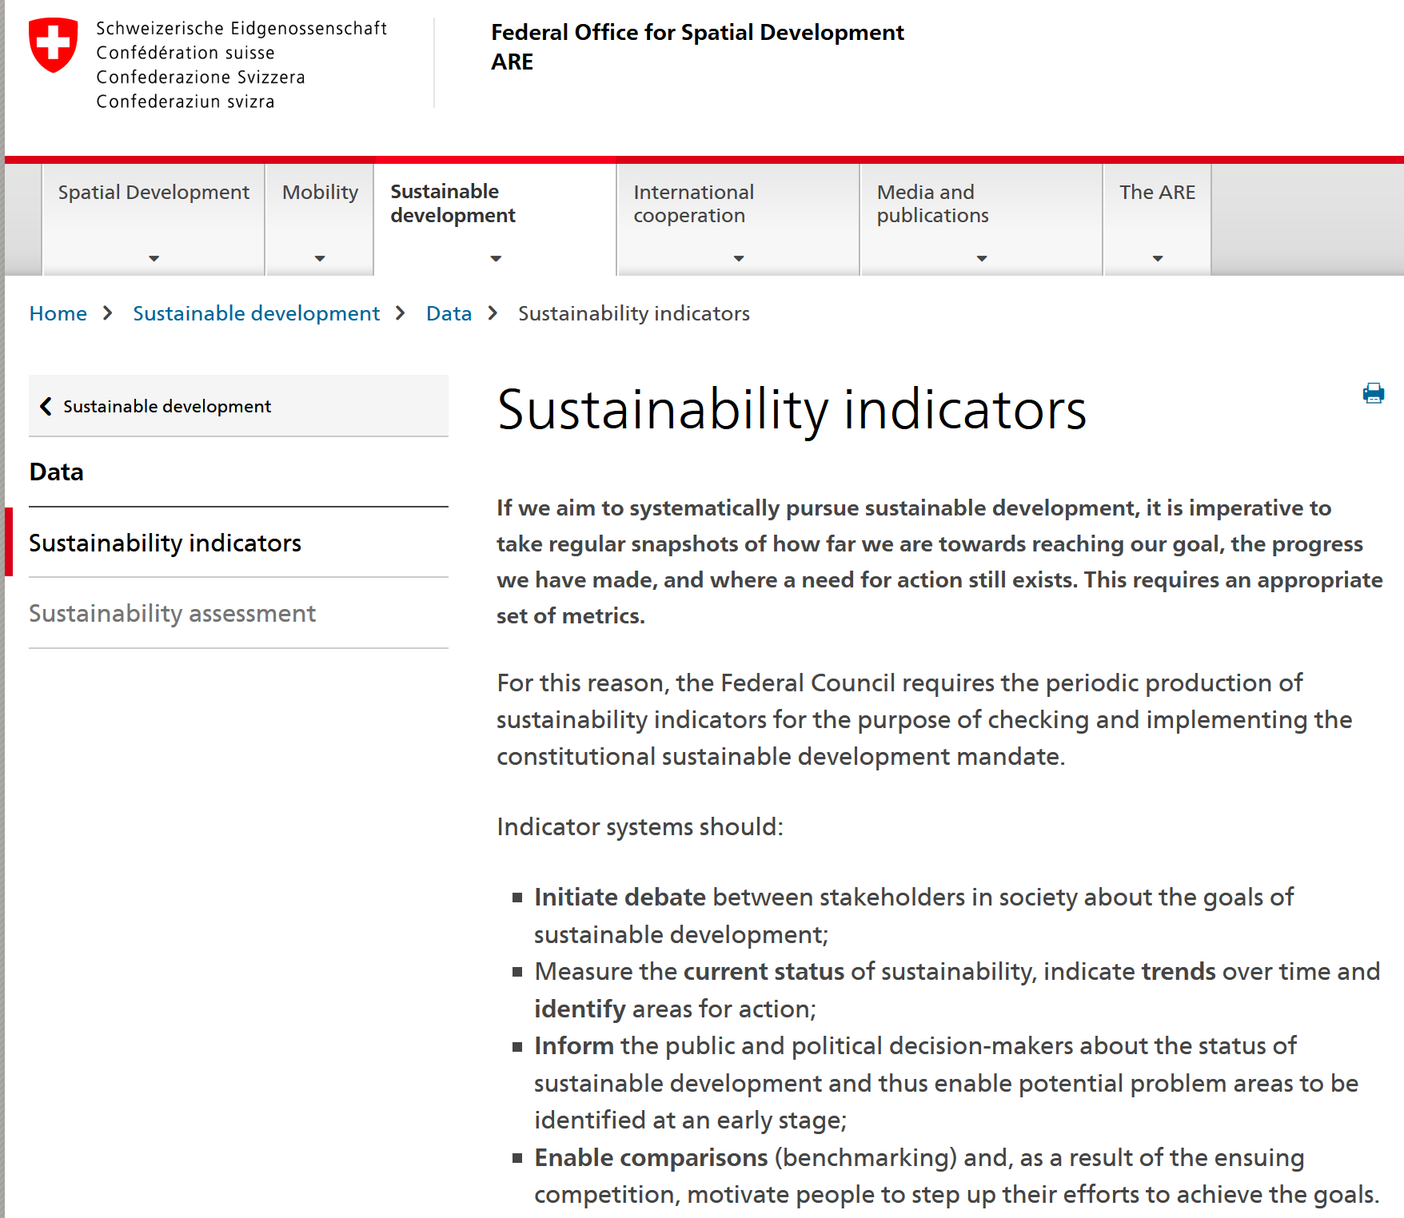
5. Example for encouragement: Switzerland
Source: https://www.are.admin.ch/are/en/home/sustainable-development/data/sustainability-indicators.html

Slide 11
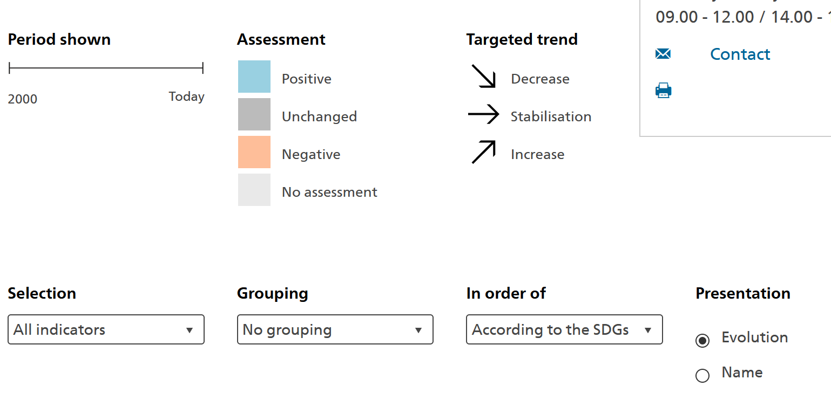
Switzerland: The MONET 2030 indicator system
“The MONET 2030 indicator system gives an overview of sustainable development in Switzerland, providing a picture of the progress made towards the 17 sustainable development goals (SDG) of the United Nations 2030 Agenda as well in relation to certain topics specific to Switzerland. Comprising over 100 indicators relating to the three environmental, social and economic dimensions, the system is structured around the 17 SDGs.”
Source: https://www.bfs.admin.ch/bfs/en/home/statistics/sustainable-development/monet-2030.html

Slide 12
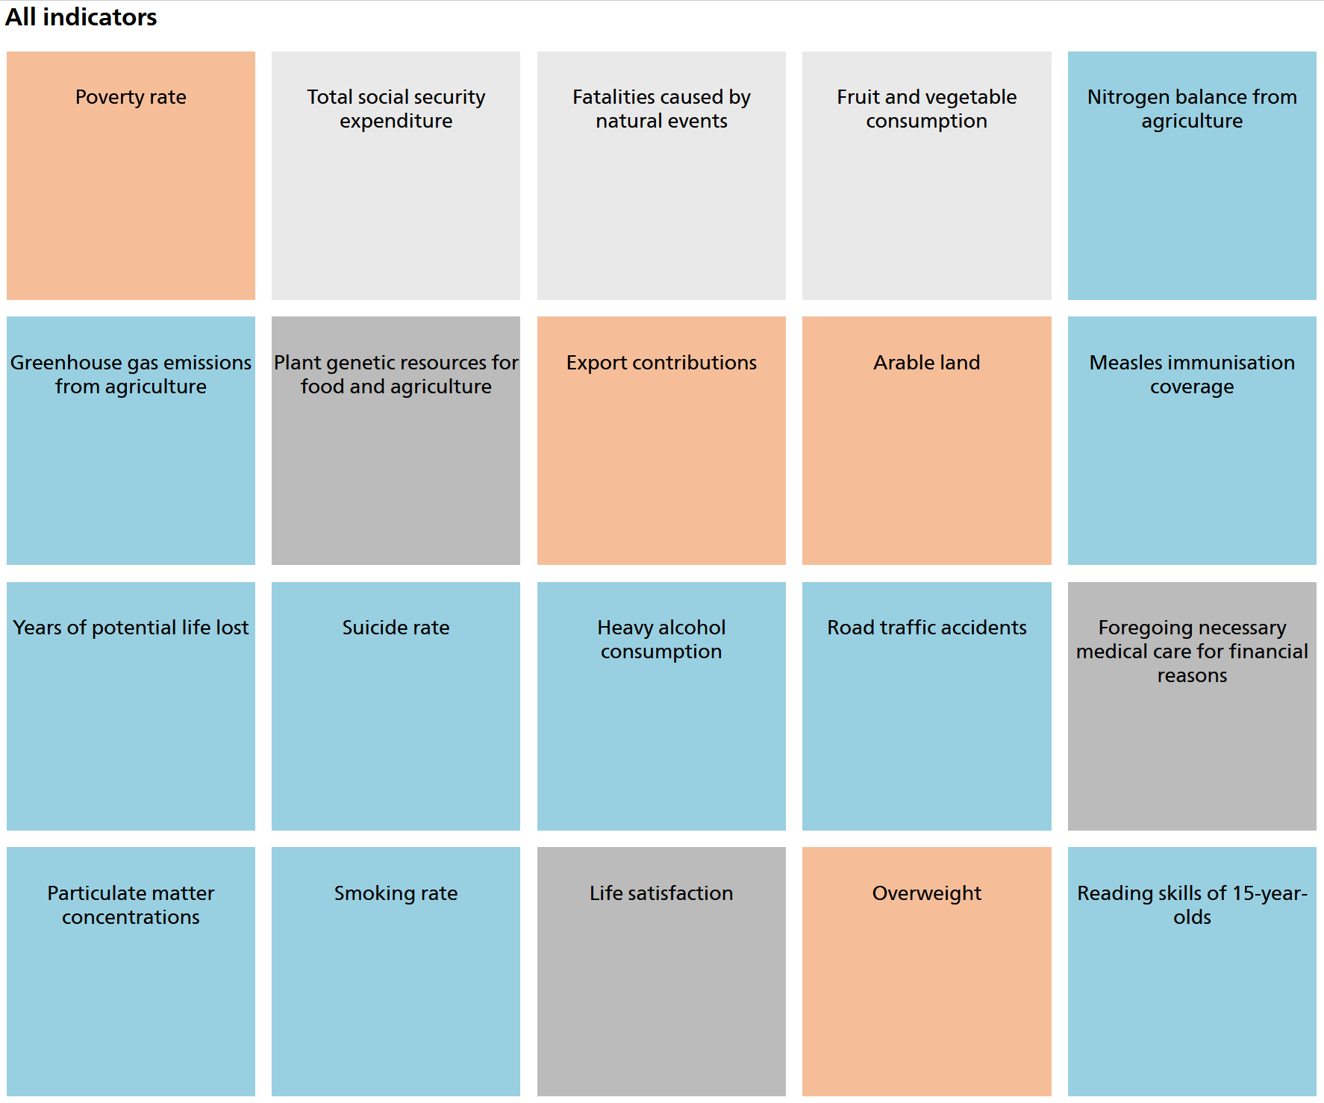
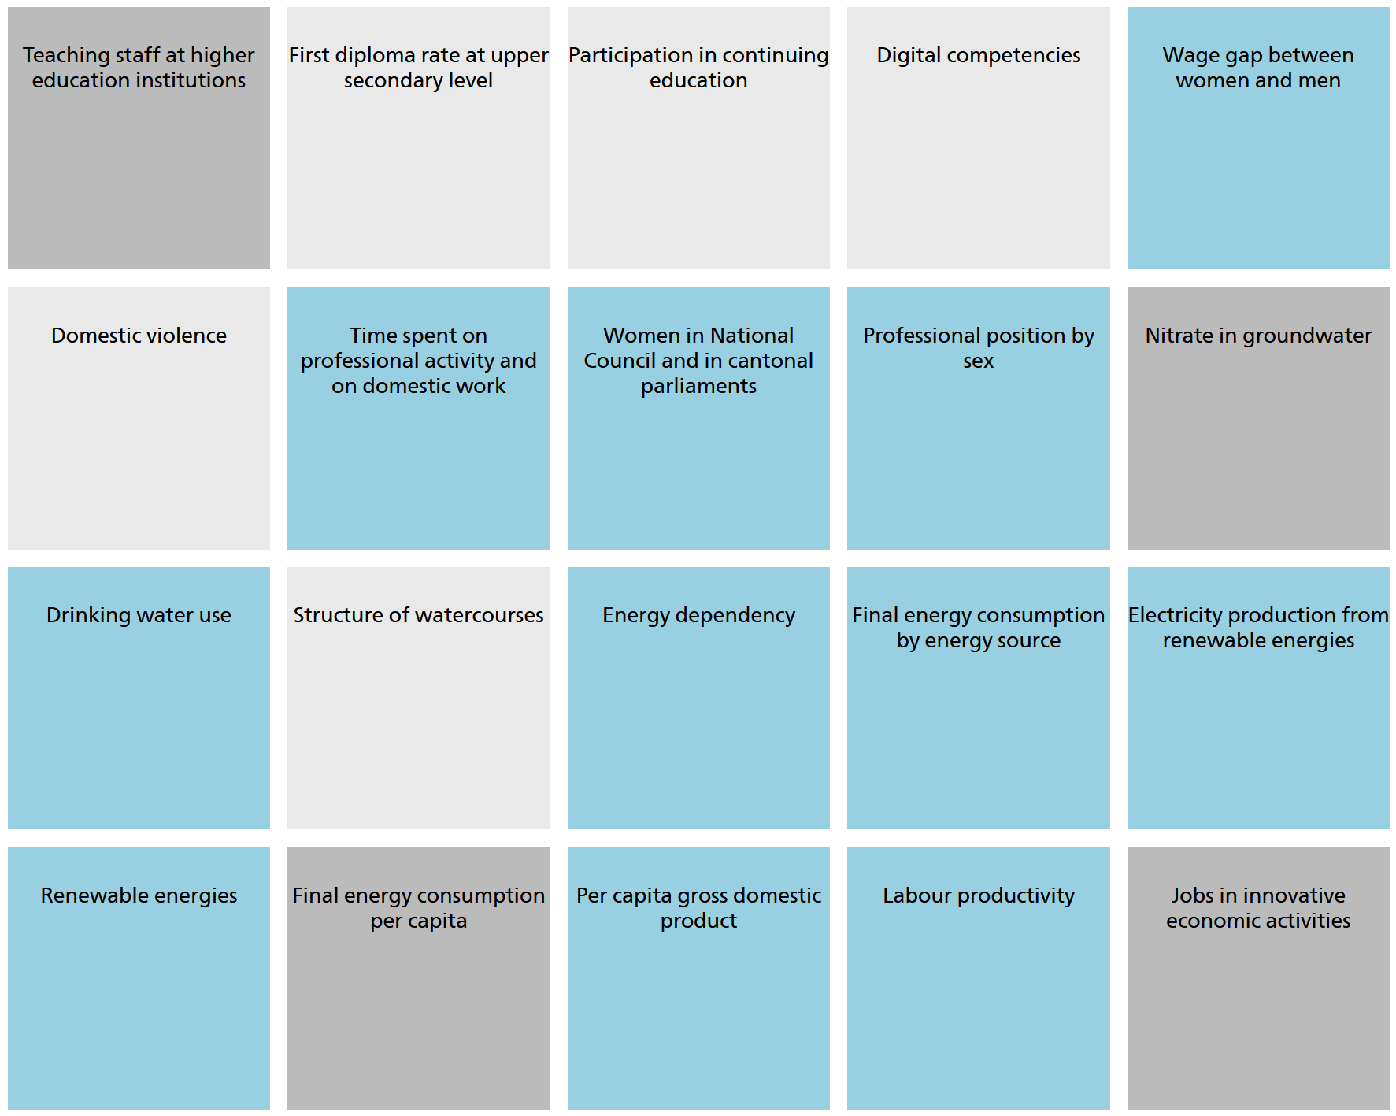
Switzerland: The MONET 2030 indicator system
Indicators (Selection)
Source: https://www.bfs.admin.ch/bfs/en/home/statistics/sustainable-development/monet-2030.html

Slide 13
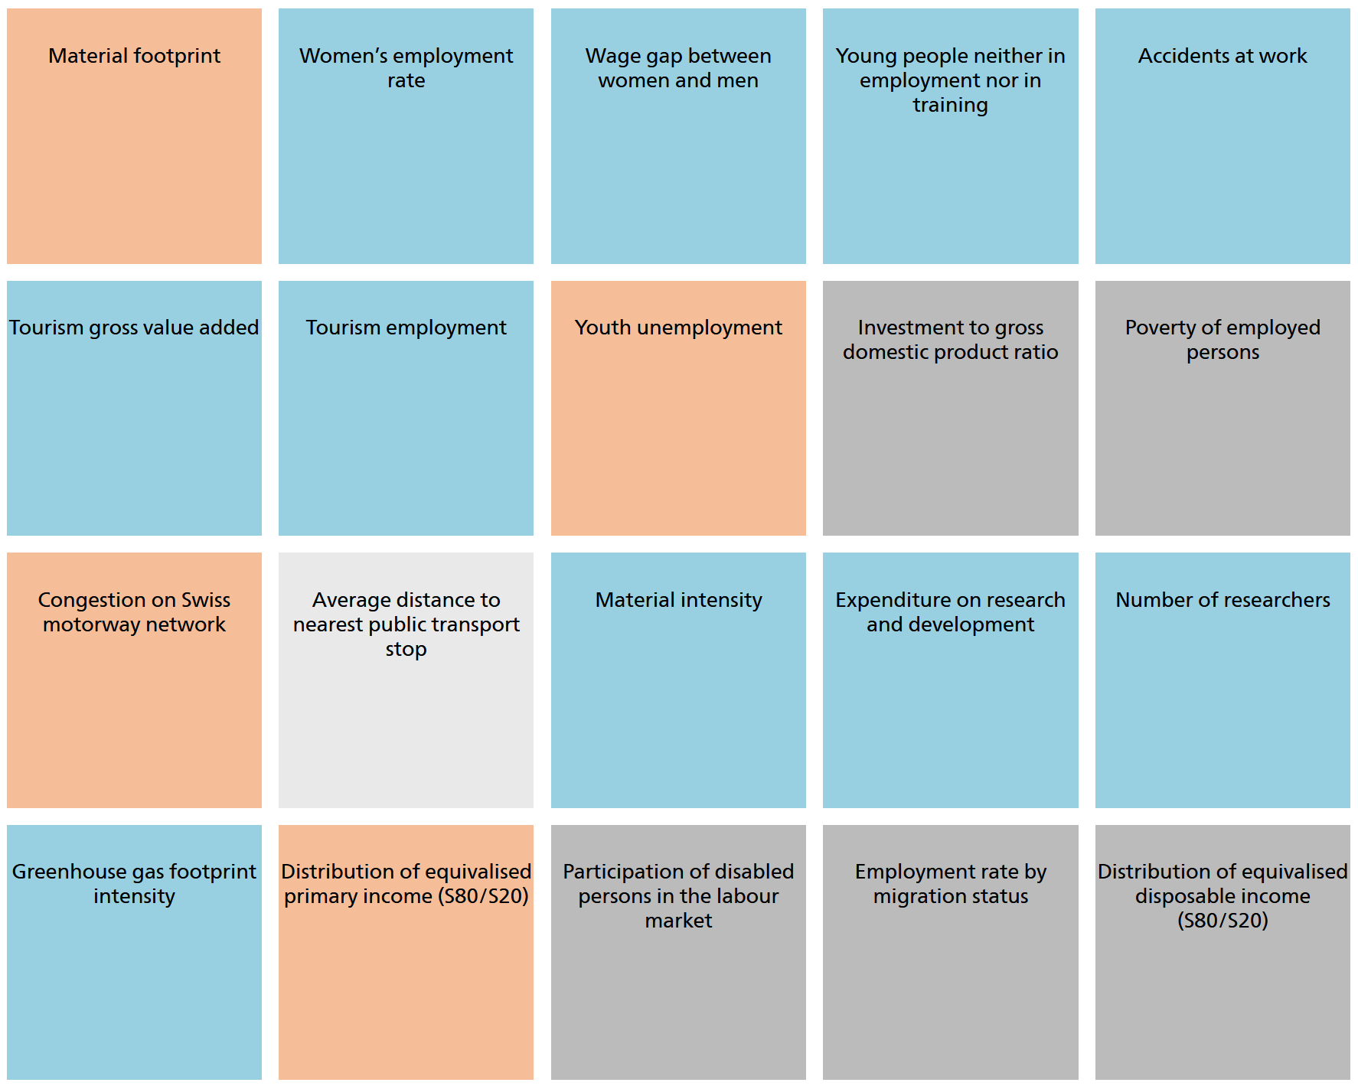
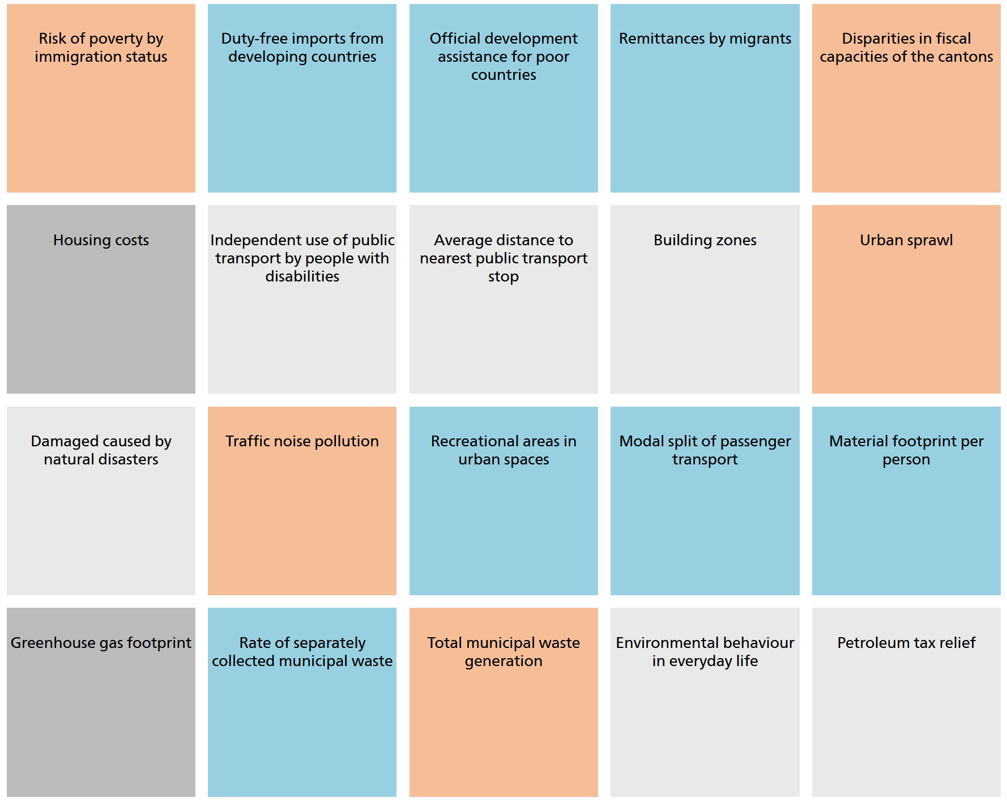
Switzerland: The MONET 2030 indicator system
Indicators (Selection)
Source: https://www.bfs.admin.ch/bfs/en/home/statistics/sustainable-development/monet-2030.html

Slide 14
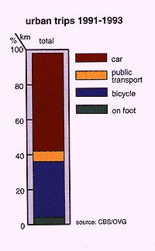
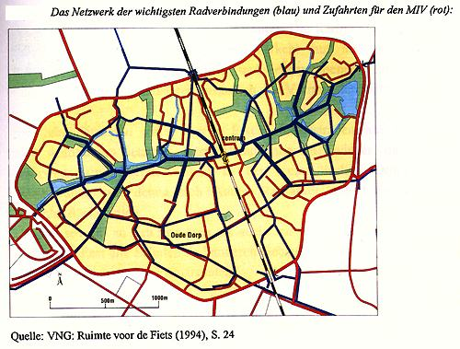
Spatial Planning, Houten (NL)
The network of the most important bicyle connections (blue) and access roads for motorized individual traffic MIT (red)
Source: CBS/OVG
Source: VNG; Ruimte voor de Fiets (1994), p. 24

Slide 15
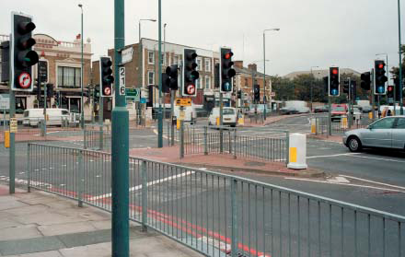
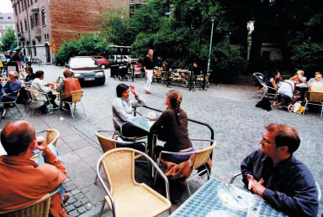
Shared Space (Mondermann)
Tip 1 The street tells its story: uses
Tip 2 A space for people: needs
Tip 3 The people have the say: planning
Tip 4 Success is in the details: materials, implementation, "love".
Tip 5 Better “messed up” than seemingly safe (One of the biggest mistakes is giving the illusion of safety).

Slide 16
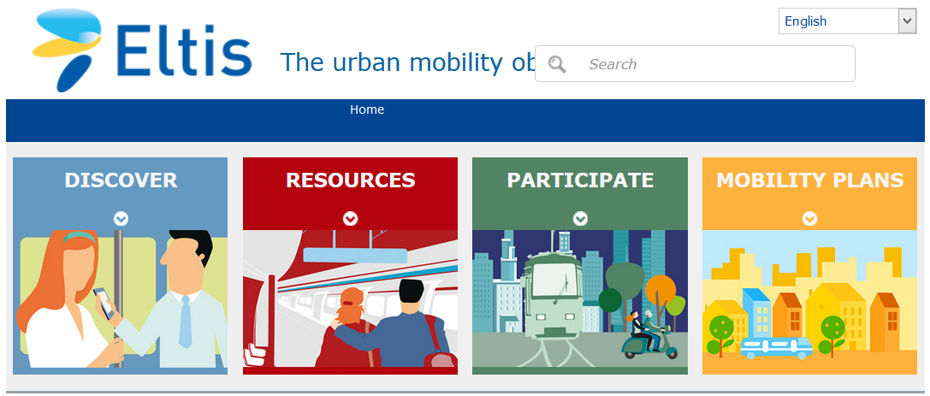
SUMP (EU Commission)
www.eltis.org The SUMP concept
www.epomm.eu MaxSumo

Slide 17
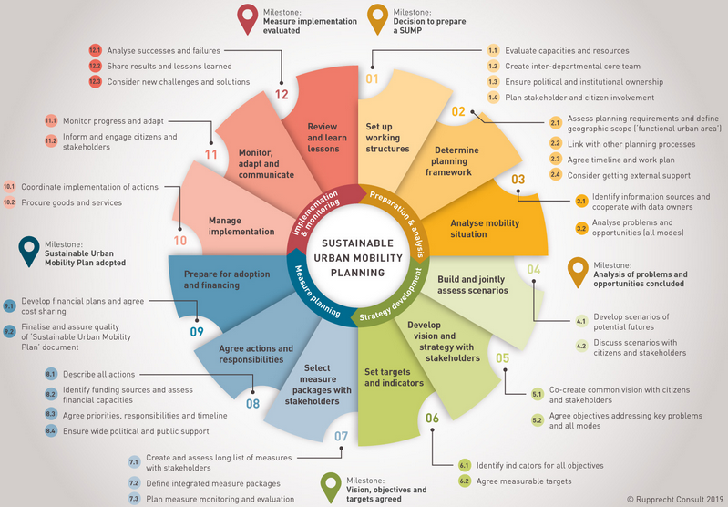
Sustainable Urban Mobility Plan (SUMP)
Source: http://www.rupprecht-consult.eu/uploads/tx_rupprecht/SUMP_Guidelines_2019_mediumres.pdf

Slide 18
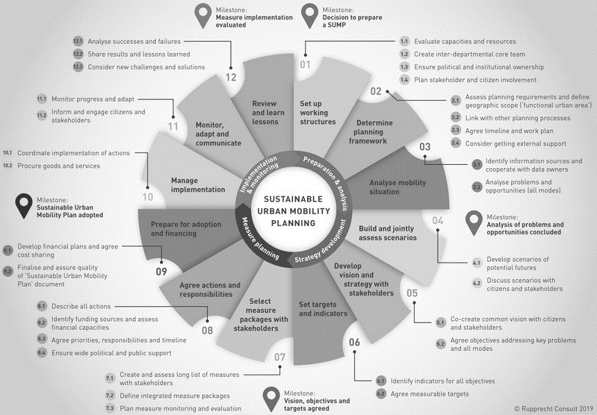
Sustainable Urban Mobility Plan (SUMP)
In step 7, the package of measures is defined:
Please always as a push & pull package, and in this package:
Make that more attractive what helps
Make that unattractive what is harmful
And this is will then be evaluated!
Source: http://www.rupprecht-consult.eu/uploads/tx_rupprecht/SUMP_Guidelines_2019_mediumres.pdf

Slide 19
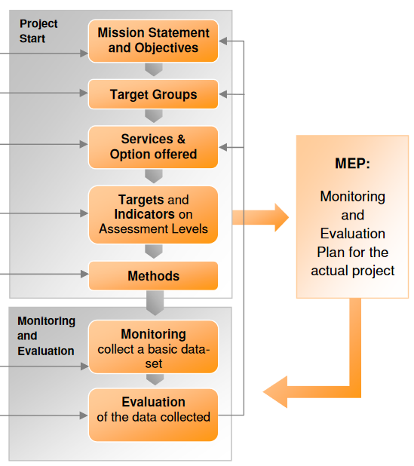
M&E : Monitoring and Evaluation, MaxSumo
Every plan needs to include M&E in an appropriate form! Tips for doing so:
You can design any possible plan.
You can use any set of indicators (at least one indicator).
You can define any approach/target group.
You should not work without M&E!
Source: http://epomm.eu/sites/default/files/files/MaxSumo_english.pdf

Slide 20
Monitoring & Evaluation – Projects at our Chair
MobilBericht wants to develop basics for a comprehensive monitoring for mobility (!) - for better planning.
Monitoring of:
Objective accessibility of places to cover needs ("city map")
Realized coverage of needs
Subjective assessments of the situation
Effects of traffic
Always both subjective and objective
In Metamorphosis, innovative approaches to make neighborhoods and transport child-friendly, based on MaxSumo, are evaluated.
Monitoring of implementation processes and results of the measures in seven European cities.
Evaluation of the implementation and results in order to identify suitable measures and to give tips for successful implementation.
METAMORPHOSIS

Slide 21
Conclusion: Transportation policy & development
Transport policy: Dynamic game of all actors and interests, often short-sighted
„Less traffic“ seems scary: Show advantages (proximity, innovation, ...)
Forecasts are instruments: Dependent on task and assumptions
Systems and models: Will help you, dynamically! Form scenarios!
Planning must not focus on traffic, congestion or vehicles. Planning must focus on people: Mobility, needs, inclusion.
No planning without Monitoring and Evaluation M&E!
From Agenda I to Agenda II: Sustainable development, for all: SUMP
The one that starts
has the hardest time
benefits ecologically first: e.g. clean air
benefits economically: smooth change
benefits socially: people have time
benefits in business terms: jobs, patents, profit
Never before have we had so many opportunities: I wish you all the best!

Slide 22
Transport Policy 2 Sustainable development
Faculty of Transport and Traffic Sciences – Chair of Transport Ecology
Prof. Dr.-Ing. Udo Becker
Prof. Dr.-Ing. Udo Becker
2021
Grant Agreement No.:
2019-1-PL01-K1203-065244

