Slide 1
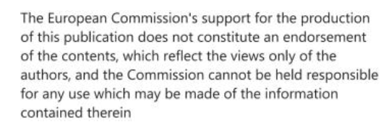
Inbound/outbound commute analysis
S@mpler
Integrated Education Based On Sustainable Urban Mobility Projects

Slide 2
Topic in the sump cycle
Inbound/outbound commute analysis
3.2 – Analyse problems and opportunities (all modes)

Slide 3
Spatial movement of inhabitants
Inbound/outbound commute analysis
4 basic types of spatial movement of inhabitants
Migration (moving) – permanent change of place of residence
Temporary changes of residence (seasonal migration) – changes of place of residence for a specified time, e.g., due to seasonal work in agriculture or construction industry, moving for studies
Commute to work and school – relatively regular movements – passengers move at relatively regular times, using the same routes and distances, mostly using the same modes of transport
Irregular temporary movement of inhabitants – trips for recreation, shopping, services, business trips, etc. – differ in direction, number of passengers, modes of transport, destination and distance
Commute to work and school
Significant component of spatial mobility of inhabitants
Caused by discrepancy in location
of economically active population/population groups going to school and job opportunities/schools
Job opportunities and schools are typically highly concentrated
Affects formation of functional and spatial links in settlement structure – inhabitants satisfy their needs in settlements other than their place of residence

Slide 4
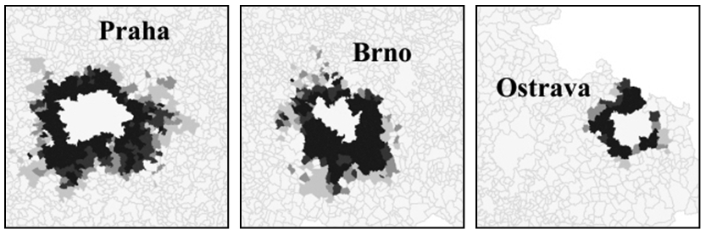
Indicators for expressing inbound/outbound commute
Inbound/outbound commute analysis
absolute numbers of inbound/outbound commuters,
inbound/outbound commute balance (inbound - outbound, or outbound - inbound),
inbound/outbound commute intensity (share of commuters in total economically active inhabitants of the settlement),
number of occupied jobs in the municipality (occupied jobs = economically active + inbound commuters - outbound commuters; can be converted per 100 or 1000 economically active citizens),
inbound/outbound commute regions (area from which people travel to a centre)
first define centres (e.g., based on number of occupied jobs, number of economically active citizens, inbound commute prevails over outbound, etc.)
then define the commute region – municipalities are associated with a respective centre based on prevailing travel

Slide 5
Factors of commute extent
Inbound/outbound commute analysis
changes in industry and social/professional structure (postwar industrialization, changes in agriculture, promotion of areas with concentrated heavy industry, significant changes in the 1990s – large heavy industry facilities broke down, economic activity scattered, etc.),
changes in spatial distribution and concentration of job opportunities,
development of transport (public vs private transport → greater spread of commute directions),
urbanization and suburbanization (1990s),
changes in living conditions and standards,
growing regional differences
housing unavailability (commute substitutes for migration or is its initial stage).
→ Resulting in:
postwar increase in work mobility of the population, particularly in the hinterland of larger cities and industrial centres (regions)

Slide 6
Sources of data on commute
Inbound/outbound commute analysis
Direct – surveys on information focused on commute (questionnaire, interview), census
Indirect – data from employers, company databases, transport providers, mobile phone operators
Exhaustive (census)
Selective (only a sample of population in a territorial unit)
VŠPS – selective workforce survey (quarterly …0.5%)
Example of use of mobile phone operator data
https://data.gov.cz/%C4%8Dl%C3%A1nky/geoloka%C4%8Dn%C3%AD-data-mobiln%C3%ADch-oper%C3%A1tor%C5%AF-principy-p%C5%99%C3%ADklady-ot%C3%A1zky

Slide 7
Commute structure
Inbound/outbound commute analysis
Spatial extent of commute
Within a district
Between districts of the same region
Between regions
By sex
Women often commute over shorter distances than men
By age
Commute intensity typically decreases with age – often replaced with migration or finding a job at the place of residence
By selected industries
By commute frequency
Daily or other frequency
By mode of transport
By size category of municipality of permanent residence
Work commute intensity decreases with growing municipality size

Slide 8
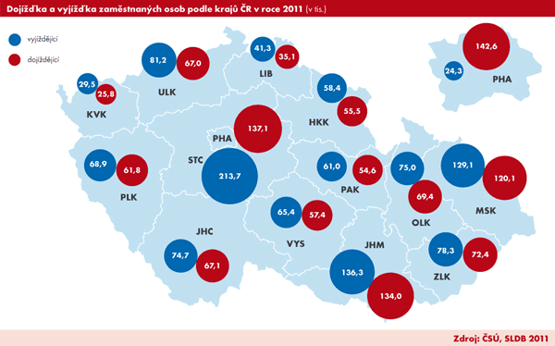
Inbound/outbound commute analysis

Slide 9
References, Sources, Bibliography
Inbound/outbound commute analysis
Atlas obyvatelstva https://www.atlasobyvatelstva.cz/
Sčítání lidu, domů a bytů https://www.czso.cz/csu/scitani2021

Slide 10
Thank you for your attention!
S@mpler
Integrated Education Based On Sustainable Urban Mobility Projects
Project information:
The main project objective is to enhance the quality of teaching at the involved universities in the field of sustainable urban mobility management. Our efforts consist in expanding students‘ practical skills through implementation of a practical project teaching method. An emphasis is put on the reflection of challenges which cities have to tackle in the real world, especially in the area of Sustainable Urban Mobility Plans (SUMP). The project is intended to contribute to improving students‘ knowledge and skills, particularly for the position and job placement of mobility managers.
Topic elaborated by: Kristýna Rybová
mobilita-ieep.cz
Link to the web database

Slide 11
CORRESPONDING PART FOR TEACHERS AND THEIR COMMUNICATION WITH STUDENTS

Slide 12
tasks
Inbound/outbound commute analysis
Find an up-to-date source of data on commute for your municipality and region, if any.
Does inbound or outbound commute prevail in your municipality? Is it possible to assess the purpose (e.g., a specific industrial facility, concentration of authorities, secondary school or university) for which people commute to/out of your municipality most often?
How can data on inbound/outbound commute be used in making mobility plans?

Slide 13
Thank you for your attention!
S@mpler
Integrated Education Based On Sustainable Urban Mobility Projects
Project information:
The main project objective is to enhance the quality of teaching at the involved universities in the field of sustainable urban mobility management. Our efforts consist in expanding students‘ practical skills through implementation of a practical project teaching method. An emphasis is put on the reflection of challenges which cities have to tackle in the real world, especially in the area of Sustainable Urban Mobility Plans (SUMP). The project is intended to contribute to improving students‘ knowledge and skills, particularly for the position and job placement of mobility managers.
Topic elaborated by: Kristýna Rybová
mobilita-ieep.cz
Link to the web database

