Slide 1
SUMP (Sustainable Urban Mobility Plan) An introduction
Faculty of Transport and Traffic Sciences – Chair of Transport Ecology
Prof. Dr.-Ing. Udo Becker
Prof. Dr.-Ing. Udo Becker
2021

Slide 2
Content and learning objectives
Content:
Introduction: SUMP - Sustainable Urban Mobility Plan
How can a municipality proceed to successfully move towards "sustainable development"?
Learning objectives:
Know SUMP (Sustainable Urban Mobility Plan)
Classify SUMP (Sustainable Urban Mobility Plan)
Recognise process design as an independent task
Every situation is different: recognise the window of opportunity
Repetition: Monitoring and evaluation for processes and impact of measures

Slide 3
1. Introduction: Mobility, Transport and the EU-27
The EU is above all a free trade union (plus more). Brussels can distribute money (farmers, Trans-European networks, subsidies).
Equal conditions for equal products. Conclusion: free movement of people and goods, harmonised.
Now there are very different problems in the 27 countries.
In the cities: "Traffic and mobility planning need improvement in many cases.”
Brussels is not really allowed to do anything. What can be done?
Make suggestions!
Source: europa.sachsen.de

Slide 4
Political background
2009: Urban Mobility Action Plan
Commission recommends sustainable urban mobility plans by providing information material, supporting exchange of best practices, identifying benchmarks and promoting training for mobility professionals. EU transport ministers support this (also Germany)!
March 2011: White Paper on Transport
"Roadmap to a Single European Transport Area - Towards a competitive and resource efficient transport system" (COM(2011) 0144). The White Paper recommends examining whether urban mobility plans according to national standards (based on EU guidelines) should become mandatory for cities of a certain size. ... further proposes an examination of whether funding from the regional development and cohesion funds for cities and regions should be linked to independently validated certification via a performance and sustainability audit for urban mobility.

Slide 5
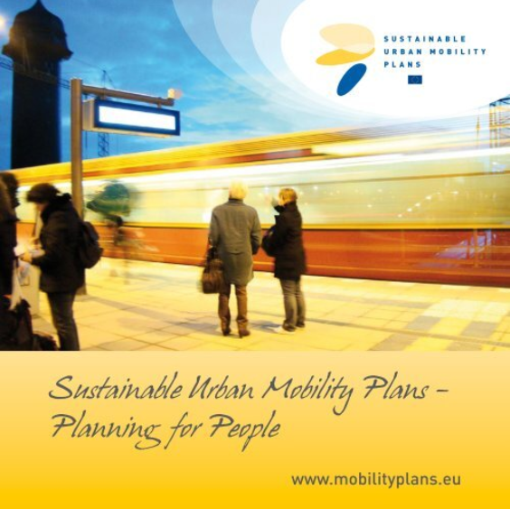
SUMP – Sustainable Urban Mobility Plan
Under the name SUMP the EU Commission supports the efforts of all other actors, to design "cities for people" instead of "cities for cars" as in the past.
Further information:
Eltis: Mobility Plans
and
New Guidelines for Sustainable Urban Mobility Planning

Slide 6
SUMP: Guidelines Version 2.0 from October 2019
… The new Sustainable Urban Mobility Planning (SUMP) guidelines were unveiled at the CIVITAS Conference in Graz, Austria.
… The Guidelines follow of an intense one-year stakeholder consultation process, including the cities, CIVITAS SUMP Projects, ELTIS and leading mobility researches. It has been validated in close cooperation with the SUMP community: by involving several major city networks, special care was taken to include feedback from all types of cities and regions.
… The Guidelines are available on Eltis – the urban mobility observatory, which has a been updated for the occasion and serve as a reference document for urban transport and mobility practitioners involved in the development and implementation of Sustainable Urban Mobility Plans (SUMPs).
… The best plans are awarded with the annual SUMP award. Nominations for the award are open until 31 October.
Source: https://ec.europa.eu/transport/themes/urban/news/2019-10-02-new-guidelines-sump_en

Slide 7
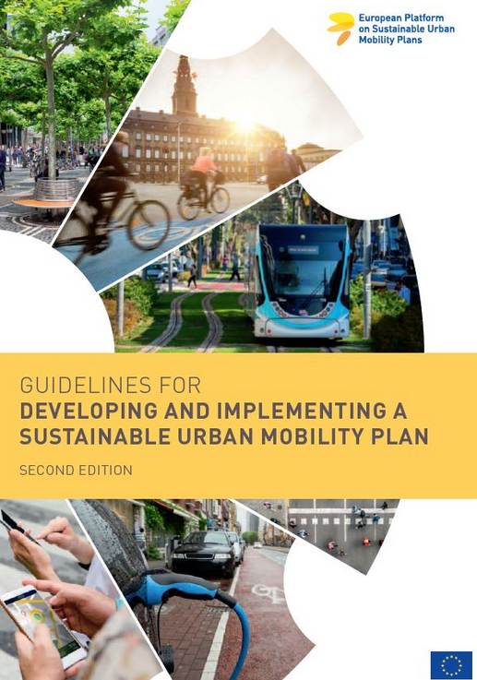
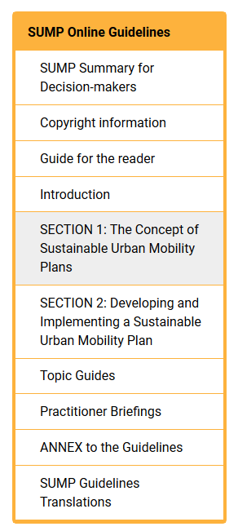
SUMP 2.0
Source: https://www.eltis.org/mobility-plans/guidelines-developing-and-implementing-sustainable-urban-mobility-plan-2nd-edition
Source: http://www.rupprecht-consult.eu/uploads/tx_rupprecht/SUMP_Guidelines_2019_mediumres.pdf

Slide 8
SUMP - Sustainable Urban Mobility Plan
Source: https://www.eltis.org/mobility-plans/sump-concept

Slide 9
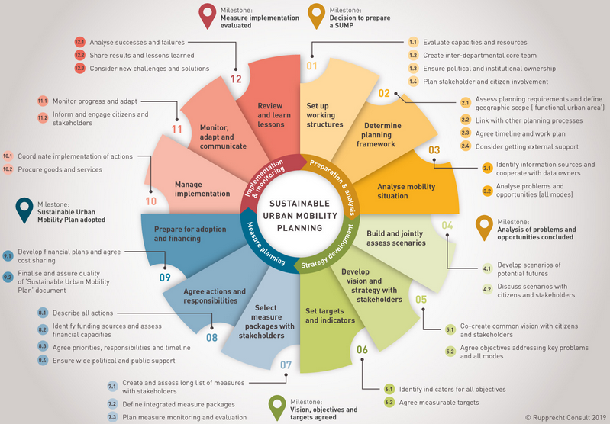
The SUMP Planning Cycle
Source: http://www.rupprecht-consult.eu/uploads/tx_rupprecht/SUMP_Guidelines_2019_mediumres.pdf

Slide 10
The SUMP Planning Cycle
A SUMP planning cycle
may actually do what the municipality wants: you set your own targets.
may be small or large, may be designed for the short or long term.
may involve few or many stakeholders.
can be adapted to the specific situation.
BUT: All SUMP concepts
must be cyclical: always think about the next round.
must clearly formulate at least one objective (quantitative).
must use at least one measure, one indicator for it.
must measure the situation BEFORE and AFTER.
must draw lessons or conclusions from this (for the next round).

Slide 11
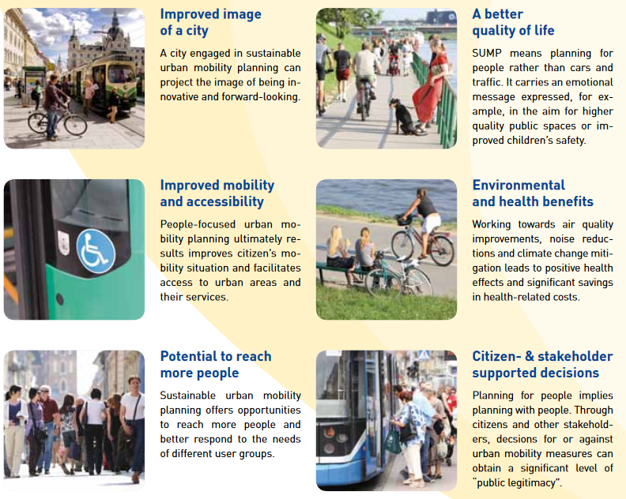
SUMP: Benefits
Source: Sustainable Urban Mobility Plans – Planning for People
Rupprecht Consult 2011 http://www.rupprecht-consult.eu/uploads/tx_rupprecht/SUMP_Brochure_final.pdf

Slide 12
SUMP in practice
Source: Sustainable Urban Mobility Plans – Planning for People
Rupprecht Consult 2011 http://www.rupprecht-consult.eu/uploads/tx_rupprecht/SUMP_Brochure_final.pdf

Slide 13
How can we go on now?
Germany
Federal Transport Infrastructure Plan
State transport plans
Municipalities are allowed to make a transport development plan
What would you suggest for your municipality? You will be allowed to take responsibility very quickly, and you will have to!
Well, first you have to see where the problems occur in which municipality.

Slide 14
SUMP: Conclusions
There are procedures you have to use (EIA, SEA, ...).
There are procedures that you can use (VEP, SUMP).
SUMP is different: you can (almost) freely determine the content and procedure.
You only need: at least one formulated objective, at least one indicator, M&E.
And you have to think in cycles: Always think about the next round.
Because that's where you can use the experience gained: that's why M&E.
This planning approach is suitable for (almost) every problem in municipalities.
The EU will eventually demand that you have this (or something similar).
Good luck!

Slide 15
2. How can a municipality proceed in order to successfully move towards "sustainable development"?
Every city is different! This was exactly the guideline for the SUMP development.
Over the years, it has been observed that in some countries and in some municipalities, great progress has been made towards sustainable development.
In other countries or municipalities, however, stagnation or regression was observed.
So the question arose as to why this is so. Research task.
The EU research network "ERA-Net" addressed these questions:
Sustainable transport development: WHAT must local authorities do?
And: HOW do they have to do it?

Slide 16
Research of the TU Dresden: Step By Step
Step By Step Stepping Stones Program
NL, SE, PL, UK, DE
IBDiM: Road and Bridge Research Institute (Poland)

Slide 17
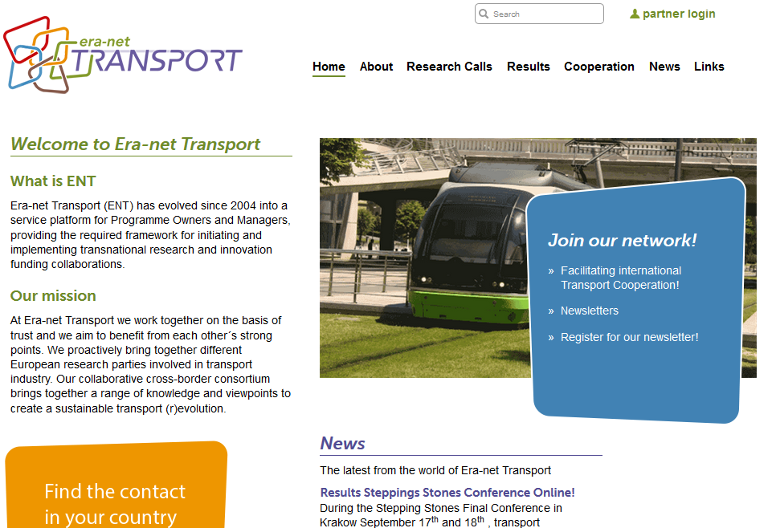
Step By Step in the ERA-NET TRANSPORT Network
Source: : http://transport-era.net/

Slide 18
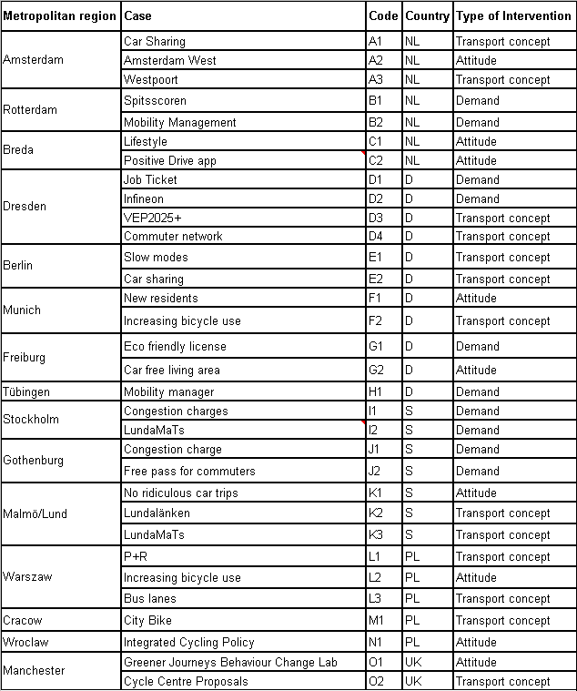
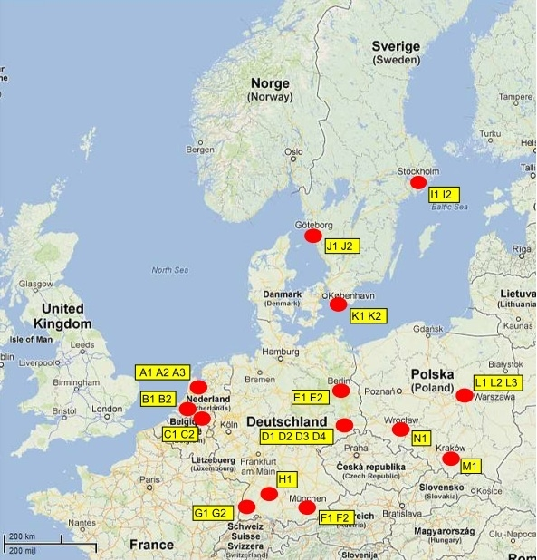
31 case studies in 15 cities

Slide 19
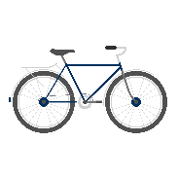
The normative background
Needs
Not possible at home: the demand
Infrastructure: the offer
Environment / World
Personal decision
FOR WHAT? Mobility satisfaction WITH WHAT? With traffic!
Needs Instruments

Slide 20
Seperate needs and instruments
Mobility: Need, cause, purpose, task
Transport: Instrument for the realisation of mobility
And what do we want now? Make a wish!
1. Ensuring needs for all: Mobility as a human right!
2. With little effort, money, noise and CO2: Little transport!
Need-based mobility with less transport

Slide 21
By the way: Sustainable transport development
Brundtland definition
Sustainable development is development,
1. that meets the needs of the present and
2. without compromising the ability of future generations to meet their own needs.
In transport:
1. Meeting the mobility needs of all people today,
2. but with fewer risks, externalizations, emissions, land, noise, injustices, acidification, CO2, ...
Need-based mobility with less transport

Slide 22
The “Step By Step” research project: How do you measure "success"?
... it depends on who you ask!
Success in what? Success can be divided into several aspects. We had five areas:
Process design
Overcoming barriers
Monitoring and Evaluation
Goals achieved?
Process continued?
Three gradations for success: 0 or 1 or 2 points

Slide 23
Our five "success factors" at Step By Step
Was the process well run? Was there:
Problem identification/ naming?
A choice of measures to solve the problem?
A clear formulation of objectives?
“Enough" communication with stakeholders and population?
Barriers:
The barriers were there, but could be overcome.
Measure was adapted, barriers partially overcome.
Only small or no barriers, measure went according to plan.
Were the effects evaluated?
All effects were evaluated according to plan and objectives.
Some effects were evaluated.
No evaluation was carried out.
Were the objectives achieved, were the effects "great"? Yes / partly / no
Will the work be continued? Yes / to a large extent / partly / no

Slide 24
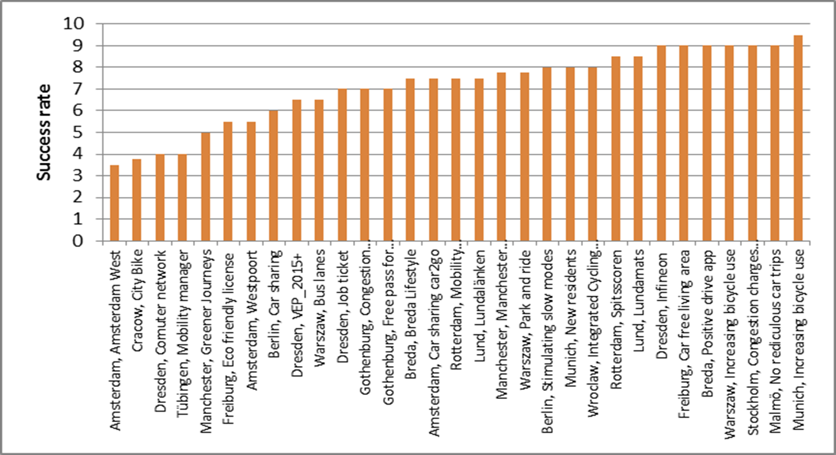
"Success" on a scale from zero to ten
Source: TU Dresden, Chair of transport ecology

Slide 25
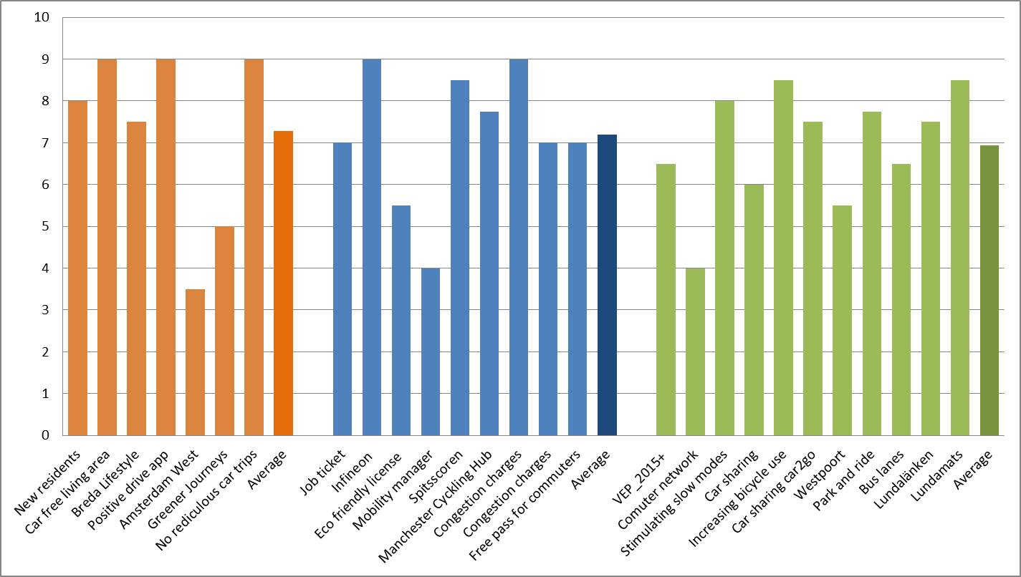
No matter what type of measure: you can be more or less successful!
Attitude
Demand
Transport concept
Source: TU Dresden, Chair of transport ecology

Slide 26
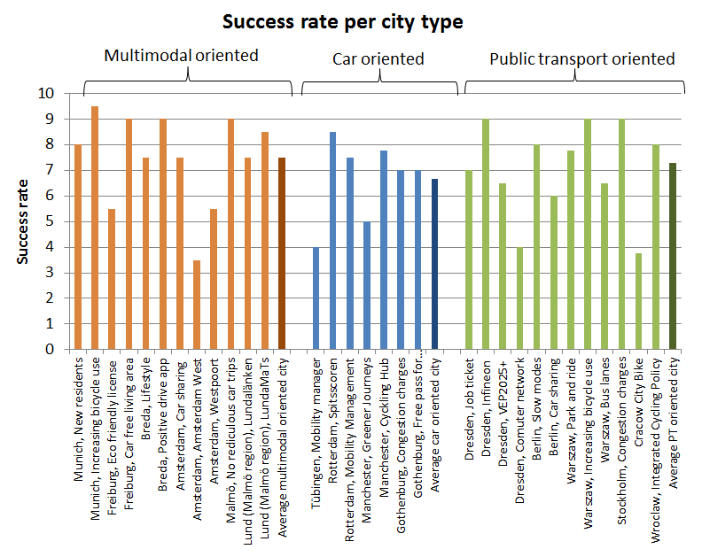
No matter what type of measure: you can be more or less successful!
Source: TU Dresden, Chair of transport ecology

Slide 27
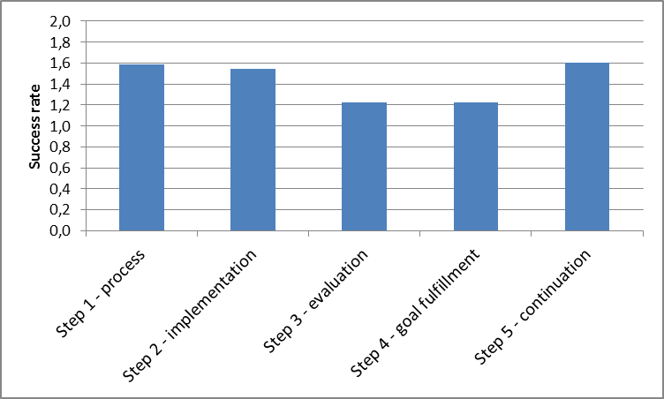
Often M&E is missing & you have more/less success
Source: TU Dresden, Chair of transport ecology

Slide 28
Outcome 1: Process orientation
You need someone who is responsible: "spider in the web“ preferably in the administration (not always).
This person has a large network of contacts with the main actors and is trusted.
A "positive" approach is often more helpful than a "negative" one: it is better to offer something or make it more attractive than to work with bans, bad conscience, price increases.
Push & pull packages are indispensable.

Slide 29
Outcome 2: Implementation
Essential: Clear analysis of problems + options for action
“Window of opportunity”:
EU or national funding programmes
Current municipal discussions
If there is no window at the moment: "model projects".
Every window is different
Exceptional situations (“mobility week") help
Municipality plays the main role
Mayor must identify with it
Will and possibilities must come together: mission and money, resolution and budget

Slide 30
Outcome 3: Monitoring & Evaluation are essential
M&E is needed to:
Be able to prove successes.
To correct failures.
M&E can:
Identify different framework conditions .
Establish a SUMP approach.
M&E measures "costs" and "environmental impact", but also "quality of life".
Land use changes always decide: include!
For M&E, define the target groups clearly at the outset.

Slide 31
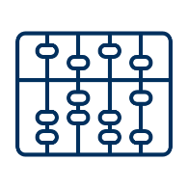
Outcome 4: Goals achieved?
Realistic goals, behavioural changes take time.
Push & pull packages are always advisable.
Each measure can be more or less successful.
Economic incentives work more.
Project size does not matter: small projects can be effective and large projects not, or vice versa .

Slide 32
Outcome 5: Continuation of the process
There is ALWAYS life after the project.
Think about the continuation already at the beginning of the project.
Continuously improve and continue the approach.
Someone must be responsible (see outcome 1).

Slide 33
Conclusion 1: WHAT is success?
Surprise: Every city is different!
"Success" on the path of sustainable development depends on the starting situation in that city at that time.
"Success" in A can mean "failure" in B.
"Success" today can mean "failure" tomorrow.
"Success" can never be defined once and for all.
If the trend is going in the wrong direction, then "delaying and blocking" is successful.
If the future direction is unclear, then pointing out a "positive vision" is successful.
If the trend is going in the right direction, then "sitting back" is bad, but "accelerating" is successful.

Slide 34
Conclusion 2: HOW to design the process?
Every city needs some convinced, networked people.
They need political support and friends (politicians, companies, press, universities, associations, NGOs ...)
They need power/responsibility and a budget.
These people know the situation best.
These people should discuss WHAT should be done in this situation.
The decision of these people is best for the city.
Don't think so long about "WHAT do I have to do?"
Think more about "HOW do I have to do it?"
Always think about the continuation of the process, the next round in the SUMP cycle.

Slide 35
SUMP (Sustainable Urban Mobility Plan) An introduction
Faculty of Transport and Traffic Sciences – Chair of Transport Ecology
Prof. Dr.-Ing. Udo Becker
Prof. Dr.-Ing. Udo Becker
2021
Grant Agreement No.:
2019-1-PL01-K1203-065244

