Slide 1
Transport ecology Introduction and tautology of transport
Faculty of Transport and Traffic Sciences – Chair of Transport Ecology
Prof. Dr.-Ing. Udo Becker
Prof. Dr.-Ing. Udo Becker
2021

Slide 2
Content and learning objectives
Content:
1.1 Introduction, objectives in transport
1.2 Tautology of transport ecology
Learning objectives:
Be able to derive the overarching objective function in transport and consequences from it.
Know the tautology of transport ecology and its factors, be able to adapt it to various questions and apply it in a goal-oriented way.

Slide 3
First of all: What do we actually want - mobility or transport?
What is the primary goal of all planning and action in transport?
Always a free ride, never traffic jams, never having to search for a parking space, never having to wait at traffic lights.
Free public transport for all.
Vision Zero: Zero accidents.
Liveable streets, high quality of life, car-free.
Premium SUVs at tax cost also for poorer population groups.
Vibrant city centres without multi-story car parks and parking spaces for cars.
….
What would you wish for yourself, your children, your grandchildren, your company?
Historically, different goals have shaped different eras.

Slide 4
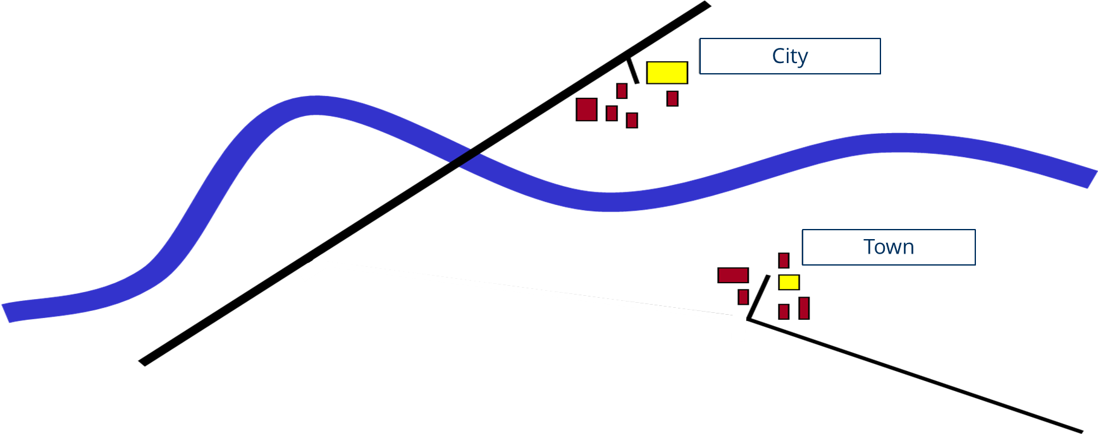
1.1 Transport objectives: 4 phases of transport planning
Brief history: Bridge on a long-distance road

Slide 5
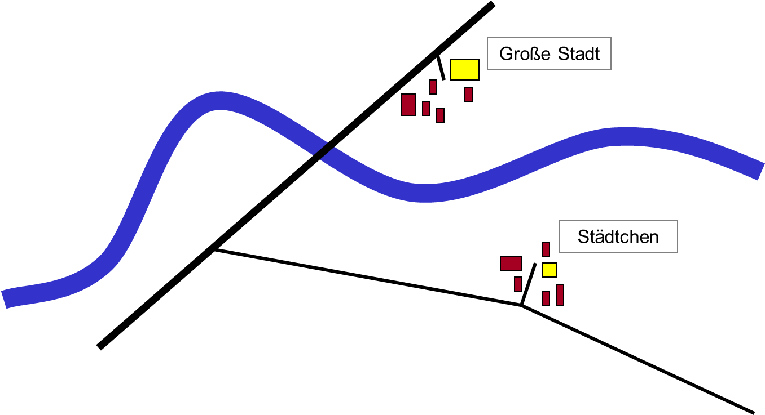
Phase 1: Main objective “build basic network”
City
Town

Slide 6
Phase 2: Main objective "meet demand”
City
Congestion
Town

Slide 7
Phase 2: Engineering data
Analysis data (vehicles per day)
City
100 000 vehicles
congestion, noise,
air pollution
Town
50 000 vehicles
50 000 vehicles
5 000 vehicles

Slide 8
Phase 2: What the planner proposes
Planning
City
Congestion
Town

Slide 9
Phase 2: ... with these values
Planning process
City
45 000 vehicles
55 000 vehicles
Town
5 000 vehicles
50 000 vehicles
5 000 vehicles

Slide 10
Phase 3: Moderating dynamic effects integratively
Survey (3 years after construction)
Market economy, spatial changes,
more traffic and longer trips
City
60 000 vehicles
congestion, noise,
air pollution
Town
10 000 vehicles
noise, air pollution

Slide 11
Phase 4: „Sustainable development“
How does "sustainable development" work? Future generations!
Mobility today - less environmental damage tomorrow
City
Bridge for cycling and walking
Town
Cost-based (long-distance) transports
Proximity, short distances, cooperation

Slide 12
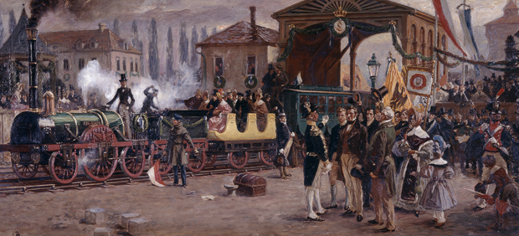
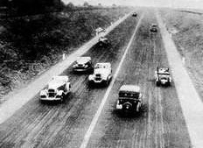
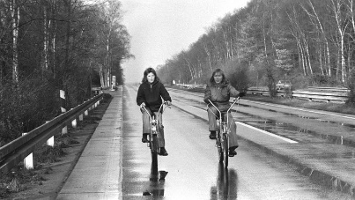
Four phases of transport planning / transport policy
1. Basic network expansion by the state
18. century → systematic construction of "bridges and roads”
19. century → expansion of railway networks (England, USA, Saxony)
2. Meeting demand with user involvement
From 1932 → motorways: ease and fluidity of traffic
From 1945 → car-friendly cities
3. Integration of the local environment
1970 → „city-friendly traffic"; traffic calming
1980 → „integrated transport" model
4. Sustainable development = for all futures
1987 → Brundtland definition
1992 → Agenda 21, UN Conference on Environment & Development in Rio
Images: Ludwigeisenbahn (DB Museum Nürnberg); BAB Köln-Bonn (aref.de); autofreier Sonntag (SpiegelOnline)

Slide 13
Back to the opening question: What do we actually want - mobility or traffic?
What is the primary goal of all planning and action in transport?
Always a free ride, never traffic jams, never having to search for a parking space, never having to wait at traffic lights.
Free public transport for all.
Vision Zero: Zero accidents.
Liveable streets, high quality of life, car-free.
Premium SUVs at tax cost also for poorer population groups.
Vibrant city centres without multi-story car parks and parking spaces for cars.
→ All these goals are understandable, but often contradictory!
What would you wish for yourself, your children, your grandchildren, your company?
Perhaps like this: Everyone should reach all destinations safely, cheaply, quickly, energy-efficiently, quietly, close by: It would be best if the destinations were all close by. We want to be mobile!

Slide 14
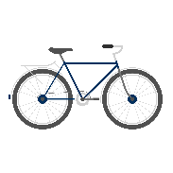
Again: The difference between need / instrument
Needs
Not possible at home: the demand
Infrastructure: the offer
Environment / World
Personal decision
FOR WHAT? Mobility satisfaction WITH WHAT? With traffic!
Needs Instruments

Slide 15
The difference: need / instrument
Mobility = For What
Measure reflecting the total number of different needs covered
Indicator for
number of needs met
number of activities
number of trips per person and day
Mobility is usually unchanged even across societies: Law of constant travel time budget
Vehicles, structures, routes and instruments are necessary
Traffic = With what
Instrument with which these needs can satisfied
Total number of all instruments for the realization of needs
Necessary to cover mobility
Measurable in different sizes regarding the effort
Goal: Ensure the possibility of meeting needs for all: Mobility
Instrument: As little traffic as possible (little effort=money, noise, ${CO}_{2}$...)

Slide 16
By the way: sustainable transport development
Brundtland definition
Sustainable development is development,
1. that meets the needs of the present and
2. without compromising the ability of future generations to meet their own needs.
In transport:
1. Meeting the mobility needs of all people today,
2. but with fewer risks, externalizations, emissions, land, noise, injustices, acidification, CO2, ...
Need-based mobility with less transport

Slide 17
Conclusion: Future-proofing is "safeguarding mobility".
In the future, the main focus must be on mobility:
Mobility is a human right: needs, today and tomorrow
Mobility is something fundamentally different from transport.
More fluid? Easier? "More traffic" complicates/prevents mobility.
How many more airports/local bypasses do we need?
How many more cycle paths do cities need, how many car-sharing stations, how many buses and trains?
How many pedestrian areas, participation, inclusion, public space, participation?
How many pedelecs/e-bikes and shared cars and village shops ensure quality of life in the flat countryside?
THIS is the overriding goal of all planning and action in the transport sector!

Slide 18
2. Evaluate measures
Acting in transport:
How does a measure work? → cannot be said clearly without considering the framework conditions
→ mainly depending on the chosen delimitations
What delimitations? → useful delimitations can only be determined after the overall objective has been identified
Only those who clearly define and disclose the goals of action can evaluate measures and expect acceptance!
And for this, the basic goals must be defined in advance (also quantitatively!)
Develop measures
Evaluate measures
Implement measures
Monitoring & Evaluation

Slide 19
Measures and their evaluation
Acting in transport = Implementing measures when goals are clear
Measures can be systematically structured and evaluated in very different ways:
according to responsibility (technical, legal, price, planning/organisational ...)
by cause (vehicle construction, parking, cold start, evaporation, driving, removal ...)
by influencing factors (vehicle technology, maintenance, driving style, traffic situation ...)
by means of transport (car, truck, diesel locomotive, bicycle, plane ...)
by mobility needs (shopping, work, cinema ...)
by settlement structure (public transport-oriented, urban, rural ...)
according to the three phases approach: avoid, relocate, improve (in that order)
according to five E: Economics, Education, Enforcement, Engineering, (Evaluation)
according to tautology of transport ecology (five factors)
according to ...

Slide 20
For environmental effects: Tautology of transport ecology
Systematically / scientifically go through all possibilities, e.g.:
Environmental impact, exhaust and noise emissions, energy consumption, CO2 ... per year
inhabitants
$$\frac{trips}{p.c. p.a.}$$
𝑡𝑟𝑖𝑝𝑠/(𝑝.𝑐. 𝑝.𝑎.)
number of trips
$$\frac{RPK}{trip}$$
𝑅𝑃𝐾/𝑡𝑟𝑖𝑝
travel distance
$$\frac{VKT}{RPK}$$
𝑉𝐾𝑇/𝑅𝑃𝐾
reciprocal occupation rate
$$\frac{spez. factor}{VKT}$$
(𝑠𝑝𝑒𝑧. 𝑓𝑎𝑐𝑡𝑜𝑟)/𝑉𝐾𝑇
techn. emission factor
VKT= vehicle kilometer travelled, RPK = revenue passenger kilometres

Slide 21
Factors of the tautology of transport ecology
Factor 1 number of people: often constant (important when population figures change)
Factor 2 number of trips per capita and year: relevant are motorised trips: dynamic effects?
Factor 3 passenger-kilometres per trip (travel distance): urban sprawl or proximity? Globalisation? Equivalent living conditions? Factor for behaviour and spatial structure
Factor 4 reciprocal of the occupancy/loading ratio: occupation levels are crucial: for mobility management, among other things
Factor 5 technical emission factors (g/km): fuel quality, exhaust gas cleaning, weight, engine management
→ Factors 2, 3, 4 mainly describe behavioural influences.
→ (Only!) factor 5 represents vehicle and engine technology.

Slide 22
Tautology of transport ecology
Systematically / scientifically go through all possibilities, e.g.:
Environmental impact, exhaust and noise emissions, energy consumption, CO2 ... per year
$\frac{trips }{p.c. p.a.}$ $\frac{RPK}{trip}$ $\frac{VKT}{RPK}$
(𝑡𝑟𝑖𝑝𝑠 )/(𝑝.𝑐. 𝑝.𝑎.) 𝑅𝑃𝐾/𝑡𝑟𝑖𝑝 𝑉𝐾𝑇/𝑅𝑃𝐾
$$\frac{spez. factor}{VKT}$$
(𝑠𝑝𝑒𝑧. 𝑓𝑎𝑐𝑡𝑜𝑟)/𝑉𝐾𝑇
Technology
inhabitants
Behaviour or spatial structure DRIVING PERFORMANCE IN
MOTORISED TRAFFIC
VKT= vehicle kilometer travelled, RPK = revenue passenger kilometres

Slide 23
Lessons learned
The dynamic effects must always be included!
Changes in technology without the corresponding changes in behaviour cannot be mapped in a meaningful way.
That is why it always depends on the environment and implementation: No two implementations are ever the same.
In practice, desired vehicles/behaviours are to be made more attractive, undesired vehicles/behaviours less attractive. So always push and pull packages, otherwise there will be rebound effects.
Ask not only: "What do we do?", but also: "How do we do it?" (process orientation).
Selecting packages of measures with attractive AND de-attractive
elements: push & pull measures → Linking with unpopular but proper measures
AND ALWAYS: MONITORING AND EVALUATION !

Slide 24
How much is the environmental impact changing?
Measure 1: Phased traffic lights
Measure package 2: improved cycle path connection + increase fuel price + phased traffic lights
Goal: Reduction of CO2 emissions
inhabitants
$$\frac{trips}{p.c. p.a.}$$
𝑡𝑟𝑖𝑝𝑠/(𝑝.𝑐. 𝑝.𝑎.)
$$\frac{RPK}{trip}$$
𝑅𝑃𝐾/𝑡𝑟𝑖𝑝
$$\frac{VKT}{RPK}$$
𝑉𝐾𝑇/𝑅𝑃𝐾
$$\frac{spez. factor}{VKT}$$
(𝑠𝑝𝑒𝑧. 𝑓𝑎𝑐𝑡𝑜𝑟)/𝑉𝐾𝑇
1,00 * 1,00 * 1,00 * 1,00 * 0,90 = 0,90
1,00 * 1,02 * 1,10 * 1,00 * 0,90 = 1,02
1,00 * 0,67 * 0,50 * 0,80 * 0,90 = 0,24
VKT= vehicle kilometer travelled, RPK = revenue passenger kilometres The values in the examples are fictitious and are used for clarification purposes

Slide 25
Conclusion: Tautology of transport ecology
The tautology of transport ecology has many applications:
Estimation of impacts of measures
Estimation of push & pull packages of measures
Useful classification of all possible influencing factors
Approach for a (rough) model, can be refined as desired
Allows forecasts, can identify counterproductive effects
You must know the tautology, but also be able to adapt it to specific problems.
You should be able to select - depending on the task and definition area - the appropriate structure and the suitable alternative options.
You should know that every problem has exactly the right demarcation.
Inappropriate delimitation → misleading result

Slide 26
Transport ecology Introduction and tautology of transport
Faculty of Transport and Traffic Sciences – Chair of Transport Ecology
Prof. Dr.-Ing. Udo Becker
Prof. Dr.-Ing. Udo Becker
2021
Grant Agreement No.:
2019-1-PL01-K1203-065244

