Slide 1
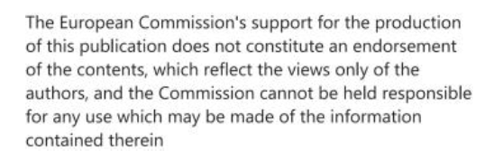
Modal split and factors influencing transport mode choice
S@mpler
Integrated Education Based On Sustainable Urban Mobility Projects

Slide 2
Topic in the sump cycle
Modal split and factors influencing transport mode choice
03 – Analyse mobility situation
05 – Develop vision and strategy with stakeholders
06 – Select targets and indicators
07 – Select measure packages with stakeholders

Slide 3
Modal split
Modal split and factors influencing transport mode choice
= relative share of different modes of transport
Share of different modes of transport in the total traffic (in %)
Useful indicator and foundation for demand models (since 1960s)
Typically quoted separately for passenger and freight transport.
Modal split changes reflect environmental and transport policy settings.

Slide 4
How is modal split identified?
Modal split and factors influencing transport mode choice
From passenger kilometres (passkm)
Lower share of non-motorized transport:
cycling/walking perform less than cars, trains or buses
From tonne kilometres (tkm)
From numbers of trips

Slide 5
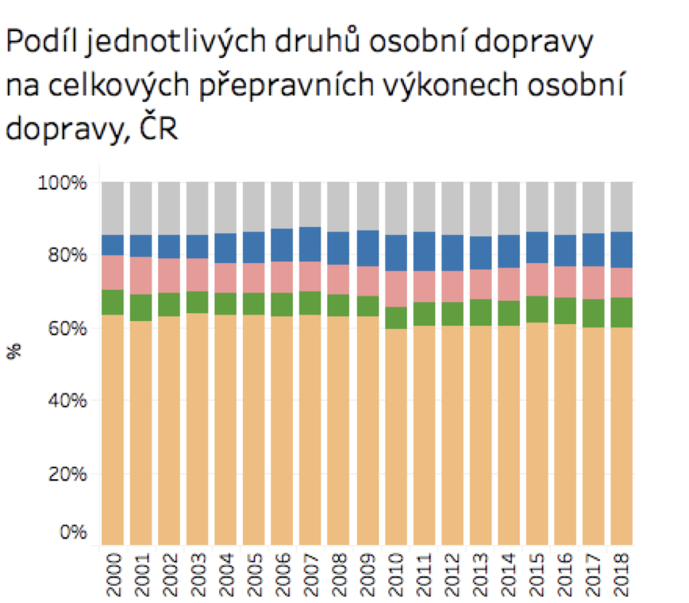
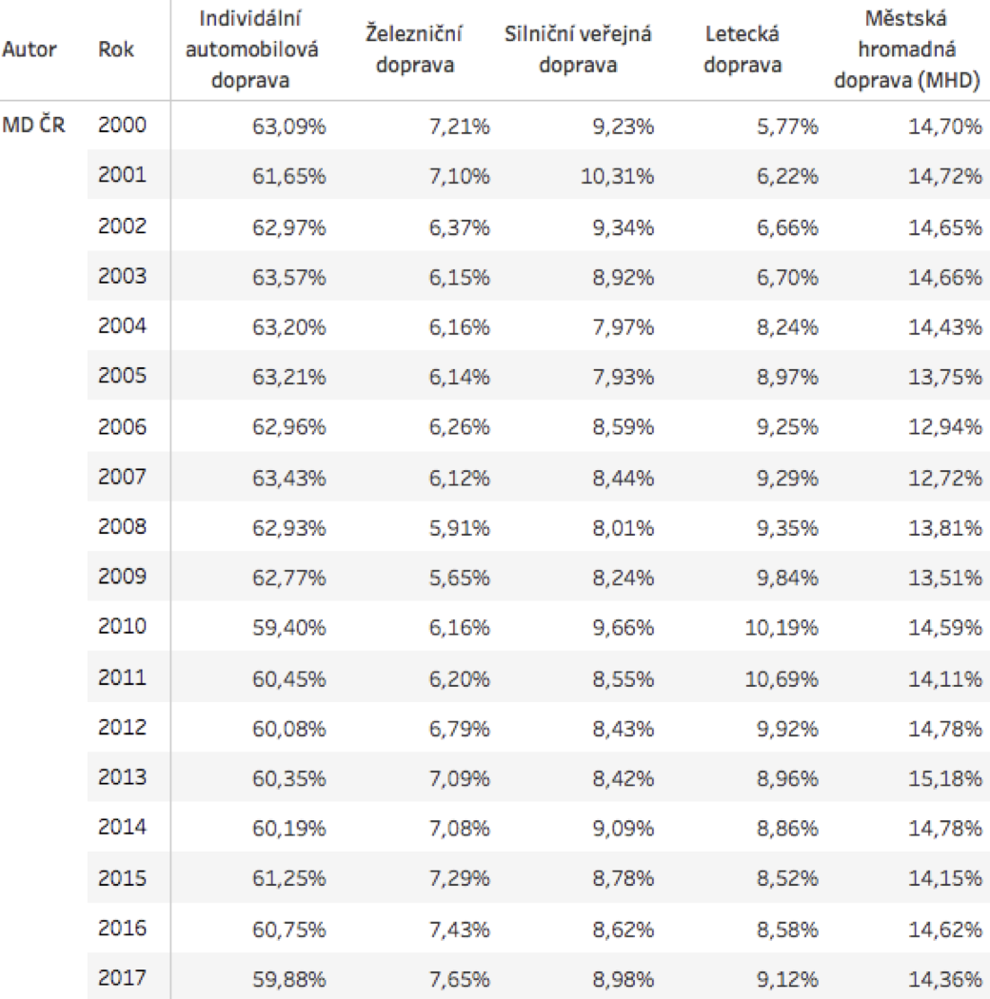
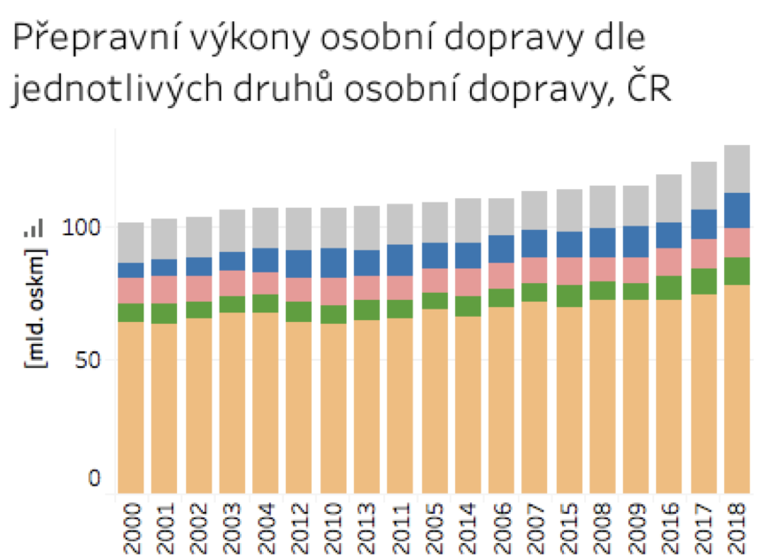
Modal split and factors influencing transport mode choice
Source: ISSaR, 2019

Slide 6
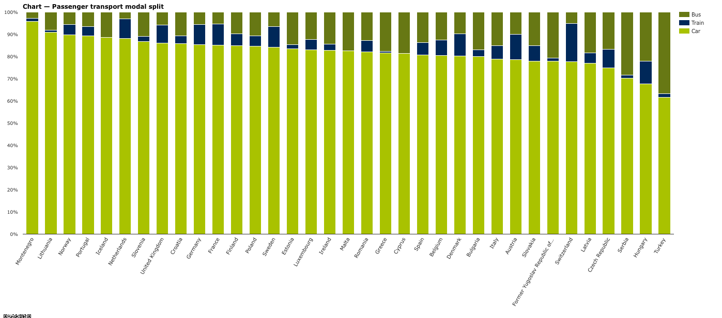
Where to find modal split data
Modal split and factors influencing transport mode choice
EPOMM (http://tems.epomm.eu/cities.php)
• created with the support of Intelligent Energy Europe in the project EPOMM-PLUS
• each city across Europe can upload their own data and control the data themselves
• cities in the EU with more than 100.000 inhabitants
Urban Audit database (https://ec.europa.eu/eurostat/web/cities/data/database)
• statistics for 258 cities across 27 European countries.
• almost 300 statistical indicators on demography, society, the economy, the environment, transport, the information society, public health, and leisure
European Environment Agency (https://www.eea.europa.eu/data-and-maps/daviz/passenger-transport-modal-split-9#eea-comments)
Annual reports or studies made for cities
Source: EEA, 2015

Slide 7
Modal split – summary
Modal split and factors influencing transport mode choice
Advantages
Simple, clear, frequently used indicator
Good for identifying trends
Used in some transport models
Drawbacks
Data comparability – careful about how modal split is calculated and from what data (existence of different data in different sources and calculation methods)

Slide 8
Factors of vehicle choice
Modal split and factors influencing transport mode choice
Capacities and attitudes of travellers
vehicle availability/ownership
driving licence ownership
household structure
sex, age, income
other factors such as the need to use a car at work, transport of other persons, etc.
population density in the area

Slide 9
Factors of vehicle choice
Modal split and factors influencing transport mode choice
Trip character
Trip purpose
Time of day
Combination of multiple trips
Other factors
Quantitative: relative travel time, relative financial costs, parking availability and costs
Qualitative: comfort, reliability and regularity, protection and safety

Slide 10
References, Sources, Bibliography
Modal split and factors influencing transport mode choice
Brůhová Foltýnová, H. (2009). Doprava a společnost : ekonomické aspekty udržitelné dopravy (1st ed. ). Karolinum.
Becker, U. J. (2008). Základy dopravní ekologie. Ústav pro ekopolitiku. http://www.digitalniknihovna.cz/mzk/uuid/uuid:1e5520d0-d739-11e3-b110-005056827e51
ISSaR: Informační systém statistiky a reportingu v životním prostředí. Praha. Retrieved 19 October 2020 from https://issar.cenia.cz

Slide 11
Thank you for your attention!
S@mpler
Integrated Education Based On Sustainable Urban Mobility Projects
Project information:
The main project objective is to enhance the quality of teaching at the involved universities in the field of sustainable urban mobility management. Our efforts consist in expanding students‘ practical skills through implementation of a practical project teaching method. An emphasis is put on the reflection of challenges which cities have to tackle in the real world, especially in the area of Sustainable Urban Mobility Plans (SUMP). The project is intended to contribute to improving students‘ knowledge and skills, particularly for the position and job placement of mobility managers.
Topic elaborated by: Lucie Vávrová
mobilita-ieep.cz
Link to the web database

Slide 12
CORRESPONDING PART FOR TEACHERS AND THEIR COMMUNICATION WITH STUDENTS

Slide 13
tasks
Modal split and factors influencing transport mode choice
Try to calculate the modal split for the whole class.
Search for modal split data in your city and compare them with other cities of Europe and the world. Can you identify any factors that can predict modal split in cities? (e.g., city size, geographic location, city transport policy, national transport policy, etc.)
How has the modal split in your selected city evolved? Make a time series as long as possible and discuss main factors of modal split in time. What is the selected city’s future modal split target?

Slide 14
Thank you for your attention!
S@mpler
Integrated Education Based On Sustainable Urban Mobility Projects
Project information:
The main project objective is to enhance the quality of teaching at the involved universities in the field of sustainable urban mobility management. Our efforts consist in expanding students‘ practical skills through implementation of a practical project teaching method. An emphasis is put on the reflection of challenges which cities have to tackle in the real world, especially in the area of Sustainable Urban Mobility Plans (SUMP). The project is intended to contribute to improving students‘ knowledge and skills, particularly for the position and job placement of mobility managers.
Topic elaborated by: Lucie Vávrová
mobilita-ieep.cz
Link to the web database

