Slide 1
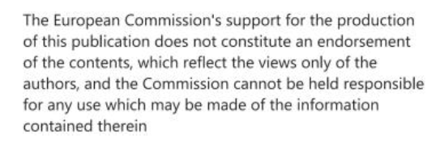
Sustainable urban mobility plans (SUMP) – Target setting
S@mpler
Integrated Education Based On Sustainable Urban Mobility Projects

Slide 2
Topic in the sump cycle
S@mpler
SUMP – Target setting
06 – Set targets and indicators

Slide 3
Prioritization and target setting
S@mpler
SUMP – Target setting
6.1 Set priorities
6.2 Set targets

Slide 4
Setting targets using the vision
S@mpler
SUMP – Target setting
Vision – a qualitative description of mobility, desirable state in the long run (horizon)
Targets – define desirable changes, measurable
Indicators – used to measure progress towards the targets

Slide 5
Targets are firmly connected with concrete measures
S@mpler
SUMP – Target setting
Targets
- define in which areas improvements should occur, what is to be “reduced, increased, maintained”, e.g., reduce traffic jams, increase share of PT, etc.
Measures (following phase 7 of the SUMP cycle)
– offer solutions for achieving the desirable state of mobility (e.g., boosting PT services)

Slide 6
Selection of priorities
S@mpler
SUMP – Target setting
Areas affected by negative impacts of transport
Those whose solution will bring the greatest positive impact and synergies with other sectors and activities
Short-term, long-term

Slide 7
S@mpler
SUMP – Target setting

Slide 8
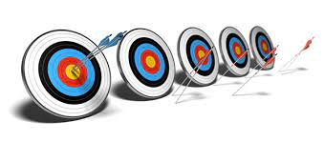
Targets have to be SMART to succeed:
S@mpler
SUMP – Target setting
Specific - qualitatively and quantitatively
Measurable - present state measured and resources for measuring change allocated
Achievable - based on the current state, at realistic costs
Realistic - suitable targets as per priorities and linked to other targets, realistic number
Time-bound - performance timetable, phases

Slide 9
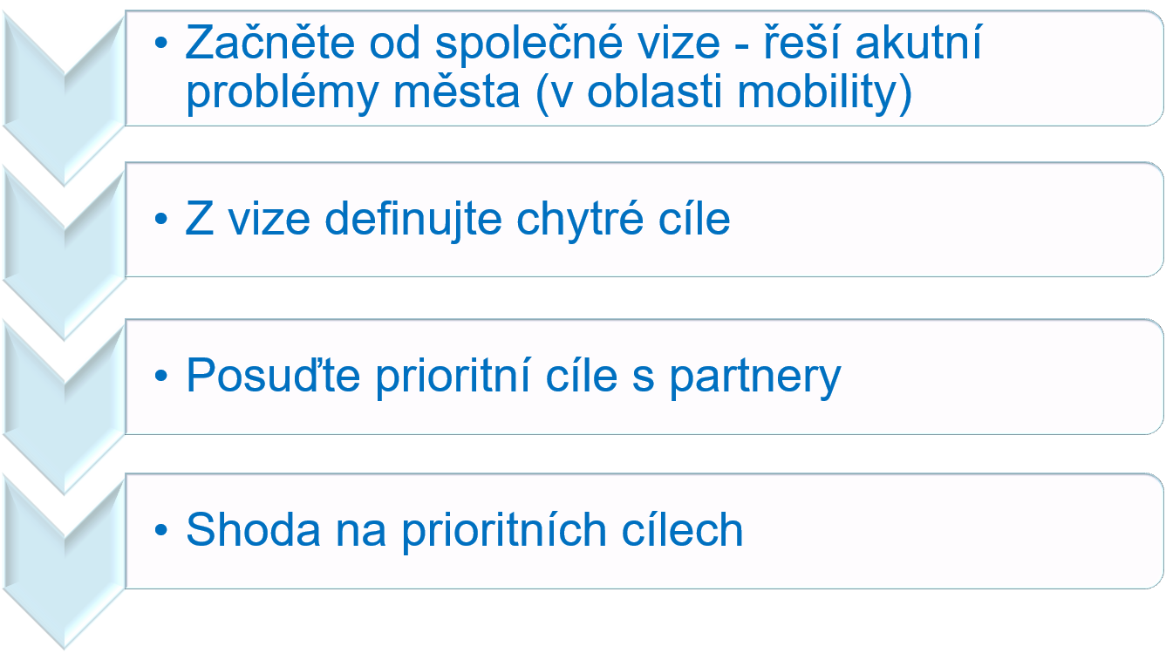
Important: Developing targets is a process:
S@mpler
SUMP – Target setting

Slide 10
Main targets of PDU (France) - 1:
S@mpler
SUMP – Target setting
Ensure coordination among all modes of transport
Significant support to energy-efficient modes of transport, alternatives to cars
Traffic safety and safety for all road users (adequate space sharing, safety observatory for cyclists and pedestrians)
Reduction of car traffic
Development of public transport and all other environmentally favourable modes of transport, notably cycling and walking

Slide 11
Main targets of PDU (France) - 2:
S@mpler
SUMP – Target setting
Optimum utilization of transport network of whole agglomeration and transport information
Parking organisation and regulation, including P+R systems and parking areas for freight vehicles
Freight road transport control and regulation and shift to railways and waterways, combined transport
Support to company mobility plans and public institutions with an emphasis on public transport and carpooling
Development of integrated fare systems for the entire mobility range, parking and support to intermodality

Slide 12
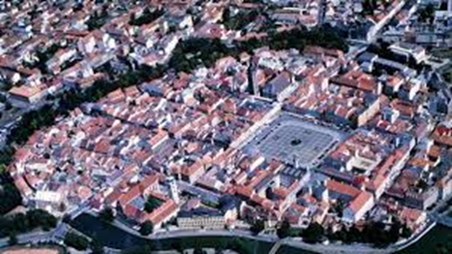
Main targets of SUMP - České Budějovice (Czechia):
S@mpler
SUMP – Target setting
Redirect through traffic outside the city, particularly the broader city centre and
residential zones;
Execute parallel routes and new road connections via territorial barriers to relieve traffic burden at critical nodes in the network;
Reduce the total growth of car traffic induced by increasing road capacity;
Include modifications to traffic regime on existing roads in favour of walking, cycling and public transport, executed simultaneously with new road building.

Slide 13
References, Sources, Bibliography
S@mpler
SUMP – Target setting
EU SUMP Guidelines - Rupprecht Consult (editor), Guidelines for Developing and Implementing a Sustainable Urban Mobility Plan (SUMP), Second Edition, 2019.

Slide 14
Thank you for your attention!
S@mpler
Integrated Education Based On Sustainable Urban Mobility Projects
Project information:
The main project objective is to enhance the quality of teaching at the involved universities in the field of sustainable urban mobility management. Our efforts consist in expanding students‘ practical skills through implementation of a practical project teaching method. An emphasis is put on the reflection of challenges which cities have to tackle in the real world, especially in the area of Sustainable Urban Mobility Plans (SUMP). The project is intended to contribute to improving students‘ knowledge and skills, particularly for the position and job placement of mobility managers.
Topic elaborated by: Radomíra Jordová
mobilita-ieep.cz
Link to the web database

Slide 15
CORRESPONDING PART FOR TEACHERS AND THEIR COMMUNICATION WITH STUDENTS

Slide 16
Questions for students
S@mpler
SUMP – Target setting
What is target setting based on?
What should the targets be like to make sense and be useful?
What is the target setting process?
What examples of SUMP targets can you quote?

Slide 17
Thank you for your attention!
S@mpler
Integrated Education Based On Sustainable Urban Mobility Projects
Project information:
The main project objective is to enhance the quality of teaching at the involved universities in the field of sustainable urban mobility management. Our efforts consist in expanding students‘ practical skills through implementation of a practical project teaching method. An emphasis is put on the reflection of challenges which cities have to tackle in the real world, especially in the area of Sustainable Urban Mobility Plans (SUMP). The project is intended to contribute to improving students‘ knowledge and skills, particularly for the position and job placement of mobility managers.
Topic elaborated by: Radomíra Jordová
mobilita-ieep.cz
Link to the web database

